Slide 1




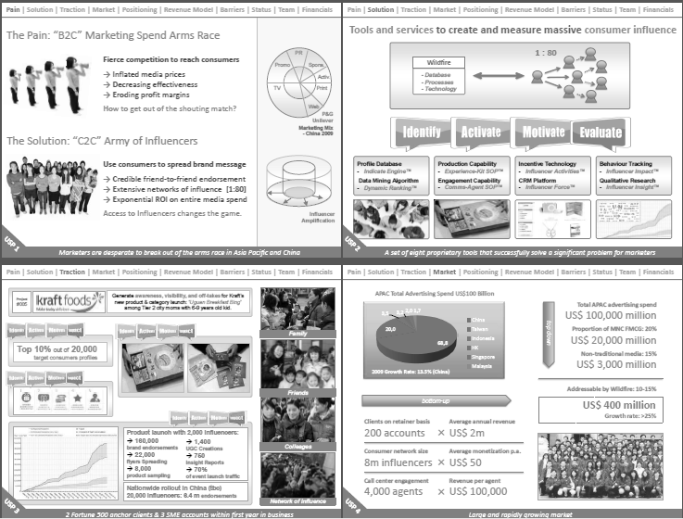
Understanding the Mini Business Plan
Every idea is partially right and partially wrong, so the bias should be to avoid overly dense hundred-plus page plans. Spend just enough time to make sure the essence of the idea is captured and it can be easily shared with others.
Select Pages of Wildfire Mini Business Plan
The Mini Business Plan should have these attributes:
Be comprehensive so it shows clarity and thoroughness of thought, but yet leverage brevity and precision
Have a blend of strategic thinking, analytics, visual descriptions
A sketch or picture of an early solution prototype
Include details on key components such as an executive summary, target consumers and their problem, the solution, business model, thumbnail financials, critical risks and proposed testing plan
The Wildfire pitch was memorable because it was compellingly organized – the core was 14 pages long, focusing on 10 unique aspects of the business.

Slide 2
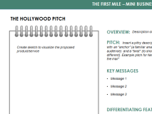
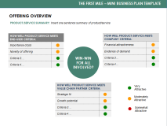
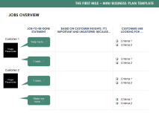
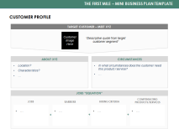
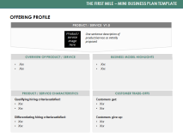
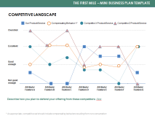
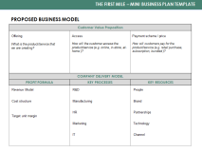
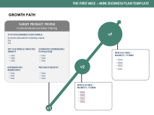
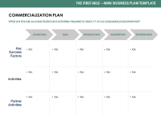
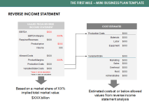
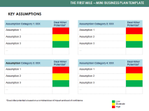
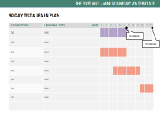
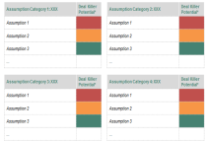
THE FIRST MILE – MINI BUSINESS PLAN TEMPLATE
KEY ELEMENTS OF A MINI BUSINESS PLAN (THE LENGTH OF EACH SECTION WILL VARY)
HOLLYWOOD PITCH | PRODUCT/SERVICE OVERVIEW | JOBS-TO-BE-DONE OVERVIEW | CUSTOMER PROFILE
Mockup and high-level description of the proposed product or service | Overview of how the proposed product or service benefits the customer, organization, and others | Summary of the important, unsatisfied customer jobs that the product or service targets | Snapshot of an individual who is representative of the target segment
OFFERING PROFILE | COMPETITIVE LANDSCAPE | PROPOSED BUSINESS MODEL | GROWTH PATH
In-depth description of the product or service for the target customer | Performance map that compares existing products and services along the dimensions that customers value | Overview of the proposed delivery model and profit formula to deliver on the value proposition | High-level view of how the business will expand from the initial foothold to capture a larger share of the market
1
2
3
4
5
6
7
8
COMMERCIALIZATION PLAN | REVERSE INCOME STATEMENT | CRITICAL ASSUMPTIONS LIST | 90 DAY TEST-AND-LEARN PLAN
List of key activities and processes necessary to reach the foothold market | Reverse income statement to identify key profit assumptions | List of the most critical assumptions that must be addressed, including deal-killers | High level test and learn plan for the next 90 days
9
10
11
12
© Copyright 2014 Innosight LLC
1

Slide 3
THE FIRST MILE – MINI BUSINESS PLAN TEMPLATE
THE HOLLYWOOD PITCH
OVERVIEW
Description of the product or service
Create a sketch to visualize the proposed product or service
PITCH
Insert a pithy description of the idea, ideally with an “anchor” (a familiar analogy to ground the audience) and a “twist” (to show how the idea is different). Example pitch for Netflix = “Blockbuster in the mail”
KEY MESSAGES
Message 1
Message 2
Message 3
DIFFERENTIATING FEATURES
Feature 1
Feature 2
Feature 3
© Copyright 2014 Innosight LLC
2

Slide 4
THE FIRST MILE – MINI BUSINESS PLAN TEMPLATE
PRODUCT/SERVICE OVERVIEW
PRODUCT/SERVICE SUMMARY: Insert one sentence summary of product or service
HOW WELL PRODUCT/SERVICE MEETS END-USER CRITERIA:
Criteria 1
Criteria 2
Criteria 3
Criteria 4
HOW WELL PRODUCT/SERVICE MEETS COMPANY CRITERIA:
Criteria 1
Criteria 2
Criteria 3
Criteria 4
WIN-WIN FOR ALL INVOLVED?
HOW WELL PRODUCT/SERVICE MEETS VALUE CHAIN PARTNER CRITERIA:
Criteria 1
Criteria 2
Criteria 3
High
Moderate
Low
© Copyright 2014 Innosight LLC
3

Slide 5

THE FIRST MILE – MINI BUSINESS PLAN TEMPLATE
JOBS-TO-BE-DONE OVERVIEW
JOB-TO-BE-DONE STATEMENT
THIS JOB-TO-BE-DONE IS IMPORTANT
AND UNSATISFIED BECAUSE…
CUSTOMERS ARE LOOKING FOR ….
Job Statement 1
Criteria 1
Criteria 2
TARGET
CUSTOMER
Job Statement 2
Image
Criteria 1
Criteria 2
Job Statement 3
Criteria 1
Criteria 2
© Copyright 2014 Innosight LLC
4

Slide 6
THE FIRST MILE – MINI BUSINESS PLAN TEMPLATE
CUSTOMER PROFILE
TARGET CUSTOMER OVERVIEW
Summary statement
Description of target customer segment
Supporting statistic 1
Supporting statistic 2
Supporting statistic 3
Set of descriptive quotes from target customer segment
MEET XX – SAMPLE QUOTES
Image
ABOUT CUSTOMER XX
CIRCUMSTANCES
Characteristic 1
Characteristic 2
Characteristic 3
In what circumstances does this customer need the product or service?
PRIORITY JOBS
What jobs are important, unsatisfied, and widely held?
© Copyright 2014 Innosight LLC
5

Slide 7
THE FIRST MILE – MINI BUSINESS PLAN TEMPLATE
OFFERING PROFILE
V1.0 PRODUCT OR SERVICE EXPERIENCE
Image
Description of the product or service as initially proposed
XXX
XXX
XXX
OVERVIEW OF PRODUCT OR SERVICE
BUSINESS MODEL HIGHLIGHTS
Image
XXX
XXX
XXX
Priority jobs fulfilled:
  XXX
  XXX
Competitive Comparison:
Compared to the best alternative, the offering is better because:
  XXX
Compared to the best alternative, the offering is worse because:
  XXX
PRODUCT OR SERVICE CHARACTERISTICS
CUSTOMER TRADE-OFFS
© Copyright 2014 Innosight LLC
6

Slide 8
THE FIRST MILE – MINI BUSINESS PLAN TEMPLATE
COMPETITIVE LANDSCAPE
Our Product/Service
Compensating Behavior 1*
Competitor X Product/Service
Competitor Z Product/Service
Overshot
Excellent
Good enough
Not good enough
Attribute/
Feature A
Attribute/ Feature B
Attribute/ Feature C
Attribute/ Feature D
Attribute/ Feature E
Attribute/ Feature F
Attribute/
Feature G
Describe how you plan to defend your offering from these competitors: XXX
* As appropriate, competitive set should include compensating behaviors resulting from non-consumption
© Copyright 2014 Innosight LLC
7

Slide 9
THE FIRST MILE – MINI BUSINESS PLAN TEMPLATE
PROPOSED BUSINESS MODEL
CUSTOMER VALUE PROPOSITION
Offering
Access
How will the customer access the product or service (e.g. online, in-store, at-home )?
Payment scheme/price
How will customers pay for the product
or service (e.g. retail purchase, subscription, bundled )?
What is the product or service that we are creating?
COMPANY DELIVERY MODEL
PROFIT FORMULA
KEY PROCESSES
KEY RESOURCES
Revenue model
Cost structure
Target unit margin
R&D
Manufacturing
HR
Marketing
IT
People
Brand
Partnerships
Technology
Channel
© Copyright 2014 Innosight LLC
8

Slide 10
THE FIRST MILE – MINI BUSINESS PLAN TEMPLATE
GROWTH PATH
TARGET PRODUCT PROFILE
Foothold Market and Initial Offering
vF
FOOTHOLD MARKET & RATIONALE:
Includes rationale for selecting market
XXX
XXX
KEY FEATURES & TARGETED BENEFIT
ESTIMATED ADDRESSABLE POPULATION
NEW FEATURES/ MARKETS/FORMS
XXX
XXX
XXX
XXX
XXX
XXX
v2
XXX
XXX
XXX
XXX
XXX
DISTRIBUTION &
MARKETING
PRICING STRATEGY
XXX
XXX
XXX
XXX
XXX
XXX
NEW FEATURES/ MARKETS/FORMS
XXX
XXX
XXX
XXX
XXX
v1
© Copyright 2014 Innosight LLC
9

Slide 11
THE FIRST MILE – MINI BUSINESS PLAN TEMPLATE
COMMERCIALIZATION PLAN
What are the key success factors and activities required to reach v1.0 of our proposed product or service?
SOURCING
R&D
MARKETING
DISTRIBUTION
PRODUCTION
Key Success Factors
XXX
XXX
XXX
XXX
XXX
XXX
XXX
XXX
XXX
XXX
Activities
XXX
XXX
XXX
XXX
XXX
Partner Activities
© Copyright 2014 Innosight LLC
10

Slide 12
THE FIRST MILE – MINI BUSINESS PLAN TEMPLATE
REVERSE INCOME STATEMENT
VALUES FROM REVERSE
INCOME STATEMENT
COST ESTIMATES
EBITDA
$XXX
Production Costs
$XXX
EBITDA Margins
XXX%
Materials
$XXX
Required Revenues
$XXX
Labor
$XXX
Product price
$XXX
Equipment
$XXX
Volume
XXX
Allowed Costs
$XXX
Variable/SG&A
$XXX
Product Margins
XXX%
Marketing
$XXX
Production Costs
$XXX
Sales
$XXX
Variable/SG&A Costs
$XXX
Overhead
$XXX
*Values in red are assumptions
*Values in black are calculations
Rent
$XXX
Administrative
$XXX
Based on a market share of XX% implied total market value:
$XXX billion
Estimated costs at or below allowed values from reverse income statement analysis
© Copyright 2014 Innosight LLC
11

Slide 13
THE FIRST MILE – MINI BUSINESS PLAN TEMPLATE
CRITICAL ASSUMPTIONS LIST
Assumption Category 1: XXX | Deal Killer Potential*
Assumption 1
Assumption 2
Assumption 3
...
Assumption Category 2: XXX | Deal Killer Potential*
Assumption 1
Assumption 2
Assumption 3
...
Assumption Category 3: XXX | Deal Killer Potential*
Assumption 1
Assumption 2
Assumption 3
...
Assumption Category 4: XXX | Deal Killer Potential*
Assumption 1
Assumption 2
Assumption 3
...
Low
*Deal-killer potential is based on a combined view of impact and level of confidence
High
Moderate
© Copyright 2014 Innosight LLC
12

Slide 14
THE FIRST MILE – MINI BUSINESS PLAN TEMPLATE
90 DAY TEST & LEARN PLAN
ASSUMPTIONS | LEARNING TESTS & COST | WEEK | 1 | 2 | 3 | 4 | 5 | 6 | 7 | 8 | 9 | 10 | 11 | 12
XXX | XXX
XXX | XXX
XXX | XXX
XXX | XXX
XXX | XXX
XXX | XXX
XXX | XXX
XXX | XXX
Key test and learn plan milestones
© Copyright 2014 Innosight LLC
13

Slide 15
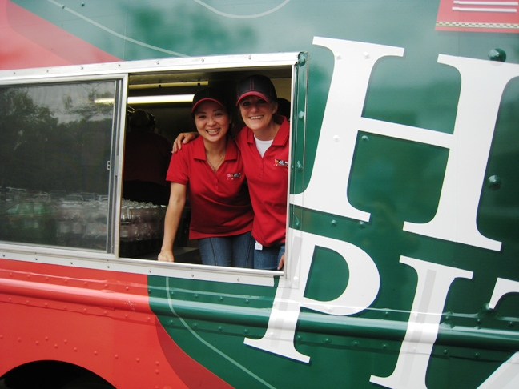
KRAFT MINI BUSINESS PLAN EXAMPLE
NOTE – SOME FACTS IN THIS EXAMPLE HAVE BEEN DISGUISED, IN THE INTEREST OF CONFIDENTIALITY

Slide 16
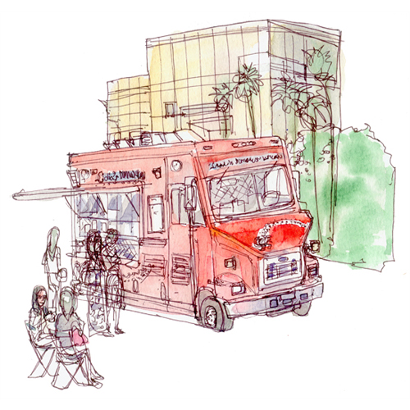
THE FIRST MILE – MINI BUSINESS PLAN TEMPLATE
THE HOLLYWOOD PITCH
OVERVIEW
40% of Millennials work for small companies – many without compelling lunch options. Buying lunch at work is becoming the new norm. They don’t want to plan ahead, but they want to get great food quickly. What if we brought great food to them with a line
of branded food service trucks? Introducing Mobile Morsels!
PITCH
Ice cream truck meets DiGiorno pizza
at your office
KEY MESSAGES
Primary Job-To-Be-Done – Make mid-day eating convenient and interesting (top quartile job)
Secondary Job-To-Be-Done – Find foods that fit my mood and my budget
DIFFERENTIATING FEATURES
Model – Multi-franchise model with different food options, locations, and meal times
Offering – Affordable, great-tasting lunch with minimal effort
© Copyright 2014 Innosight LLC
15

Slide 17
THE FIRST MILE – MINI BUSINESS PLAN TEMPLATE
SERVICE OVERVIEW
SERVICE SUMMARY: Pizza truck serving hot, fresh DiGiorno Pizza at office parks
HOW WELL THE SERVICE MEETS END-USER CRITERIA:
Importance of job
Frequency of job
Unsatisfactory alternatives
Novelty of offering
HOW WELL THE SERVICE MEETS COMPANY CRITERIA:
Financial attractiveness
Evidence of demand
Capability & asset leverage
Ease of implementation & scale
WIN-WIN FOR ALL INVOLVED?
HOW WELL THE SERVICE MEETS FRANCHISE OWNER CRITERIA:
Strategic fit
Growth potential
Ease of implementation
High
Moderate
Low
© Copyright 2014 Innosight LLC
16

Slide 18

THE FIRST MILE – MINI BUSINESS PLAN TEMPLATE
JOBS-TO-BE-DONE OVERVIEW
JOB-TO-BE-DONE STATEMENT
THIS JOB-TO-BE-DONE IS IMPORTANT
AND UNSATISFIED BECAUSE…
CUSTOMERS ARE LOOKING FOR ….
“Find foods that fit my mood and my budget”
Millennials consider “mood” and “feeling excited by what you’re eating” to be the most important way to achieve variety
Millennials are money conscious, looking for options that offer restaurant-quality foods at a good value
Inexpensive
food options
Variety of
food choices
(e.g. different
toppings and crusts)
TARGET
CUSTOMER
“Find convenient satisfying lunches despite limited options, that fit my workday schedule”
Having lunch options that are close and convenient to work is more important to Millennials than Boomers
CPK recipes, even without brand names, are Millennials’ flavor combinations
Convenient
food options
Satisfying and
fun meals
(e.g. pizza has
this ultimate combo)
“Eliminate the need to plan ahead and the work associated with weekday lunches”
Millennials are more likely to assume that lunch at work means buying lunch, than Boomers are
“Make mid-day eating more interesting
and convenient” is the 10th-highest job-opportunity gap (out of 40) for Millennials
Real-time
information
to optimize my
lunch experience
(e.g. Twitter alerts
when truck is
near office park)
© Copyright 2014 Innosight LLC
17

Slide 19
THE FIRST MILE – MINI BUSINESS PLAN TEMPLATE
CUSTOMER PROFILE
TARGET CUSTOMER OVERVIEW
There are ~18MM potential target customers in the US
Target customers are white collar employees of businesses in office parks
80% of the Millennial population is in the workforce
50% work for companies with <1,000 employees
40% rated “not having to plan ahead” and “not having to go far for lunch”
as important or very important when considering lunch options
MEET STACEY – SAMPLE QUOTES
“When I’m in the middle
of work, I’m on a tight timetable – I can’t spend the time to walk to a restaurant or cafeteria across campus.”
“At lunchtime, I just want something good and satisfying. Bringing something cold to work really doesn’t cut it.”
“When I buy lunch from a restaurant, I feel really guilty about spending the money. I feel like it really adds up and that I should be more responsible.”
ABOUT STACEY
CIRCUMSTANCES
27 years old
Lab technician on a medical campus in Indianapolis
Has busy schedule of lab work and meetings and
is often in the middle of timed experiments
Earns a decent salary but is saving for a home down payment and is quite money conscious
Doesn’t want to make lunch at home, given the effort required and the lack of refrigerator space
PRIORITY JOBS
Find foods that fit my mood and my budget
Find convenient satisfying lunches despite limited options, that fit my workday schedule
Eliminate the need to plan ahead
and the work associated with lunches
© Copyright 2014 Innosight LLC
18

Slide 20
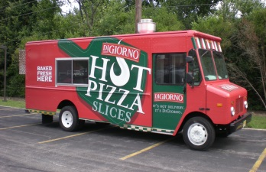
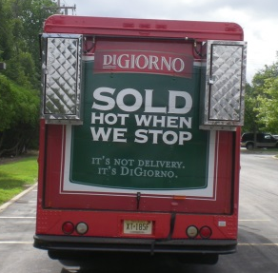
THE FIRST MILE – MINI BUSINESS PLAN TEMPLATE
OFFERING PROFILE
V1.0 SERVICE EXPERIENCE
The Mobile Morsels Experience: In the morning, the truck picks up its stock of frozen pizzas and stores them in the onboard freezer. The truck pulls up to a parking spot in an office park, and employees in the truck heat up the DiGiorno pizzas using an onboard oven. Around lunchtime, employees at the office park run out to the truck right outside their office, buy a slice of pizza, snack and drink and are back at work in only a few minutes.
Target Customer: Millennials in office parks with
limited lunch options (~18M prime prospects)
Ultimate Vision: Multi-franchise model with different food options, locations, and meal times
Trend: Supports trend of buying lunch at work
OVERVIEW OF SERVICE
BUSINESS MODEL HIGHLIGHTS
Reaching $100MM:
1.5MM trucks, 125 transactions
per day, $5 per transaction
Reason to Believe: Truck
needs to achieve X% sales
of one Domino’s franchise to be profitable
Priority jobs fulfilled:
  Provide affordable options
  Require minimal effort
  Purchase from a trusted brand (i.e. DiGiornio)
  Superior taste (i.e. DiGiornio pizza)
Competitive Comparison:
Compared to the best alternative, the offering is better because:
  More affordable, yet still tastes good
  Less effort required
Compared to the best alternative, the offering is worse because:
  Less extensive menu of lunch options
  Not a fine dining experience for lunch
SERVICE CHARACTERISTICS
CUSTOMER TRADE-OFFS
© Copyright 2014 Innosight LLC
19

Slide 21
THE FIRST MILE – MINI BUSINESS PLAN TEMPLATE
COMPETITIVE LANDSCAPE
Mobile Morsels
Delivery
Quick Restaurant
Brown Bag/Leftovers
Stockpile at Desk
Overshot
Excellent
Good enough
Not good enough
Effort/time in the morning
Effort/time at lunch
Cost
Taste
Ability to match mood
Flexibility to eat when I want
Wide selection of options
© Copyright 2014 Innosight LLC
20

Slide 22
THE FIRST MILE – MINI BUSINESS PLAN TEMPLATE
GROWTH PATH
TARGET SERVICE PROFILE
Foothold Market and Initial Offering
vF
FOOTHOLD MARKET & RATIONALE:
White-collar employees of businesses located in office parks
Busy schedule and have little time to run out for lunch
Cost-conscious
Feel it takes too much time and effort to make lunch at home, plus there may not be refrigerator space at work
Restaurants in the area are mediocre and/or the cafeteria has ‘boring’ options or is a long walk away
NEW FEATURES/MARKETS/FORMS
KEY FEATURES
ADDRESSABLE POPULATION
Full franchise model
New locations (e.g. urban centers, universities)
National launch
Fresh foods
More meals and foods
Affordable
2-4 types of pizza,
served quickly
Convenient, ‘at your door’
~18MM foothold in the US
~40% rated not having to plan ahead or go far as important or very important
v2
DISTRIBUTION/MARKETING
PRICING STRATEGY
Ads in and around offices
Free pizza opening day to encourage trial and repeat
Per meal charge
Meal plan/loyalty program
Company-owned trucks
NEW FEATURES/MARKETS/FORMS
Add CPK pizza and flatbreads
Scaled launch in 3-5 appropriate markets
Combination of owned trucks and franchise tests
v1
© Copyright 2014 Innosight LLC
21

Slide 23
THE FIRST MILE – MINI BUSINESS PLAN TEMPLATE
COMMERCIALIZATION PLAN
What are the key success factors and activities required to reach v1.0 of our proposed service?
SOURCING
R&D
MARKETING
DISTRIBUTION
PRODUCTION
Key Success Factors
Acquire and service trucks, including truck kitchen, for reasonable price
Align on right set of menu options to appeal to customers
Consumers will try and repeat
to reach adequate number of transactions
Market via direct messaging to employers –
and ultimately via social media
Leverage existing
supply chain to the best of our ability
Contact appropriate truck supplier
Gather set of estimates and weigh tradeoffs
Conduct market research
to identify customer preferences
Execute in-field testing and market research
on lunch behavior
Conduct
multiple leg
test to identify activities and level of spending required
Hold internal meetings and conduct research with internal stakeholders
Activities
Not applicable
Partner Activities
Provide estimates and information regarding plan and investment required
© Copyright 2014 Innosight LLC
22

Slide 24
THE FIRST MILE – MINI BUSINESS PLAN TEMPLATE
REVERSE INCOME STATEMENT
CONSUMER ESTIMATES TO HIT $100MM
BUSINESS MODEL ESTIMATES TO HIT $100MM
$20,000
franchise fee
5.5% of 18MM prime prospects in US
$2,000 fee/truck/year
2,500 office parks
$3MM
franchise fees
10 year
renewable contract
1MM
Staceys
1,500 trucks
400 Staceys per park
7% of the number of US Subway stores
$100MM
Revenue
$86MM
revenue from food sales to franchisees
1,500 trucks
$5.00 revenue/ transaction
0.4 trans-actions/week
$57,500
revenue/truck from food sales to franchisees
$2 paid to Kraft/transaction
20 trans-actions/year
125 transactions/day
50 weeks/ year
230 days/year
1,500 trucks
5% of revenue
$5.00
revenue/ transaction
$11MM royalty
$143,750 revenue/truck
125
transactions/ day
Assumptions in Red Calculations in Black
28,750
transactions/ year
Key variables solved for in order to reach $100M revenue
230 days/year
© Copyright 2014 Innosight LLC
23

Slide 25
THE FIRST MILE – MINI BUSINESS PLAN TEMPLATE
CRITICAL ASSUMPTIONS LIST
Consumer | Deal Killer Potential*
Menu options are appealing to consumers
Location | Deal Killer Potential*
Sufficient desirable sites can be found with no legal hurdles to parking
Supply Chain | Deal Killer Potential*
Able to leverage existing supply chain
Financial | Deal Killer Potential*
Consumers will try and repeat to reach adequate number of transactions
Total costs to run truck allow it to remain profitable
Franchise | Deal Killer Potential*
Can cost-effectively develop capability to manage franchisees
Can find sufficient number of franchisees
Marketing | Deal Killer Potential*
Marketing required to drive awareness, trial, and repeat is not cost prohibitive
Truck | Deal Killer Potential*
Able to acquire and service trucks, including kitchen, for reasonable price
Legal | Deal Killer Potential*
Able to obtain needed health code and business permits
Low
*Deal-killer potential is based on a combined view of impact and level of confidence
High
Moderate
© Copyright 2014 Innosight LLC
24

Slide 26
THE FIRST MILE – MINI BUSINESS PLAN TEMPLATE
90 DAY TEST & LEARN PLAN
KILLER ASSUMPTIONS | LEARNING TESTS | WEEK | 1 | 2 | 3 | 4 | 5 | 6 | 7 | 8 | 9 | 10 | 11 | 12
Compelling menu/ concept | Conduct primary market research with consumers
Sufficient appropriate locations can be found | Explore office parks and understand legal guidelines
Supply chain issues are manageable | Conduct internal discussions with supply chain and pizza division
Trial, repeat, and daily transactions can be achieved | Purchase a truck and run a trial
Key test and learn plan milestones
© Copyright 2014 Innosight LLC
25

