Slide 1
GCSE: Box Plots and Cumulative Frequency
Skipton Girls’ High School

Slide 2
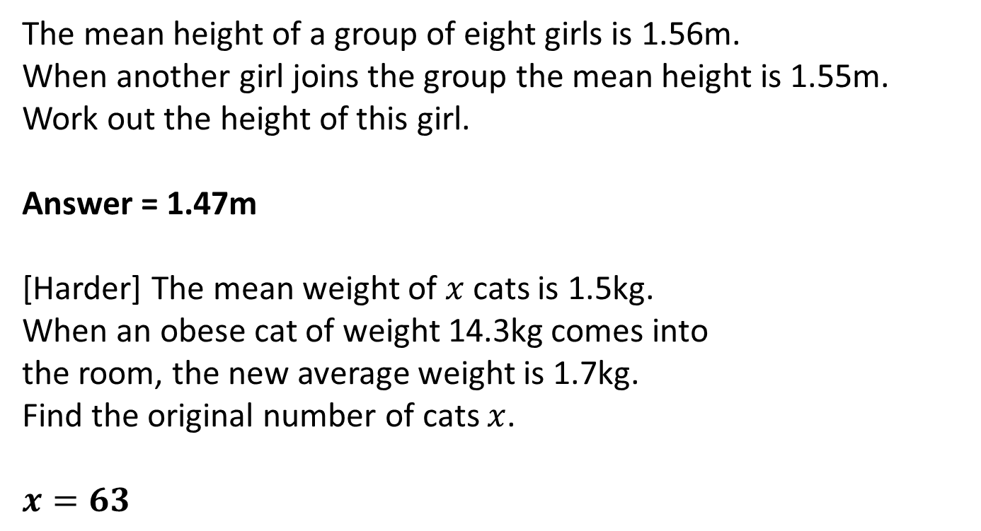
Starter: Problems involving mean
The mean height of a group of eight girls is 1.56m.
When another girl joins the group the mean height is 1.55m.
Work out the height of this girl.
Answer = 1.47m
[Harder] The mean weight of $x$ cats is 1.5kg.
When an obese cat of weight 14.3kg comes into
the room, the new average weight is 1.7kg.
Find the original number of cats $x$.
$$x=63$$
?
Girl
?

Slide 3
The Whole Picture...
Frequency Polygon
Histogram
Grouped Frequency Table
Cumulative Frequency Table
Widths (cm):
4, 4, 7, 9, 11, 12, 14, 15, 15, 18, 28, 42
Width (cm) | Frequency
0 < w < 10 | 4
10 < w < 25 | 6
25 < w < 60 | 2
Width (cm) | Cum Freq
0 < w < 10 | 4
0 < w < 25 | 10
0 < w < 60 | 12
Determine Median/LQ/UQ
Median/LQ/UQ class interval
Cumulative Frequency Graph
Estimate of Median/LQ/UQ/num values in range
Box Plots

Slide 4
Median/Quartile Recap
Here are the ages of 10 people at Pablo’s party. Choose the correct value.
12, 13, 14, 14, 15, 16, 16, 17, 19, 24
✗
15
✓
15.5
✗
16
Median:
✗
13
✗
13.5
✓
14
LQ:
✓
17
✗
18
✗
19
UQ:
Interquartile
Range:
?
?
3
12
Range:

Slide 5
Quickfire Quartiles
LQ
Median
UQ
1, 2, 3
?
?
?
1
2
3
?
?
?
1, 2, 3, 4
1.5
2.5
3.5
?
?
?
1, 2, 3, 4, 5
1.5
3
4.5
?
?
?
1, 2, 3, 4, 5, 6
2
3.5
5
Rule for lower quartile:
Even num of items: find median of bottom half.
Odd num of items: throw away middle item, find medium of remaining half.

Slide 6



What if there’s lots of items?
There are 31 items, in order of value. What items should we use for the median and lower/upper quartiles?
0 1 1 2 4 5 5 6 7 8 10 10 14 14 14 14 15 16 17 29 31 31 37 37 38 39 40 40 41 43 44
?
LQ
Use the 8 ^{th} item
Use $\frac{1}{4}{\left(n+1\right)}^{th}$ item
Median
?
Use $\frac{1}{2}{\left(n+1\right)}^{th}$ item
Use the 16th item
UQ
?
Use $\frac{3}{4}{\left(n+1\right)}^{th}$ item
Use the 24th item

Slide 7
What if there’s lots of items?
Num items
LQ
Median
UQ
15
?
?
?
4th
8th
12th
?
?
?
23
6th
12th
18th
?
?
?
39
10th
20th
30th
?
?
?
47
12th
24th
36th
Notes:
Emphasise that GCSE exams always seem to use a number of items 1 less than a multiple of 4.

Slide 8
Box Plots
Box Plots allow us to visually represent the distribution of the data.
Minimum | LQ | Median | UP | Maximum
3 | 15 | 17 | 22 | 27
Sketch
Sketch
Sketch
Sketch
Sketch
range
IQR
0 5 10 15 20 25 30
How is the IQR represented in this diagram?
Sketch
How is the range represented in this diagram?
Sketch

Slide 9

Box Plots
Sketch a box plot to represent the given weights of cats:
5lb, 6lb, 7.5lb, 8lb, 8lb, 9lb, 12lb, 14lb, 20lb
Minimum | Maximum | Median | Lower Quartile | Upper Quartile
5 | 20 | 8 | 6.75 | 13
?
?
?
?
?
0 4 8 12 16 20 24
Sketch

Slide 10
Worksheet
Printed handout. Q1
Reference: GCSE-BoxPlotsQuartileStemLeaf

Slide 11
Box Plots
If you only had the diagram, how could we interpret the distribution of data?
What we observe
What we can deduce
The second box is wider than the first.
?
There is a greater spread of weights in the top half. This is known as positive skew.
The length of the second ‘whisker’ (pun intended) is quite long.
?
The fattest cat has a weight that is an extreme value, because the weight is far above the Upper Quartile.
0 4 8 12 16 20 24

Slide 12
Comparing Box Plots
Box Plot comparing house prices of Croydon and Kingston-upon-Thames.
Croydon
Kingston
£100k £150k £200k £250k £300k £350k £400k £450k
“Compare the prices of houses in Croydon with those in Kingston”. (2 marks)
For 1 mark, one of:
In interquartile range of house prices in Kingston is greater than Croydon.
The range of house prices in Kingston is greater than Croydon.
For 1 mark:
The median house price in Kingston was greater than that in Croydon.
(Note that in old mark schemes, comparing the minimum/maximum/quartiles would have been acceptable, but currently, you MUST compare the median)
?
?

Slide 13
Worksheet
Printed handout. Q7
Reference: GCSE-BoxPlotsQuartileStemLeaf

Slide 14
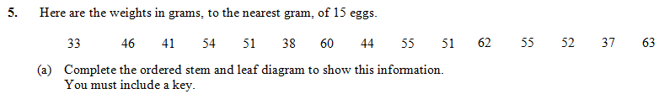
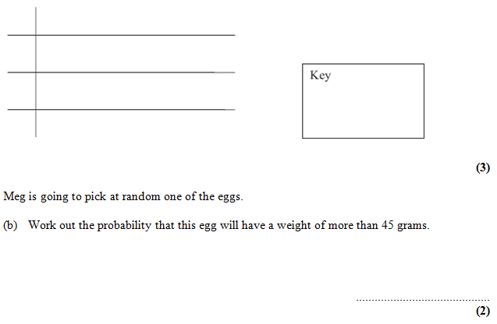

Stem and Leaf
Median/
Quartiles?
3
3 7 8
?
?
4
?
1 4 6
5
1 1 2 4 5 5
?
?
1|3 means 13
6
0 2 3
?
?
$$\frac{2}{3}$$

Slide 15
Worksheet
Printed handout. Q3
Reference: GCSE-BoxPlotsQuartileStemLeaf

Slide 16
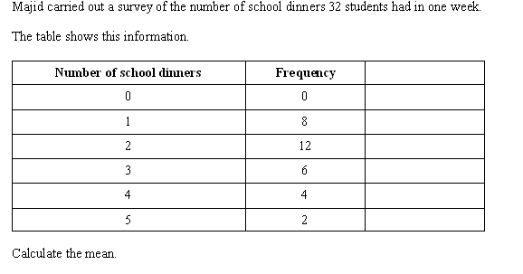


Recap: Frequency Tables
(x)
(f)
?
?
Total of values
Num values
$$\frac{\sum{fx}}{\sum{f}}$$
How would we usually calculate the mean from a list of items?
Mean of a list =
=
?
?
?
Mode $=2$

Slide 17

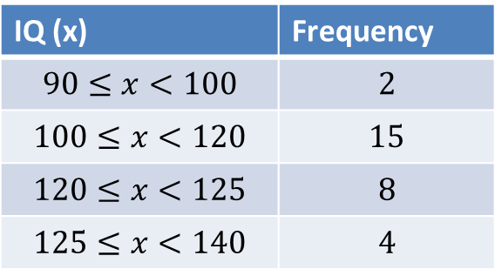
Frequency Polygons
With a bar chart, we’d plot each value with its frequency.
But we’ve now grouped the data. We all each IQ range a class interval.
What could we use as a representative value for each class interval?
IQ (x) | Frequency
$$90≤x<100$$ | $$2$$
$$100≤x<120$$ | $$15$$
$$120≤x<125$$ | $$8$$
$$125≤x<140$$ | $$4$$
16
14
12
10
8
6
4
2
Modal class interval: $100≤x<120$
?
90 100 110 120 130 140

Slide 18
Worksheet
Frequency Polygons
Printed handout. Q1, 2

Slide 19
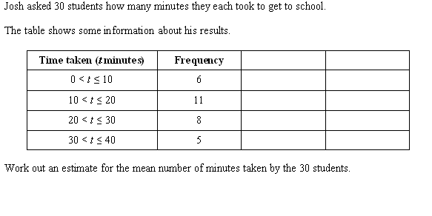
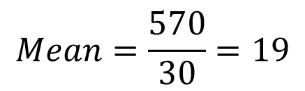
Recap: Grouped Frequency Tables
$$Mean=\frac{570}{30}=19$$
?
Question: Why is our mean going to be an estimate?
?
Because we don’t know the exact times within each range.

Slide 20
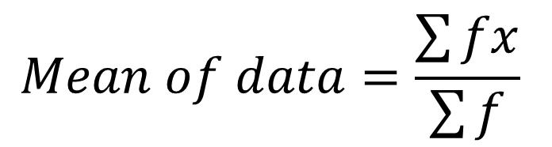
Write Down
The Greek letter “capital sigma”, means “sum of”.
frequencies
midpoint of range
$$Mean of data=\frac{\sum{fx}}{\sum{f}}$$

Slide 21
Worksheet
Grouped Frequency Tables
Printed handout. Q1, 2
Reference: GCSE-GroupedDataCumFreq

Slide 22
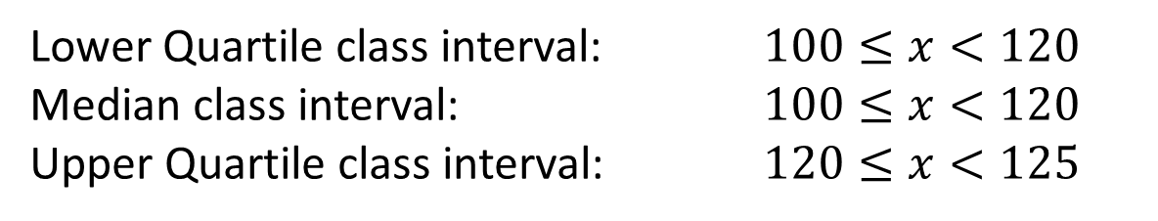

Median from Grouped Frequency Tables
IQ (x) | Frequency
$$90≤x<100$$ | $$5$$
$$100≤x<120$$ | $$15$$
$$120≤x<125$$ | $$8$$
$$125≤x<140$$ | $$3$$
?
Lower Quartile class interval: $100≤x<120$
Median class interval: $100≤x<120$
Upper Quartile class interval: $120≤x<125$
?
?
We will see soon that we can actually estimate a value (rather than just give a range) for the median, using something called a cumulative frequency graph.

Slide 23
The Whole Picture...
Frequency Polygon
Histogram
✓
Grouped Frequency Table
Cumulative Frequency Table
Widths (cm):
4, 4, 7, 9, 11, 12, 14, 15, 15, 18, 28, 42
Width (cm) | Frequency
0 < w < 10 | 4
10 < w < 25 | 6
25 < w < 60 | 2
Width (cm) | Cum Freq
0 < w < 10 | 4
0 < w < 25 | 10
0 < w < 60 | 12
Determine Median/LQ/UQ
✓
Median/LQ/UQ class interval
✓
Cumulative Frequency Graph
Estimate of Median/LQ/UQ/num values in range
✓
Box Plots

Slide 24
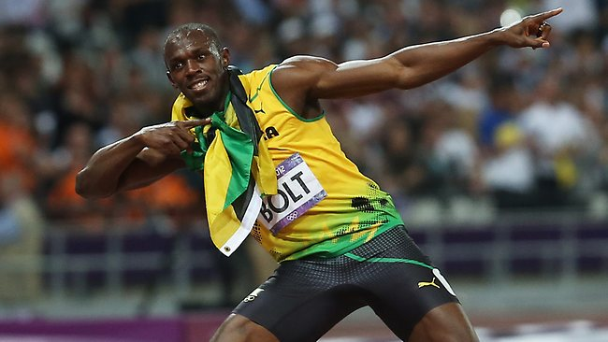
100m times at the 2012 London Olympics
Modal class interval
10.05 < t ≤ 10.2
?
?
Median class interval
10.05 < t ≤ 10.2
?
Estimate of mean
10.02
?
Time (s) | Frequency | Cumulative Freq
9.6 < t ≤ 9.7 | 1 | 1
9.7 < t ≤ 9.9 | 4 | 5
9.9 < t ≤ 10.05 | 10 | 15
10.05 < t ≤ 10.2 | 17 | 32
TOTAL
?
?
?
?

Slide 25
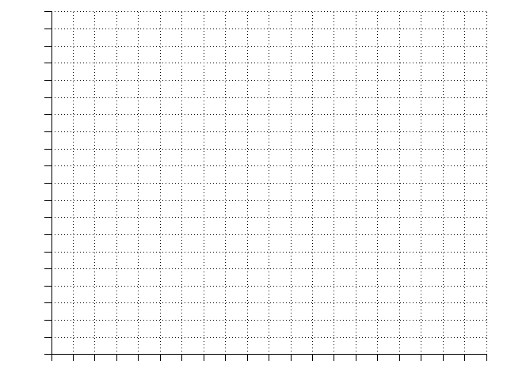
Time (s) | Frequency | Cum Freq
9.6 < t ≤ 9.7 | 1 | 1
9.7 < t ≤ 9.9 | 4 | 5
9.9 < t ≤ 10.05 | 10 | 15
10.05 < t ≤ 10.2 | 17 | 32
Cumulative Frequency Graphs
Plot
This graph tells us how many people had “this value or less”.
Plot
Plot
32
28
24
20
16
12
8
4
0
Plot
Median = 10.07s
?
Lower Quartile
= 9.95s
Cumulative Frequency
?
Upper Quartile
= 10.13s
?
Interquartile Range
= 0.18s
?
9.5 9.6 9.7 9.8 9.9 10.0 10.1 10.2 10.3
Time (s)

Slide 26
A Cumulative Frequency Graph is very useful for finding the number of values greater/smaller than some value, or within a range.
Cumulative Frequency Graphs
Estimate how many runners had a time less than 10.15s.
26 runners
Estimate how many runners had a time more than 9.95
32 – 8 = 24 runners
Estimate how many runners had a time between 9.8s and 10s
11 – 3 = 8 runners
32
28
24
20
16
12
8
4
0
?
Cumulative Frequency
?
?
9.5 9.6 9.7 9.8 9.9 10.0 10.1 10.2 10.3
Time (s)

Slide 27
Time (s) | Frequency | Cumulative Freq
9.6 < t ≤ 9.7 | 1 | 1
9.7 < t ≤ 9.9 | 4 | 5
9.9 < t ≤ 10.05 | 17 | 22
10.05 < t ≤ 10.2 | 10 | 32
Plot
Plot
Sketch Line
Plot
Plot
Cumulative Frequency Graph
Frequency Polygon
32
28
24
20
16
12
8
4
0
18
16
14
12
10
8
4
2
0
Cumulative Frequency
Frequency
9.5 9.6 9.7 9.8 9.9 10.0 10.1 10.2 10.3
9.5 9.6 9.7 9.8 9.9 10.0 10.1 10.2
Time (s)
Time (s)

Slide 28
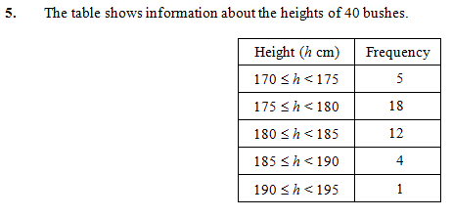
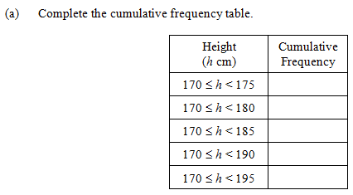
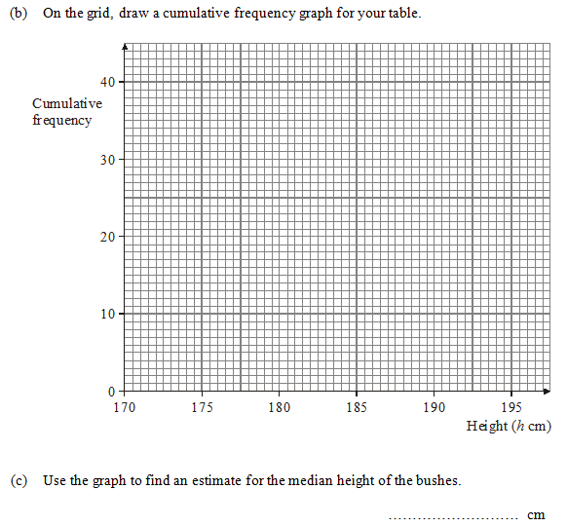
5
23
35
39
40
?
?
?
?
?
?
179
?

Slide 29
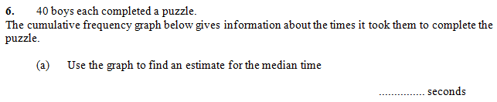
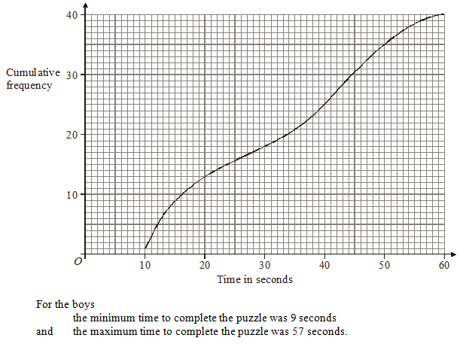
34
?
Lower Quartile = 16
Upper Quartile = 44.5
?
?

Slide 30
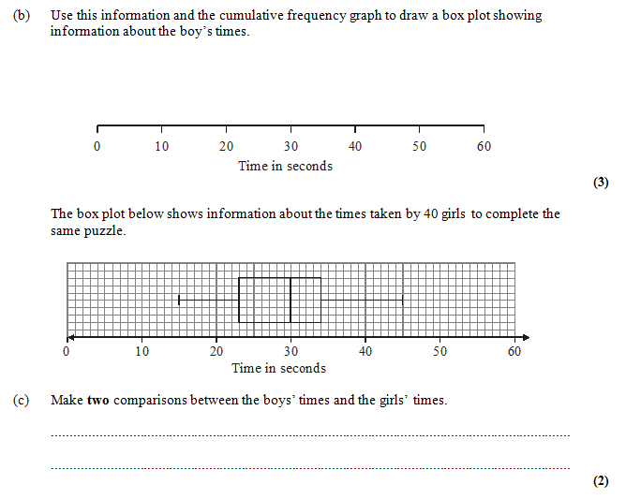
We previously found:
Minimum = 9, Maximum = 57, LQ = 16, Median = 34, UQ = 44.5
?
1 mark: Range/interquartile range of boys’ times is greater.
1 mark: Median of boys’ times is greater.
?

Slide 31
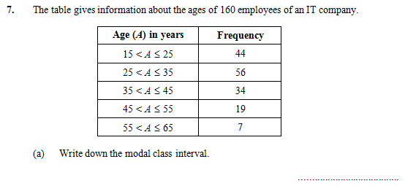
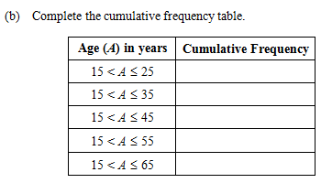
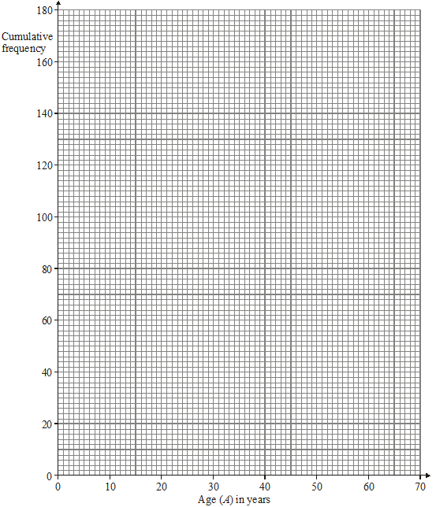
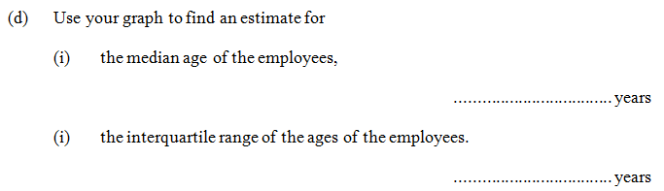


?
44
100
134
153
160
?
$$25<A≤35$$
?
?
30
$$40.9−24.1=16.8$$
?

Slide 32
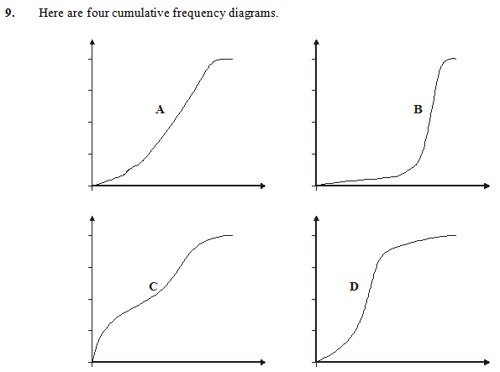
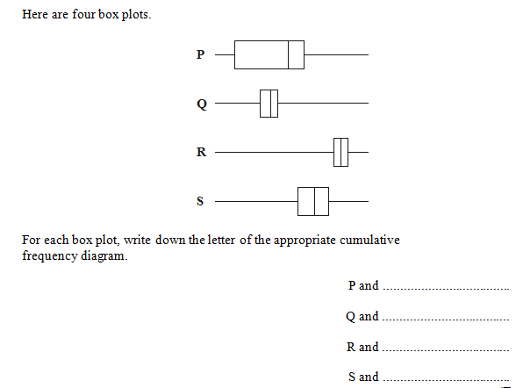
C
?
D
?
B
?
A
?

Slide 33

Summary
You use a time machine (you made in DT) to travel forward time to when you’re doing your GCSE, in order to give yourself 2 things not to forget when drawing a cumulative frequency diagram. What do you tell yourself?
Plot the point with 0 cumulative frequency at the START of your first range, not necessarily at the start of the x-axis.
?
Use the END of each range when plotting points, so that your cumulative frequency includes all the people in the range.
?

Slide 34
The Whole Picture...
Frequency Polygon
Histogram
✓
Grouped Frequency Table
Cumulative Frequency Table
Widths (cm):
4, 4, 7, 9, 11, 12, 14, 15, 15, 18, 28, 42
Width (cm) | Frequency
0 < w < 10 | 4
10 < w < 25 | 6
25 < w < 60 | 2
Width (cm) | Cum Freq
0 < w < 10 | 4
0 < w < 25 | 10
0 < w < 60 | 12
Determine Median/LQ/UQ
✓
✓
Median/LQ/UQ class interval
✓
Cumulative Frequency Graph
Estimate of Median/LQ/UQ/num values in range
✓
Box Plots

Slide 35
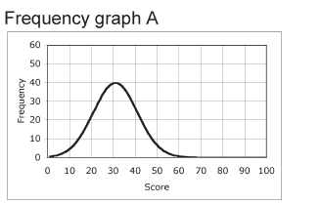
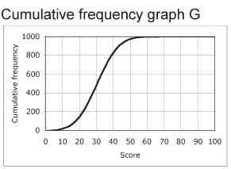
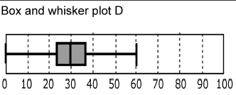

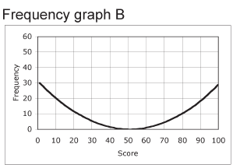
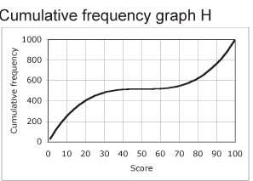

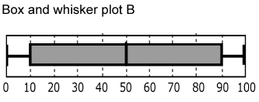
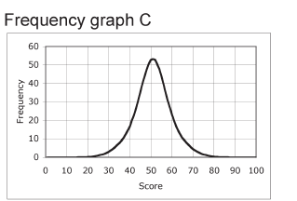
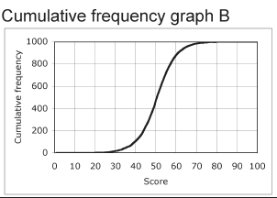
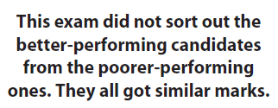
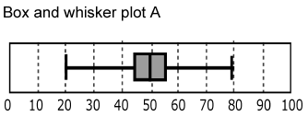
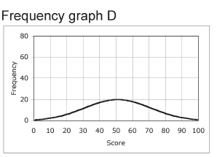
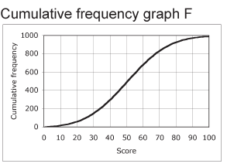
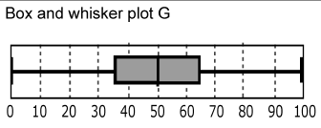
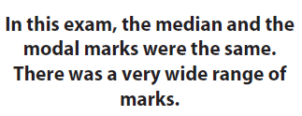
?
Description
?
Cumulative Frequency Graph
?
Box Plot
?
Description
?
Cumulative Frequency Graph
?
Box Plot
?
Description
?
Cumulative Frequency Graph
?
Box Plot
?
Description
?
Cumulative Frequency Graph
?
Box Plot
CARD SORT SOLUTIONS

Slide 36
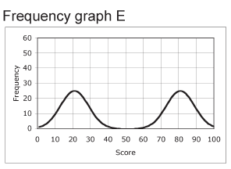
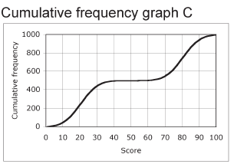
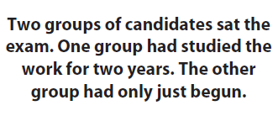
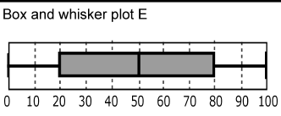
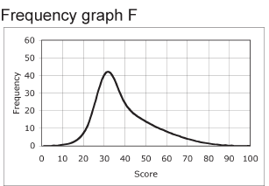
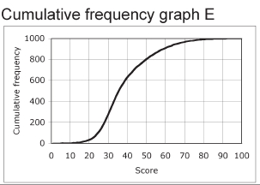

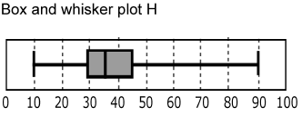
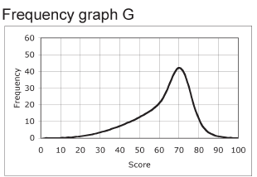
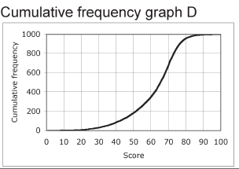

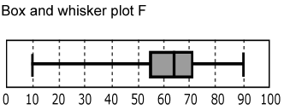
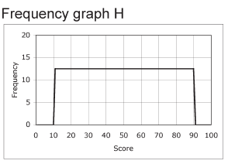
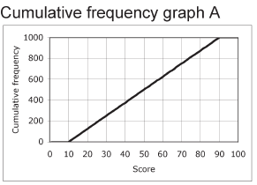


?
Description
?
Cumulative Frequency Graph
?
Box Plot
?
Description
?
Cumulative Frequency Graph
?
Box Plot
?
Description
?
Cumulative Frequency Graph
?
Box Plot
?
Description
?
Cumulative Frequency Graph
?
Box Plot

