Slide 1
GCSE: Non-Right Angled Triangles
Skipton Girls’ High School

Slide 2
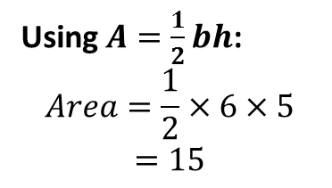
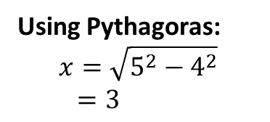
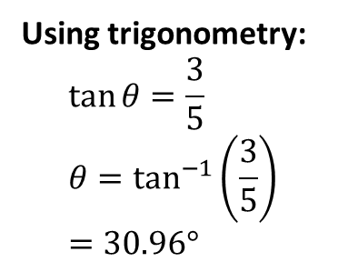
RECAP: Right-Angled Triangles
We’ve previously been able to deal with right-angled triangles, to find the area, or missing sides and angles.
5
4
6
3
Area = 15
?
30.96°
?
3
5
5
?
Using Pythagoras:
$$x=\sqrt{5^{2}−4^{2}} \\ =3$$
Using $A=\frac{1}{2}bh$:
$$Area=\frac{1}{2}×6×5 \\ =15$$
Using trigonometry:
$$\tan{θ}=\frac{3}{5} \\ θ=\tan^{−1}\left(\frac{3}{5}\right)=30.96°$$

Slide 3





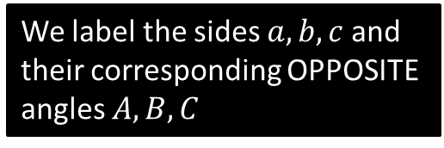




Labelling Sides of Non-Right Angle Triangles
Right-Angled Triangles:
Non-Right-Angled Triangles:
$$a$$
$$h$$
$$C$$
?
$$o$$
$$b$$
?
$$B$$
?
$$A$$
$$a$$
$$c$$
We label the sides $a, b, c$ and their corresponding OPPOSITE angles $A, B, C$

Slide 4
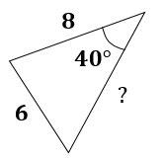
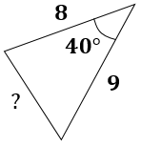
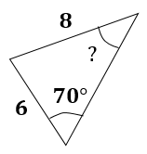
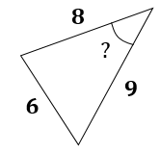
OVERVIEW: Finding missing sides and angles
You have | You want | Use
#1: Two angle-side opposite pairs | Missing angle or side in one pair | Sine rule
#2 Two sides known and a missing side opposite a known angle | Remaining side | Cosine rule
#3 All three sides | An angle | Cosine rule
#4 Two sides known and a missing side not opposite known angle | Remaining side | Sine rule twice

Slide 5
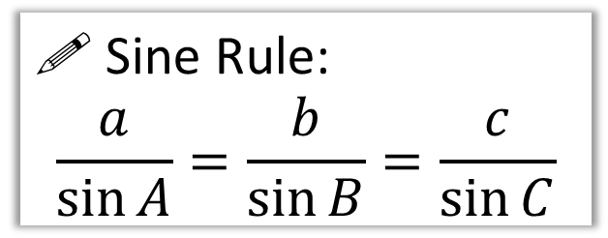
The Sine Rule
b
For this triangle, try calculating each side divided by the sin of its opposite angle. What do you notice in all three cases?
65°
c
5.02
A
10
85°
! Sine Rule:
$$\frac{a}{\sin{A}}=\frac{b}{\sin{B}}=\frac{c}{\sin{C}}$$
?
C
B
30°
9.10
a
You have | You want | Use
#1: Two angle-side opposite pairs | Missing angle or side in one pair | Sine rule

Slide 6
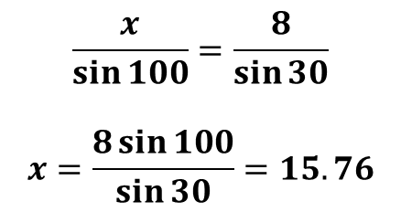
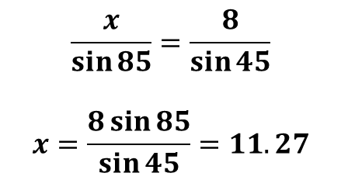
Examples
8
Q2
Q1
8
50°
85°
100°
15.76
45°
?
30°
11.27
?
$$\frac{x}{\sin{85}}=\frac{8}{\sin{45}}$$
$$x=\frac{8\sin{85}}{\sin{45}}=11.27$$
$$\frac{x}{\sin{100}}=\frac{8}{\sin{30}}$$
$$x=\frac{8\sin{100}}{\sin{30}}=15.76$$
You have | You want | Use
#1: Two angle-side opposite pairs | Missing angle or side in one pair | Sine rule

Slide 7
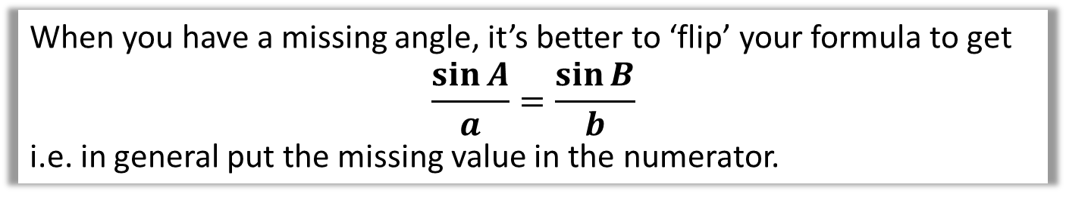
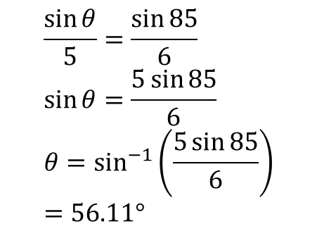
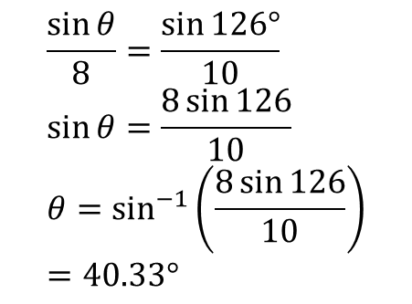
Examples
When you have a missing angle, it’s better to ‘flip’ your formula to get
$$\frac{\sin{A}}{a}=\frac{\sin{B}}{b}$$
i.e. in general put the missing value in the numerator.
5
Q3
Q4
8
126°
85°
40.33°
?
56.11°
6
10
?
$$\frac{\sin{θ}}{5}=\frac{\sin{85}}{6} \\ \sin{θ}=\frac{5\sin{85}}{6} \\ θ=\sin^{−1}\left(\frac{5\sin{85}}{6}\right) \\ =56.11°$$
$$\frac{\sin{θ}}{8}=\frac{\sin{126°}}{10} \\ \sin{θ}=\frac{8\sin{126}}{10} \\ θ=\sin^{−1}\left(\frac{8\sin{126}}{10}\right) \\ =40.33°$$

Slide 8












Test Your Understanding
$$Q$$
$$82°$$
$$P$$
$$20°$$
$$10m$$
$$θ$$
$$85°$$
$$5cm$$
$$12m$$
$$R$$
Determine the angle $θ$.
$$\frac{\sin{θ}}{10}=\frac{\sin{82}}{12}$$
$$θ=sin^{−1}\left(\frac{10\sin{82}}{12}\right) \\ =55.6°$$
Determine the length $PR$.
$$\frac{PR}{\sin{20}}=\frac{5}{\sin{85}}$$
$$PR=\frac{5\sin{20}}{\sin{85}}=1.72cm$$
?
?

Slide 9




























Exercise 1
Find the missing angle or side. Please copy the diagram first! Give answers to 3sf.
Q1
Q2
Q3
$$15$$
$$85°$$
$$10$$
$$16$$
$$12$$
$$y$$
$$x$$
$$30°$$
$$30°$$
$$40°$$
$$x$$
$$20$$
$$y=56.4°$$
$$x=53.1°$$
?
$$x=23.2$$
?
?
$$x$$
Q4
Q6
Q5
$$70°$$
$$35°$$
$$10$$
$$40°$$
$$5$$
$$10$$
$$α$$
$$20$$
$$α=16.7°$$
?
$$x=5.32$$
?
$$x$$
$$x=6.84$$
?

Slide 10




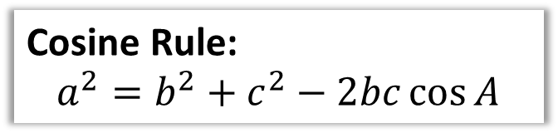





Cosine Rule
The sine rule could be used whenever we had two pairs of sides and opposite angles involved.
However, sometimes there may only be one angle involved. We then use something called the cosine rule.
$$b$$
Cosine Rule:
$$a^{2}=b^{2}+c^{2}−2bc\cos{A}$$
$$15$$
$$A$$
The only angle in formula is $A$, so label angle in diagram $A$, label opposite side $a$, and so on ($b$ and $c$ can go either way).
$$x^{2}={15}^{2}+{12}^{2}−\left(2×15×12×\cos{115}\right) \\ x^{2}=521.14257… \\ x=22.83$$
$$115°$$
How are sides labelled ?
$$a$$
$$c$$
$$x$$
$$12$$
Calculation?

Slide 11
















Sin or Cosine Rule?
If you were given these exam questions, which would you use?
$$10$$
$$x$$
$$x$$
$$10$$
$$70°$$
$$70°$$
$$15$$
$$15$$
✓
Sine
Sine
✓
✗
✗
Cosine
Cosine
$$10$$
$$10$$
$$α$$
$$7$$
$$α$$
$$70°$$
$$15$$
$$12$$
✓
Sine
✓
Sine
✗
✗
Cosine
Cosine

Slide 12










Test Your Understanding
e.g. 1
e.g. 2
$$x$$
$$x$$
$$4$$
$$7$$
$$8$$
$$47°$$
$$106.4°$$
$$7$$
$$x=8.99$$
$$x=6.05$$
?
?
You have | You want | Use
Two sides known and a missing side opposite a known angle | Remaining side | Cosine rule

Slide 13
































Exercise 2
Use the cosine rule to determine the missing angle/side. Quickly copy out the diagram first.
Q1
Q2
Q3
$$135°$$
$$5$$
$$8$$
$$58$$
$$5$$
$$x$$
$$100°$$
$$60°$$
$$70$$
$$x$$
$$7$$
$$y$$
$$x=6.24$$
?
?
$$y=10.14$$
$$x=50.22$$
?
Q5
$$x$$
Q6
Q4
$$6$$
$$4$$
$$5$$
$$75°$$
$$x$$
$$10$$
$$43°$$
$$65°$$
$$8$$
$$6$$
$$3$$
$$x=4.398$$
?
$$3$$
$$x$$
?
$$x=9.513$$
$$x=6.2966$$
?

Slide 14
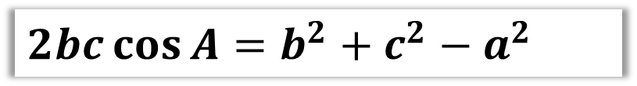

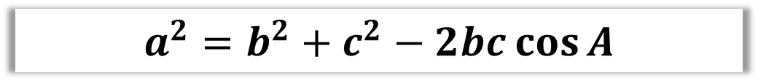



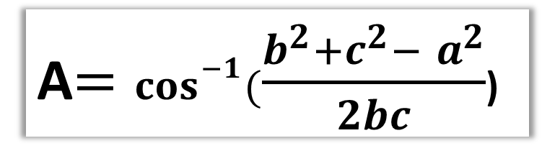

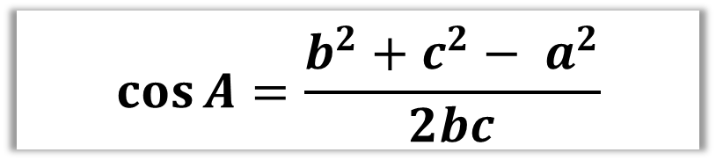
Dealing with Missing Angles
You have | You want | Use
All three sides | An angle | Cosine rule
$$a^{2}=b^{2}+c^{2}−2bc\cos{A}$$
How would you rearrange the formula to have just cosA=…………..?
$$7$$
?
$2bc\cos{A}=b^{2}+c^{2}−$ $a^{2}$
$$α$$
$$4$$
$$9$$
?
$$\cos{A}=\frac{b^{2}+c^{2}− a^{2}}{2bc}$$
?
A$=\cos^{−1}(\frac{b^{2}+c^{2}− a^{2}}{2bc}$)
$$α=25.2°$$
?

Slide 15

Dealing with Missing Angles
You have | You want | Use
All three sides | An angle | Cosine rule
$$a^{2}=b^{2}+c^{2}−2bc\cos{A}$$
$$7$$
$$α$$
Label sides then substitute into formula.
$$4$$
?
$$9$$
$$4^{2}=7^{2}+9^{2}−\left(2×7×9×\cos{α}\right) \\ 16=130−126\cos{α} \\ 126\cos{α}=130−16 \\ \cos{α}=\frac{114}{126} \\ α=\cos^{−1}\left(\frac{114}{126}\right)=25.2°$$
?
Simplify each bit of formula.
?
Rearrange (I use ‘swapsie’ trick to swap thing you’re subtracting and result)
?
$$α=25.2°$$
?

Slide 16










Test Your Understanding
$$4cm$$
$$8$$
$$7cm$$
$$5$$
$$θ$$
$$θ$$
$$9cm$$
$$7$$
$$4^{2}=7^{2}+9^{2}−\left(2×7×9×\cos{θ}\right) \\ 16=130−126\cos{θ} \\ 114=126\cos{θ} \\ \cos{θ}=\frac{114}{126} \\ θ=\cos^{−1}\left(\frac{114}{126}\right)=25.21°$$
?
?
$$8^{2}=7^{2}+5^{2}−\left(2×7×5×\cos{θ}\right) \\ 64=74−70\cos{θ} \\ 10=70\cos{θ} \\ \cos{θ}=\frac{1}{7} \\ θ=\cos^{−1}\left(\frac{1}{7}\right)=81.79°$$

Slide 17















Exercise 3
1
2
3
$$12$$
$$5.2$$
$$7$$
$$6$$
$$β$$
$$θ$$
$$11$$
$$5$$
$$θ$$
$$13.2$$
$$6$$
$$8$$
$$β=92.5°$$
$$θ=71.4°$$
?
?
$$θ=111.1°$$
?

Slide 18

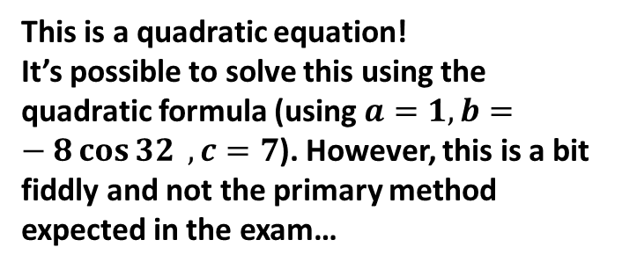




Using sine rule twice
You have | You want | Use
#4 Two sides known and a missing side not opposite known angle | Remaining side | Sine rule twice
Given there is just one angle involved, you might attempt to use the cosine rule:
$$3^{2}=x^{2}+4^{2}−\left(2×x×4×\cos{32}\right)$$
$$9=x^{2}+16−8x\cos{32}$$
$$4$$
?
$$3$$
$$32°$$
$$x$$
This is a quadratic equation!
It’s possible to solve this using the quadratic formula (using $a=1, b=−8\cos{32} , c=7$). However, this is a bit fiddly and not the primary method expected in the exam…

Slide 19


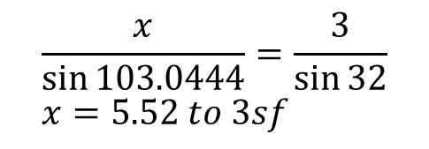
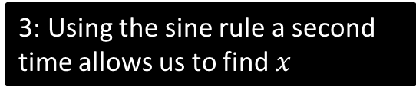



Using sine rule twice
You have | You want | Use
#4 Two sides known and a missing side not opposite known angle | Remaining side | Sine rule twice
!
2: Which means we would then know this angle.
$$4$$
?
$$180−32−44.9556=103.0444$$
1: We could use the sine rule to find this angle.
$$32°$$
$$3$$
3: Using the sine rule a second time allows us to find $x$
?
$$\frac{\sin{A}}{4}=\frac{\sin{32}}{3}$$
$$A=44.9556°$$
$$x$$
$$\frac{x}{\sin{103.0444}}=\frac{3}{\sin{32}} \\ x=5.52 to 3sf$$
?

Slide 20



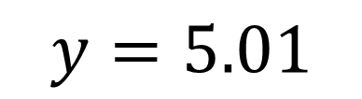


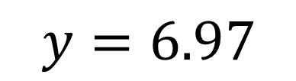



Test Your Understanding
$$9$$
?
$$y=6.97$$
$$y$$
$$61°$$
$$10$$
$$4$$
$$3$$
$$53°$$
?
$$y=5.01$$
$$y$$

Slide 21
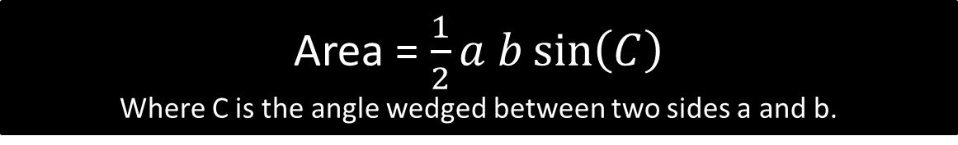
Area of Non Right-Angled Triangles
3cm
Area = 0.5 x 3 x 7 x sin(59)
= 9.00cm²
?
59°
7cm
!
Area = $\frac{1}{2}a b\sin\left(C\right)$
Where C is the angle wedged between two sides a and b.

Slide 22
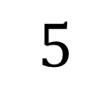
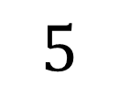

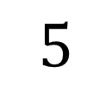
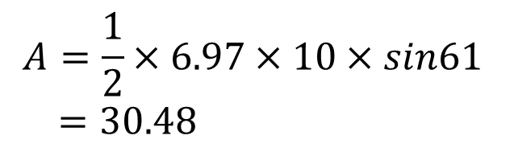

Test Your Understanding
$$A=\frac{1}{2}×6.97×10×sin61 \\ =30.48$$
?
$$9$$
$$6.97$$
$$61°$$
$$10$$
$$5$$
$$5$$
$$A=\frac{1}{2}×5×5×\sin{60} \\ =\frac{25\sqrt{3}}{4}$$
?
$$5$$

Slide 23
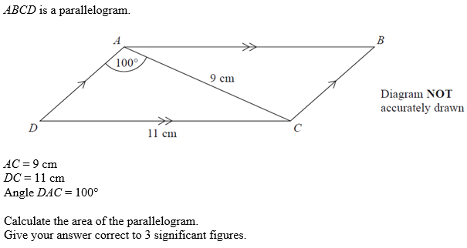
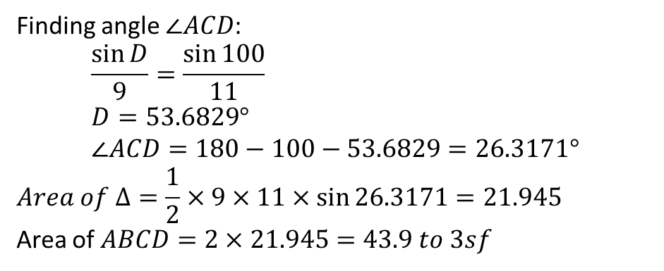




Harder Examples
Q1 (Edexcel June 2014)
Q2
$$6$$
$$7$$
$$8$$
?
Finding angle $∠ACD$:
$$\frac{\sin{D}}{9}=\frac{\sin{100}}{11} \\ D=53.6829° \\ ∠ACD=180−100−53.6829=26.3171°$$
$$Area of Δ=\frac{1}{2}×9×11×\sin{26.3171}=21.945$$
Area of $ABCD=2×21.945=43.9 to 3sf$
Using cosine rule to find angle opposite 8:
$$\cos{θ}=\frac{21}{84} \\ θ=75.52249°$$
$$Area=\frac{1}{2}×6×7×\sin{75.5…=20.3}$$
?

Slide 24
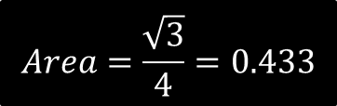












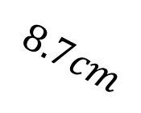

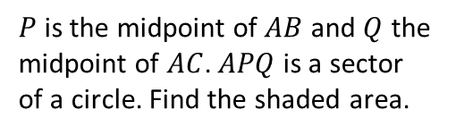
Exercise 4
Q2
Q3
Q1
Q4
$$5$$
3.6
$$3$$
$$1$$
$$1$$
5
100°
3.8
75°
$$8$$
Area = 7.39
$$1$$
5.2
70°
?
$$Area=\frac{\sqrt{3}}{4}=0.433$$
?
Area = 9.04
?
Area = 8.03
?
2cm
Q5
Q6
Q7
$$110°$$
$$8.7cm$$
3cm
?
Area = $3.11cm^{2}$
$$49°$$
$$64°$$
Q8
4.2m
?
3m
$$Area=29.25cm^{2}$$
$P$ is the midpoint of $AB$ and $Q$ the midpoint of $AC$. $APQ$ is a sector of a circle. Find the shaded area.
5.3m
$$\left(\frac{1}{2}×6^{2}×\sin{60}\right)−\frac{1}{6}π\left(3^{2}\right)=10.9cm^{2}$$
?
?
Area = $6.29m^{2}$

Slide 25


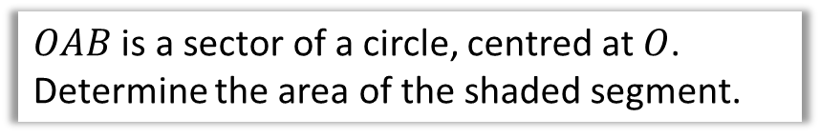

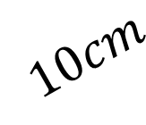


Segment Area
$$A$$
$OAB$ is a sector of a circle, centred at $O$.
Determine the area of the shaded segment.
$$10cm$$
$$O$$
$$Area of sector=\frac{70}{360}×\left(π×{10}^{2}\right)=61.0865cm^{2} \\ Area of triangle=\frac{1}{2}×{10}^{2}×\sin{70}=46.9846cm^{2}$$
$$Area of segment=61.0865−46.9846$$
$=14.1 to 3sf$
$$70°$$
?
?
?
$$B$$

Slide 26
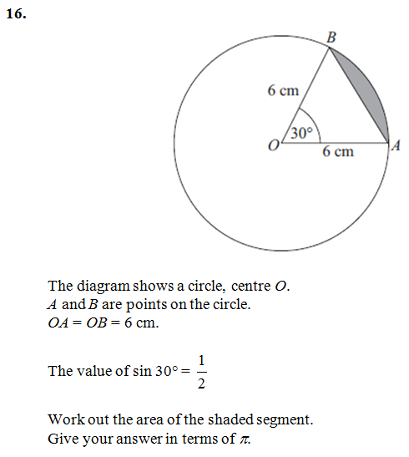
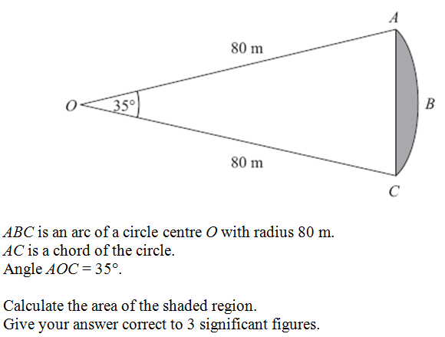


Test Your Understanding
$$A=119m2$$
?
$$A=3π−9$$
?

Slide 27
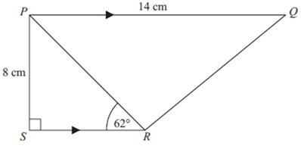


































Exercise 5 - Mixed Exercises
Q4
$$90m$$
Q1
Q2
Q3
$$z$$
$$27$$
$$30°$$
$$130°$$
$$80°$$
$$11$$
$$8$$
$$y$$
$$α$$
$$60m$$
$$40°$$
$$70°$$
$$18$$
$$x$$
?
$$10$$
$$α=17.79° \\ z=26.67 \\ Area=73.33$$
$$Perimeter \\ =286.5m$$
?
$x=41.37$
b) $Area=483.63$
?
?
?
?
$$y=10.45 \\ Area=37.59$$
?
?
Q5
$$4.6$$
Q7
Q8
$$θ$$
$$15$$
$$7$$
$$5$$
$$52°$$
$$6cm$$
$$61°$$
Q6
$$12$$
$$x$$
$$QR=12.6cm$$
?
$$Area=2.15cm^{2}$$
$$θ=122.8°$$
?
?
$$x=7.89 \\ Area=17.25$$
?
?

