Slide 1
Economic Foundations of Business
Natural resources
Land, forests, mineral, water, and other things not made by people
Human resources (also called labor)
The physical and mental abilities people use to produce goods and services
Financial resources (also called capital)
The funds used to acquire the natural and human resources needed to provide products
Intangible resources
Such as a good reputation for quality products or being socially responsible
18
Notes:
We use the term resources to refer to natural resources, human resources, financial resources and intangible resources. Natural resources are land, forest, minerals, water and other things not made by people. Human resources are the physical and mental abilities people use to produce goods and services; also called labor. Financial resources are the funds used to acquire the natural and human resources needed to provide products; also called capital.
Because natural, human, and financial resources are used to produce goods and services, they are sometimes called factors of production. The firm can also have intangible resources such as a good reputation for quality products or being socially responsible. The goal is to turn the factors of production and intangible resources into a competitive advantage.

Slide 2
Economic Systems
Economic system
A description of how a particular society distributes its resources to produce goods and services
All economic systems must address these 3 important issues:
What goods and services, and how much of each, will satisfy consumers’ needs?
How will goods and services be produced, who will produce them, and with what resources will they be produced?
How are the goods and services to be distributed to consumers?
19
Notes:
An economic system describes how a particular society distributes its resources to produce goods and services.
A central issue of economics is how to fulfill an unlimited demand for goods and services in a world with a limited supply of resources.
Although economic systems handle the distribution of resources in different ways, all economic systems must address three important issues:
What goods and services, and how much of each, will satisfy consumers’ needs?
How will goods and services be produced, who will produce them, and with what resources will they be produced?
How are the goods and services to be distributed to consumers?

Slide 3
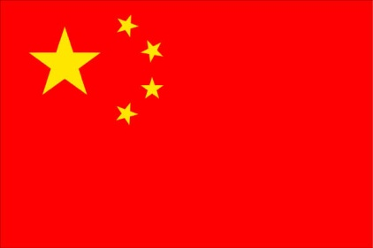
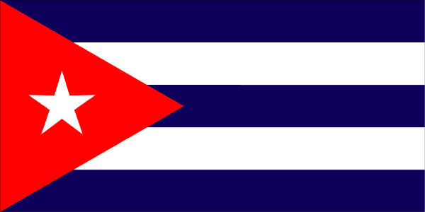
Communism
Communism
First described by Karl Marx as a society in which the people, without regard to class, own all the nation’s resources
On paper it appears efficient, but in practice, these economies suffer from:
low standards of living
critical shortages of consumer goods
high prices
corruption and little freedom
C
H
I
N
A
C
U
B
A
20
Notes:
Communism was first described by Karl Marx as a society in which the people, without regard to class, own all of the nation’s resources. Today, there are a few countries that are considered to be communistic but no true communist economy exists today that satisfies Marx’s ideal.
On paper, communism appears to be efficient and equitable, producing less of a gap between rich and poor. In practice, however, communist economies have been marked by low standards of living, critical shortages of consumer goods, high prices, corruption, and little freedom. Examples of communist societies include China and Cuba.

Slide 4
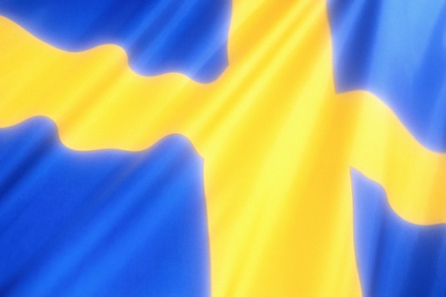
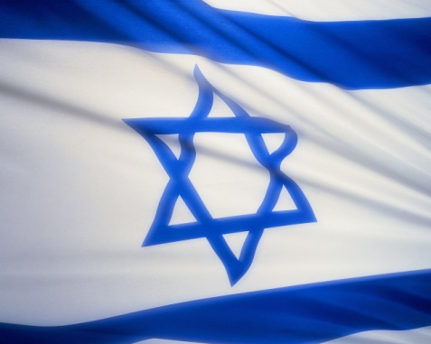
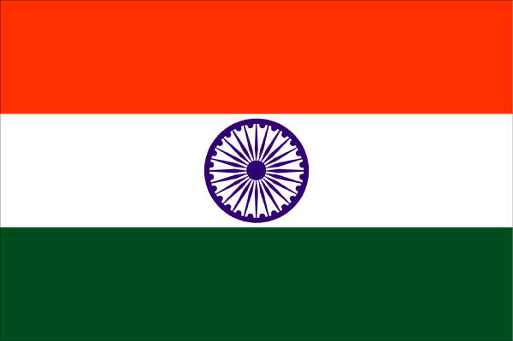
Socialism
Socialism
An economic system in which the government owns and operates basic industries but individuals own most businesses
Most socialist countries are democratic and recognize individual freedoms
The socialist system may allow a higher standard of living and is more stable; but taxes and unemployment are generally higher in socialist countries
S
W
E
D
E
N
I
S
R
A
E
L
I
N
D
I
A
21
Notes:
Socialism is an economic system in which the government owns and operates the basic industries (postal service, telephone, utilities, transportation, health care, banking, and some manufacturing) but individuals own most businesses.
Most socialist nations are democratic and recognize basic individual freedoms. Socialist economies profess egalitarianism—equal distribution of income and social services. They believe their economies are more stable than those of other nations. Although this may be true, taxes and unemployment are generally higher in socialist countries. Examples of socialistic societies include Sweden, Israel, and India.

Slide 5
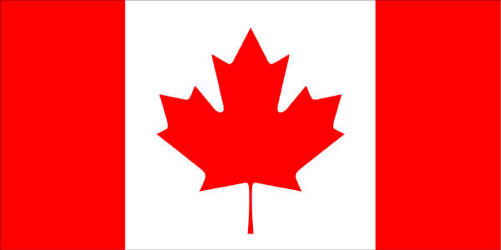
Capitalism
Capitalism, or Free Enterprise
An economic system in which individuals own and operate the majority of businesses that provide goods and services
Pure capitalism or free-market system happens when all economic decisions are made without government intervention; also called laissez-faire capitalism
Modified capitalism differs from pure capitalism in that the government intervenes and regulates business to some extent
C
A
N
A
D
A
J
A
P
A
N
U
S
A
22
Notes:
Capitalism, or free enterprise, is an economic system in which individuals own and operate the majority of businesses that provide goods and services. Competition, supply, and demand determine which goods and services are produced, how they are produced, and how they are distributed. Examples include Australia, the United States, Canada, and Japan.
There are two forms of capitalism: free-market system and modified capitalism.
In pure capitalism, also called a free-market system, all economic decisions are made without government intervention. It was first described by Adam Smith, the father of capitalism, who said the “invisible hand of competition” best regulates the economy in his famous treatise The Wealth of Nations. Smith’s system is also called laissez-faire (“let it be”) capitalism because the government does not interfere in business.
Modified capitalism differs from pure capitalism in that the government intervenes and regulates business to some extent. One of the ways in which the United States and Canadian governments regulate business is through laws.

Slide 6
Comparison of Communism, Socialism, and Capitalism (1 of 2)
 | Communism | Socialism | Capitalism
Business ownership | Most businesses are owned and operated by the government. | The government owns and operates major industries; individuals own small businesses. | Individuals own and operate all businesses.
Competition | None. The government owns and operates everything. | Restricted in major industries; encouraged in small business. | Encouraged by market forces and government regulations.
Profits | Excess income goes to the government. | Profits earned by small businesses may be reinvested in the business; profits from government-owned industries go to the government. | Individuals are free to keep profits and use them as they wish.
23
Notes:
Communism was first described by Karl Marx as a society in which the people, without regard to class, own all of the nation’s resources. Today, there are a few countries that are considered to be communistic but no true communist economy exists today that satisfies Marx’s ideal.
On paper, communism appears to be efficient and equitable, producing less of a gap between rich and poor. In practice, however, communist economies have been marked by low standards of living, critical shortages of consumer goods, high prices, corruption, and little freedom. Examples of communist societies include China and Cuba.

Slide 7
Comparison of Communism, Socialism, and Capitalism (2 of 2)
 | Communism | Socialism | Capitalism
Product availability and price | Consumers have a limited choice of goods and services; prices are usually high. | Consumers have some choice of goods and services; prices are determined by supply and demand. | Consumers have a wide choice of goods and services; prices are determined by supply and demand.
Employment options | Little choice in choosing a career; most people work for government-owned industries or farms. | Some choice of careers; many people work in government jobs. | Unlimited choice of careers.
24
Notes:
Communism was first described by Karl Marx as a society in which the people, without regard to class, own all of the nation’s resources. Today, there are a few countries that are considered to be communistic but no true communist economy exists today that satisfies Marx’s ideal.
On paper, communism appears to be efficient and equitable, producing less of a gap between rich and poor. In practice, however, communist economies have been marked by low standards of living, critical shortages of consumer goods, high prices, corruption, and little freedom. Examples of communist societies include China and Cuba.

Slide 8
Mixed Economies
No country practices pure capitalism, socialism, or communism
Mixed Economies
Economies made up of elements from more than one economic system
No country practices a pure form of any economic system, although most favor one system over others
China and Russia have used state capitalism to advance the economy, integrating the powers of the state with the advantages of capitalism
25
Notes:
No country practices a pure form of communism, socialism, or capitalism, although most tend to favor one system over the others. Most nations operate as mixed economies, which have elements from more than one economic system.
In socialist Sweden, most businesses are owned and operated by private individuals. In capitalist United States, an independent federal agency operates the postal service.
Countries such as China and Russia have used state capitalism to advance the economy. State capitalism tries to integrate the powers of the state with the advantages of capitalism. It is led by the government but uses capitalistic tools such as listing state-owned companies on the stock market and embracing globalization.

Slide 9
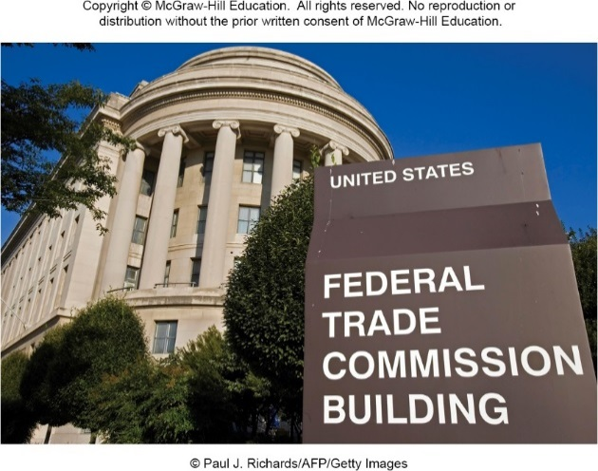
Modified Capitalism
Modified capitalism differs from pure capitalism in that the government intervenes and regulates business to some extent
One way of regulating business is through laws
Federal Trade Commission Act created the Federal Trade Commission
Importance of government’s role in economy
Enforces antitrust laws and monitors businesses to ensure fair competition
26
Notes:
Modified capitalism differs from pure capitalism in that the government intervenes and regulates business to some extent. One of the ways in which the United States and Canadian governments regulate business is through laws. Laws such as the Federal Trade Commission Act, which created the Federal Trade Commission to enforce antitrust laws and monitor businesses to ensure fair competition, illustrate the importance of the government’s role in the economy.

Slide 10
The Free-Enterprise System
Many large economies are free-enterprise – including the U.S., Canada and Japan
Many communist and socialist countries apply free-enterprise principles – including China and Russia
Free enterprise allows a company to succeed or fail on the basis of market demand
An entrepreneur presents his idea for a new product. Entrepreneurs are more productive in free-enterprise systems.
27
Notes:
Many economies – including those in the United States, Canada and Japan – are based on free enterprise, and many communist and socialist countries, such as China and Russia, are applying more principles of free enterprise to their own economic systems. Free enterprise allows a company to succeed or fail on the basis of market demand. Companies that can efficiently manufacture and sell products consumers desire will probably succeed, those companies that do not, will most likely fail.
An entrepreneur presents his idea for a new product. Entrepreneurs are more productive in free-enterprise systems.

Slide 11
Individual and Business Rights
Basic individual and business rights which must exist in order to motivate companies to succeed
Right to own property
Right to earn profits and use them as one wishes
Right to determine business operations
Right to choose
Career to pursue
Where to live or where to locate a business
What goods/services to purchase and more
28
Notes:
A number of basic individual and business rights must exist for free enterprise to work. These rights are the goals of many countries that have recently embraced free enterprise.
1. Individuals must have the right to own property and to pass this property on to their heirs. This right motivates people to work hard and save to buy property.
2. Individuals and businesses must have the right to earn profits and to use the profits as they wish, within the constraints of their society’s laws, principles, and values.
3. Individuals and businesses must have the right to make decisions that determine the way the business operates. Although there is government regulation, the philosophy in countries like the United States and Australia is to permit maximum freedom within a set of rules of fairness.
4. Individuals must have the right to choose what career to pursue, where to live, what goods and services to purchase, and more. Businesses must have the right to choose where to locate, what goods and services to produce, what resources to use in the production process, and so on.
Without these rights, businesses cannot function effectively because they are not motivated to succeed. Thus, these rights make possible the open exchange of goods and services.

