Slide 1
GCSE: Solving Quadratic Equations
Skipton Girls’ High School

Slide 2
Overview
There are 4 ways in which we can solve quadratic equations.
$$2x^{2}−5x−3=0$$
1
By Factorising
2
By using the Quadratic Formula
Go To Slides >>
>>
?
?
$$2x^{2}−5x−3=0 \\ \left(2x+1\right)\left(x−3\right)=0 \\ x=−\frac{1}{2}or x=3$$
$$x=\frac{5±\sqrt{25−\left(4×2×−3\right)}}{4} \\ x=−\frac{1}{2}or x=3$$
3
By ‘Completing the Square’
4
Approximating by using a Graph
>>
>>
?
$$x^{2}−\frac{5}{2}x−\frac{3}{2}=0 \\ {\left(x−\frac{5}{4}\right)}^{2}−\frac{25}{16}−\frac{3}{2}=0$$
$${\left(x−\frac{5}{4}\right)}^{2}=\frac{49}{16} \\ x−\frac{5}{4}=±\frac{7}{4} \\ x=−\frac{1}{2} or x=3$$
?
$$−\frac{1}{2}$$
$$3$$

Slide 3
Solving (quadratic) equations
But now we’re moving on...
Quadratic
Expression
Equation
x² – 5x + 6
= 0
Click to Move On

Slide 4
Starter
×
=
0
If two things multiply to give 0, what do you know?
At least one of those things must be 0.
?

Slide 5
Solving Equations
Therefore, how could we make this equation true?
(x + 3)(x – 2) = 0
x = -3
or
x = 2
?
?
Why do you think the ‘or’ is important?
While both values satisfy the equation, x can’t be both values at the same time, so we wouldn’t use the word ‘and’.
This will be clearer when we cover inequalities later this year.
?

Slide 6
Quickfire Questions
Solving the following.
(x – 1)(x + 2) = 0
x(x – 6) = 0
(6 – x)(5 + x) = 0
(2x + 1)(x – 3) = 0
(3x – 2)(5x + 1) = 0
(1 – 4x)(3x + 2) = 0
x = 1 or x = -2
x = 0 or x = 6
x = 6 or x = -5
x = -0.5 or x = 3
x = 2/3 or x = -1/5
x = 1/4 or x = -2/3
?
?
?
?
?
?
Bro Tip: To get the solution quickly in your head, negate the sign you see, and make the constant term the numerator.

Slide 7
Exercise 1
Solving the following equations.
1
x(x – 3) = 0
x(x + 2) = 0
(x + 7)(x – 9) = 0
(7x + 2)(x – 4) = 0
(9 – 2x)(10x – 7) = 0
x(5 – x)(5 + 2x) = 0
x²(x + 3) = 0
x(2x – 5)(x + 1)² = 0
x cos(x) = 0
cos(2x + 10) = 0
x = 0 or x = 3
x = 0 or x = -2
x = -7 or x = 9
x = -2/7 or x = 4
x = 9/2 or x = 7/10
x = 0 or x = 5 or x = -5/2
x = 0 or x = -3
x = 0 or x = 5/2 or x = -1
x = 0 or x = 90, 270, 450, ...
x = 40, 130, 220, 310, ...
?
2
?
3
?
4
?
5
?
6
?
7
?
8
?
N
?
N
?

Slide 8
Solving non-factorised equations
We’ve seen that solving equations is not too difficult when we have it in the form:
[factorised expression] = 0
Solve x² + 2x = 15
x² + 2x – 15 = 0 Put in form [expression] = 0
(x + 5)(x – 3) = 0 Factorise
x = -5 or x = 3
?

Slide 9
In pairs...
In pairs, discuss what solutions there are to the following equation.
x³ = x
?
x³ – x = 0
x(x² – 1) = 0
x(x + 1)(x – 1) = 0
x = 0 or x = -1 or x = 1

Slide 10
Final example
Solve the following.
x² = 4
Method 1
Method 2
?
?
Square root both sides.
x = ±2
Factorise.
x² – 4 = 0
(x + 2)(x – 2) = 0
x = ±2

Slide 11
Exercise 2
Solve the following equations.
x² + 7x + 12 = 0
x² + x – 6 = 0
x² + 10x + 21 = 0
x² + 2x + 1 = 0
x² – 3x = 0
x² + 7x = 0
2x² – 2x = 0
x² – 49 = 0
4x = x²
10x² – x – 3 = 0
12y² – 16y + 5 = 0
64 – z² = 0
2x² = 8
16x² – 1 = 0
x² + 5x = 14
2x² + 7x = 15
2x² = 8x + 10
4x² + 7 = 29x
y² + 56 = 15y
63 – 2y = y²
8 = 3x² + 10x
x⁶ = 9x³ – 8
x⁴ = 5x² – 4
x³ = x² + x – 1
x³ + 1 = – x – x²
x⁴ + 2x³ = 8x + 16
x = ± 1/4
x = -7 or x = 2
x = -5 or x = 3/2
x = -1 or x = 5
x = 1/4 or x = 7
y = 7 or y = 8
x = -9 or x = 7
x = -4 or x = 2/3
x = 1 or x = 2
x = ±1 or ± 2
x = ±1
x = -1
x = ±2
1
x = -3 or x = -4
x = -3 or x = 2
x = -7 or x = -3
x = -1
x = 0 or x = 3
x = 0 or x = -7
x = 0 or x = 1
x = -7 or x = 7
x = 0 or x = 4
x = -1/2 or x = 3/5
y = 1/2 or y = 5/6
z = ±8
x = ±2
?
?
14
2
?
15
?
3
?
16
?
4
?
17
?
5
?
18
?
6
?
19
?
7
?
20
?
8
?
21
?
9
?
N
?
10
?
N
?
11
?
N
?
12
?
N
?
13
?
N
?

Slide 12
Harder Equations
Sometimes it’s a little trickier to manipulate quadratic (and some other) equations to solve, but the strategy is always the same: get into the form [something] = 0 then factorise (you may need to expand first).
2x(x – 1) = (x+1)² – 5
?
2x² – 2x² = x² + 2x + 1 – 5
x² – 4x + 4 = 0
(x – 2)(x – 2) = 0
x = 2

Slide 13
Test Your Understanding
Solve (x – 4)² = x + 8
x = 1 or x = 8
?
Level 8/9 GCSE Question Alert!
5(2x + 1)² = (5x – 1)(4x + 5)
5(4x² + 4x + 1) = 20x² + 25x – 4x – 5
20x² + 20x + 5 = 20x² + 21x – 5
x = 10
(It turned out this simplified to a linear equation!)
?

Slide 14
Exercise 3
Solve the following equations.
N
Determine x
1
x(x + 10) = -21
6x(x+1) = 5 – x
(2x+3)² = -2(2x + 3)
(x + 1)² – 10 = 2x(x – 2)
(2x – 1)² = (x – 1)² + 8
3x(x + 2) – x(x – 2) + 6 = 0
$x=17−\frac{30}{x}$
$16=\frac{1}{x^{2}}$
$10x=1+\frac{3}{x}$
$4x+\frac{7}{x}=29$
$x+4=\frac{21}{x}$
$x^{3}+x^{2}−4x=4$
?
x = -3 or x = -7
x = -5/3 or x = 1/2
x = -5/2 or x = -3/2
x = 3
x = 2 or x = -4/3
x = -1 or x = -3
x = 2 or x = 15
x = ±1/4
x = -1/2 or x = 3/5
$x=\frac{1}{4}$ or $x$ = 7
$$x=−7 or x=3$$
$$x=2, −2, 1$$
2
?
3x - 1
3
?
x
4
?
5
?
x + 1
6
?
7
?
?
x = 8/7
8
?
9
?
N
10
?
For what n is the n^{th} term of the sequence 21, 26, 35, 48, 65, ... and the sequence 60, 140, 220, 300, 380, ... the same?
2n² – n + 20 = 80n – 20
n = 40 (you can’t have the 0.5th term!)
11
?
12
?
?

Slide 15
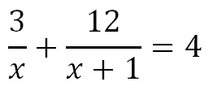
Dealing with fractions
Usually when dealing with solving equations involving fractions in maths, our strategy would usually be:
To multiply by the denominator.
?
Multiplying everything by x and x+1, we get:
3(x+1) + 12x = 4x(x+1)
Expanding and rearranging:
4x2 – 11x – 3 = 0
(4x + 1)(x – 3) = 0
So x = -1/4 or x = 3
?
?

Slide 16
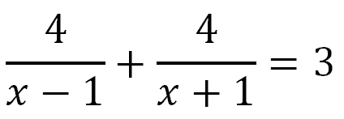
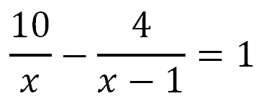
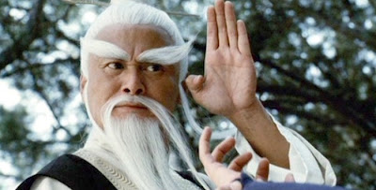
Wall of Fraction Destiny
1
2
x = 2, 5
?
x = -1/3, 3
?
3
x = -4/3, 2
?
“To learn secret way of quadratic ninja, find $x$ you must.”

Slide 17
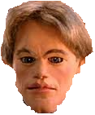
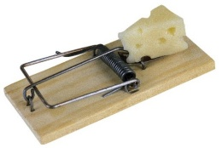
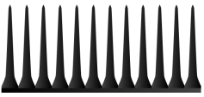
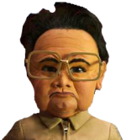
The Adventures of Matt DamonTM
Kim Jong Il is threatening to blow up America with nuclear missiles.
Help Matt Damon save the day by solving Kim’s quadratic death traps.
$$\frac{x}{2x−3}+\frac{4}{x+1}=1$$
$$\frac{6}{x}+\frac{6}{x−1}=5$$
$$\frac{8}{x}+\frac{15}{x+1}=5$$
1
3
2
$$x=1, 9$$
?
?
$$x=3 , \frac{2}{5}$$
$$x=4, −\frac{2}{5}$$
?
5
$$\frac{12}{x}+\frac{8}{x}=x+1$$
$$\frac{3x−1}{x−2}+\frac{2x+2}{x−1}=12$$
4
?
?
x = 4, -5
$$x=3,\frac{9}{7}$$
6
$$\frac{x}{4}+\frac{4}{x}=\frac{x}{2}$$
?
$$x=±4$$
8
$$2+\frac{4x−8}{x^{2}}=x$$
$$\frac{3}{x+3}−\frac{4}{x−3}=\frac{5x}{x^{2}−9}$$
7
$$x=±2$$
?
$$x=−\frac{7}{2}$$
?

Slide 18
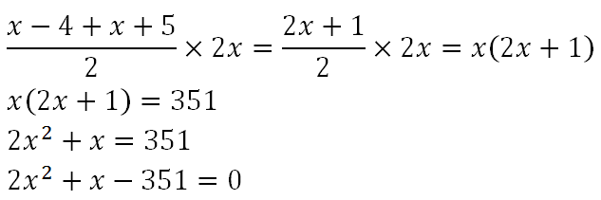
Geometric Algebraic Problems
?
?
2x² + 27x – 26x – 351 = 0 (by splitting middle term)
x(2x + 27) – 13(2x + 27) = 0
(x – 13)(2x + 27) = 0
x = 13

Slide 19
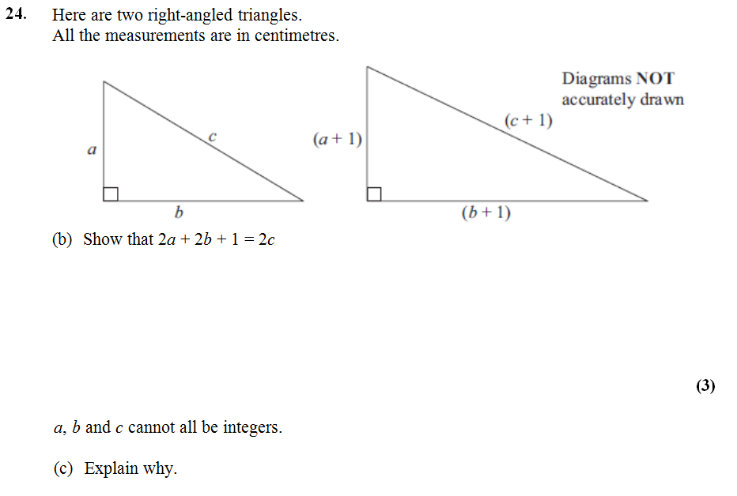
Geometric Algebraic Problems
?
First triangle: a² + b² = c² (1)
Second triangle: (a+1)² + (b+1)² = (c+1)²
➔ a² + 2a + 1 + b² + 2b + 1 = c² + 2c + 1 (2)
Using (1) to substitute c² with a² + b² in (2):
c² + 2a + 2b + 2 = c² + 2c + 1
2a + 2b + 1 = 2c
The LHS of the equation must be odd since 2a and 2b are both even.
The RHS however must be even since 2c is even. Thus a, b and c can’t be integers.
?

Slide 20
Exercises
Determine x
Determine the length of the hypotenuse.
Determine x
1
3
5
2x - 1
x
x + 4
4x + 2
x
2x
Area = 96
x + 1
x + 2
x + 1
Answer: x = 3
Answer: x = 5
?
Answer: x = 6
?
?
2
4
N
[Maclaurin] An arithmetic sequence is one in which the difference between successive terms remains constant (for example, 4, 7, 10, 13, …). Suppose that a right-angled triangle has the property that the lengths of its sides form an arithmetic sequence. Prove that the sides of the triangle are in the ratio 3:4:5.
Solution: Making sides x – a, x and x + a, we obtain x = 4a by Pythagoras. Thus sides are 3a, 4a, 5a which are in desired ratio.
3x - 4
x
x + 1
Area = 28
x - 4
5x + 2
4x
Determine x
Answer: x = 6
Given the two triangles have the same area, determine x.
Answer: x = 2
?
?
?

Slide 21
Test Your Topic Understanding
…of solving by factorising.
1
Solve $3x^{2}−11x−4=0$ by factorising.
?
$$\left(3x+1\right)\left(x−4\right)=0 \\ x=−\frac{1}{3} or x=4$$
2
Determine the side $AC$.
?
$$A$$
$$x^{2}+{\left(2x+2\right)}^{2}={\left(2x+3\right)}^{2}$$
$$x^{2}+4x^{2}+8x+4=4x^{2}+12x+9$$
$$x^{2}−4x−5=0$$
$$\left(x+1\right)\left(x−5\right)=0$$
$$x=5$$
$$AC=13$$
$$2x+3$$
$$2x+2$$
$$B$$
$$C$$
$$x$$

Slide 22
#2 Solving by using the Quadratic Formula
Try to solve the following by factorising. What problem do you encounter?
$$x^{2}+2x−5=0$$
?
There are no two integers numbers which add to give 2 and multiply to give -5. We therefore can’t factorise.
We can use something called the Quadratic Formula to find solutions to quadratic equations (whether or not they factorise).

Slide 23
The Quadratic Formula
Mr B’s Hint #1: Notice that we need 0 on the RHS.
! If $ax^{2}+bx+c=0$
Then:
$$x=\frac{−b±\sqrt{b^{2}−4ac}}{2a}$$
?
Solve $x^{2}−3x−5=0$ giving your answers to 3 significant figures.
$$a=1 b=−3 c=−5$$
$$x=\frac{3±\sqrt{9−\left(4×1×−5\right)}}{2}$$
$$x=\frac{3±\sqrt{29}}{2}$$
$$x=4.19 or x=−1.19$$
?
#2: You know you won’t be able to factorise if a GCSE question ends with “to 3sf” or “to 2dp”.
?
#3: Explictly write out $a$, $b$ and $c$ to avoid making errors when you substitute into the formula.
Don’t be intimidated by the $±$: calculate your value with $+$ and then with $−$.
?
#4: Use brackets around the $4ac$ part: this will reduce the chance you make a sign error.
?

Slide 24
Test Your Understanding
! If $ax^{2}+bx+c=0$
Then:
$$x=\frac{−b±\sqrt{b^{2}−4ac}}{2a}$$
Equation | $$a$$ | $$b$$ | $$c$$ | Solutions (to 3sf)
$$x^{2}+5x+1=0$$ | $$1$$ | $$5$$ | $$1$$ | $$x=−4.79 or x=−0.209$$
$$x^{2}−x−1=0$$ | $$1$$ | $$−1$$ | $$−1$$ | $$x=1.62 or x=−0.618$$
$$4x^{2}+4x+1=0$$ | $$4$$ | $$4$$ | $$1$$ | $$x=−\frac{1}{2}$$
$$3−5x−x^{2}=0$$ | $$−1$$ | $$−5$$ | $$3$$ | $$x=−5.54 or x=0.541$$
$$x^{2}+x+1=0$$ | $$1$$ | $$1$$ | $$1$$ | No solutions.
?
?
?
?
?
?
?
?
?
?
?
?
?
?
?
?
?
?
?
?

Slide 25
Practising using the Quad Formula
1
Solve the following, giving your answers as
(a) exact answers (involving surds) and
(b) to 3 significant figures.
2
Solve the following. Use exact values.
$$\frac{5x}{x+1}=x−2 x=3±\sqrt{11}$$ $$\frac{x+2}{2x}=x+1 x=±\sqrt{2} \\ \frac{{\left(2x−3\right)}^{2}}{x+1}=3 x=\frac{1}{8}\left(15±\sqrt{129}\right)$$
?
Example:
x² + x – 1 Exact: $x=−0.5±0.5\sqrt{5}$
Decimal: x = -1.62 or x = 0.62
x² + 3x + 1 = 0 $x=−2.62$ or $x=−0.382$
x² – 6x + 2 = 0 x = 0.354 or x = 5.65
x² + x – 5 = 0 x = -2.79 or x = 1.79
2y² + 5y – 1 = 0 x = -2.69 or x = 0.186
x(2x + 3) = 4 x = -2.35 or x = 0.851
4(1–3x) = 2x(x+3) x = -9.22 or x = 0.217
y(5y+1) = 4(3y+2) y = -0.576 or y = 2.78
?
?
?
N
The sides of a rectangle are $3x+1$ and $4x+1$. Its area is 40. Determine $x$.
$$x=1.53$$
?
?
Find the exact value of $\sqrt{1+\sqrt{1+\sqrt{1+…}}}$
$$x=\sqrt{1+x} \\ x^{2}=1+x \\ x^{2}−x−1=0 \\ x=\frac{1+\sqrt{5}}{2}=φ$$
?
N
?
?
?
?
?

Slide 26
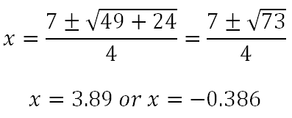
Typical PPQ and What to watch out for!
Q
Solve 2x² – 7x – 3 = 0, giving your answer to 3 significant figures.
a = 2, b = -7, c = -3
?
What kind of mistakes do you think might be easy to make?
If b is negative, then putting –b as negative as well. i.e. Using -7 in the fraction instead of 7.
When squaring a negative value of b, putting the result as negative. i.e. Using -49 in the fraction instead of 49.
When doing the -4ac bit, subtracting instead of adding when one of a or c is negative. i.e. Using -24 in the fraction instead of +24.
?

Slide 27
#3 Solving by Completing the Square
Before we solve equations by completing the square, we’ll learn how to complete the square with a quadratic expression.
What the devil is ‘completing the square’?
?
$$ax^{2}+bx+c$$
$$a{\left(x+__\right)}^{2}+__$$
It means putting a quadratic expressions in the form on the right, i.e. where $x$ only appears once.
What’s the point?
?
It has two main uses of which we will explore:
Solving quadratic equations (including deriving the quadratic formula!).
Sketching quadratic equations to find minimum points and roots.

Slide 28
Starter
Expand the following:
$${\left(x+3\right)}^{2}=x^{2}+6x+9$$
?
$${\left(x+5\right)}^{2}+1=x^{2}+10x+26$$
?
$${\left(x−3\right)}^{2}=x^{2}−6x+9$$
?
$${\left(x+a\right)}^{2}=x^{2}+2ax+a^{2}$$
?
What do you notice about the coefficient of the $x$ term in each case?

Slide 29
Completing the square
Typical GCSE question:
“Express $x^{2}+6x$ in the form ${\left(x+p\right)}^{2}+q$, where $p$ and $q$ are constants.”
$$x^{2}+6x$$
$${=\left(x+3\right)}^{2}−9$$
?
Halve whatever number is on $x$, and write ${\left(x+ ___\right)}^{2}$
We square this 3 and then ‘throw it away’ (so that the $−9$ cancels with the $+9$ in the expansion of ${\left(x+3\right)}^{2}$.

Slide 30
Completing the square
More examples:
?
$$x^{2}−2x={\left(x−1\right)}^{2}−1$$
$$x^{2}−6x+4={\left(x−3\right)}^{2}−5$$
$$x^{2}+8x+1={\left(x+4\right)}^{2}−15$$
$$x^{2}+10x−3={\left(x+5\right)}^{2}−28$$
$$x^{2}+4x+3={\left(x+2\right)}^{2}−1$$
$$x^{2}−20x+150={\left(x−10\right)}^{2}+50$$
?
?
?
?
?
$$x^{2}−6x+4 \\ ={\left(x−3\right)}^{2}−9+4 \\ ={\left(x−3\right)}^{2}−5$$
$$x^{2}+8x+1={\left(x+4\right)}^{2}−16+1 \\ ={\left(x+4\right)}^{2}−15$$

Slide 31
Exercises
Express the following in the form ${\left(x+p\right)}^{2}+q$
$$x^{2}+2x={\left(x+1\right)}^{2}−1$$
$$x^{2}+12x={\left(x+6\right)}^{2}−36$$
$$x^{2}−22x={\left(x−11\right)}^{2}−121$$
$$x^{2}+6x+10={\left(x+3\right)}^{2}+1$$
$$x^{2}+14x+10={\left(x+7\right)}^{2}−39$$
$$x^{2}−2x+16={\left(x−1\right)}^{2}+15$$
$$x^{2}−40x+20={\left(x−20\right)}^{2}−380$$
$$x^{2}+x={\left(x+\frac{1}{2}\right)}^{2}−\frac{1}{4}$$
$$x^{2}+5x−1={\left(x+\frac{5}{2}\right)}^{2}−\frac{29}{4}$$
$$x^{2}−9x+20={\left(x−\frac{9}{2}\right)}^{2}−\frac{1}{4}$$
?
1
?
N
$$x^{2}+2ax+1={\left(x+a\right)}^{2}−a^{2}+1$$
2
?
N
$$x^{2}+3a\sqrt{b}x={\left(x+\frac{3a\sqrt{b}}{2}\right)}^{2}−\frac{9a^{2}b}{4}$$
?
3
?
4
?
5
?
6
?
7
?
?
8*
?
9
?
10

Slide 32
$ax^{2}+…$
So far the coefficient of the $x^{2}$ term has been 1. What if it isn’t?
Express $3x^{2}+12x−6$ in the form ${a\left(x+b\right)}^{2}+c$
$$3x^{2}+12x−6 \\ =3\left(x^{2}+4x−2\right) \\ =3\left({\left(x+2\right)}^{2}−4−2\right) \\ =3\left({\left(x+2\right)}^{2}−6\right) \\ =3{\left(x+2\right)}^{2}−18$$
Just factorise out the coefficient of the $x^{2}$ term. Now we have an expression just like before for which we can complete the square!
?
?
Now expand out the outer brackets.
?
Express $2−4x−2x^{2}$ in the form $a−b{\left(x+c\right)}^{2}$
$$−2x^{2}−4x+2 \\ =−2\left(x^{2}+2x−1\right) \\ =−2\left({\left(x+1\right)}^{2}−1−1\right) \\ =−2\left({\left(x+1\right)}^{2}−2\right) \\ =−2{\left(x+1\right)}^{2}+4 \\ =4−2{\left(x+1\right)}^{2}$$
?
Reorder the terms so you always start with something in the form $ax^{2}+bx+c$
?
?
Be jolly careful with your signs!
?
You were technically done on the previous line, but it’s nice to reorder the terms so it’s more explicitly in the requested form.
?

Slide 33
Express the following in the form $a{\left(x+p\right)}^{2}+q$:
$$2x^{2}−8x+10$$
$$2x^{2}−8x+10$$

Slide 34
Exercises
Put in the form $a{\left(x+p\right)}^{2}+q$ or $q−a{\left(x+p\right)}^{2}$
$$2x^{2}+4x=2{\left(x+1\right)}^{2}−2$$
$$2x^{2}−12x+28=2{\left(x−3\right)}^{2}+10$$
$$3x^{2}+24x−10=3{\left(x+4\right)}^{2}−58$$
$$5x^{2}+20x−19=5{\left(x+2\right)}^{2}−39$$
$$−x^{2}+2x+16=17−{\left(x−1\right)}^{2}$$
$$9+4x−x^{2}=13−{\left(x−2\right)}^{2}$$
$$1−3x−x^{2}=\frac{13}{4}−{\left(x+\frac{3}{2}\right)}^{2}$$
1
?
2
?
3
?
4
?
5
?
6
?
?
7
$$a\left(x^{2}+\frac{b}{a}x+\frac{c}{a}\right) =a\left({\left(x+\frac{b}{2a}\right)}^{2}−\frac{b^{2}}{4a}+\frac{c}{a}\right) \\ =a\left({\left(x+\frac{b}{2a}\right)}^{2}−\frac{b^{2}−4ac}{4a^{2}}\right) =a{\left(x+\frac{b}{2a}\right)}^{2}−\frac{b^{2}−4ac}{4a}$$
?
N
$$ax^{2}+bx+c$$

Slide 35
Uses of Completing The Square
1. Sketching Parabolas
You can find this in the ‘Sketching Quadratic Equations’ slides.
Completing the square allows us to find the minimum or maximum point of a curve, and is especially useful for sketching when the quadratic has no ‘roots’.
2. Solving Quadratics
$$x^{2}+2x−5=0 \\ {\left(x+1\right)}^{2}−6=0 \\ {\left(x+1\right)}^{2}=6 \\ x+1=±\sqrt{6} \\ x=−1±\sqrt{6}$$
?
Complete the square on LHS.
?
Move lone constant to other side.
?
Now make $x$ the subject.
KEY POINT: Don’t forget the $±$ !
?

Slide 36
Solving by Completing the Square
Possible GCSE question
Put the expression $x^{2}+6x+1$ in the form ${\left(x+a\right)}^{2}+b$. ${\left(x+3\right)}^{2}−8$
Hence find the exact solutions to $x^{2}+6x+1=0$.
$${\left(x+3\right)}^{2}=8 \\ x+3=±\sqrt{8} \\ x=−3±\sqrt{8}$$
?
?
Hint: Be careful to observe how the question asks you to give your solution.
If it says exact solution, then you have to use surds, because any decimal form would be a rounded value.

Slide 37
Test Your Understanding
Complete the square to find exact solutions to…
$$x^{2}−8x+2=0$$
$${\left(x−4\right)}^{2}−14=0 \\ {\left(x−4\right)}^{2}=14 \\ x−4=±\sqrt{14} \\ x=4±\sqrt{14}$$
$${6x}^{2}+24x+6=0$$
$$x^{2}+4x+1=0 \\ {\left(x+2\right)}^{2}−3=0 \\ x+2=±\sqrt{3} \\ x=−2±\sqrt{3}$$
?
?
Key point: Notice that when we have an equation rather than an expression, we can just divide by 6 rather than having to factorise out the 6 (because $0÷6=0$)

Slide 38
Exercises
Solve the following by completing the square, giving your answers to 3sf.
1
$$x^{2}+8x+1=0 x=−4±\sqrt{15} x=−0.127 or −7.87$$
$$x^{2}−6x+2=0 x=3±\sqrt{7} x=5.65 or x=0.354$$
$−x^{2}+10x−1=0 x=5±\sqrt{24} x=0.101 or x=9.90$
$$2x^{2}+10x−4=0 x=−5.37 or x=0.37$$
$$x^{2}+x=1 x=−1.61 or x=0.618$$
$${\left(x+3\right)}^{2}+x=10 x=−7.14 or x=0.140$$
$x^{2}+ax=b$ (giving your answer in terms of $a$ and $b$).
$${\left(x+\frac{a}{2}\right)}^{2}−\frac{a^{2}}{4}=b {\left(x+\frac{a}{2}\right)}^{2}=\frac{4b+a^{2}}{4} \\ x+\frac{a}{2}=±\frac{\sqrt{4b+a^{2}}}{2} x=±\frac{−a±\sqrt{4b+a^{2}}}{2}$$
By forming an appropriate equation and completing the square, show that the value of the infinite expression $1+\frac{1}{1+\frac{1}{…}}$ is the Golden Ratio, i.e. $\frac{1+\sqrt{5}}{2}$.
Let $x=1+\frac{1}{1+\frac{1}{…}}$. Then $x=1+\frac{1}{x}$. Then $x^{2}=x+1.$
$$x^{2}−x−1=0 {\left(x−\frac{1}{2}\right)}^{2}=\frac{5}{4} x=\frac{1±\sqrt{5}}{2}$$
?
2
?
3
?
4
?
5
?
6
?
N₁
?
N₂
?
N₃
Make $x$ the subject of $x^{2}+x=y$ $x=\frac{−1±\sqrt{1−4y}}{2}$
?

Slide 39
Summary So Far…
Solve the equation $x^{2}+7x−18=0$ by:
#1
Factorising
?
$$\left(x+9\right)\left(x−2\right)=0 \\ x=−9 or x=2$$
#2
Using the Quadratic Formula
?
$$a=1, b=7, c=−18 \\ x=\frac{−7±\sqrt{49+72}}{2}=\frac{−7±11}{2} \\ =−9 or 2$$
#3
Completing the Square
?
$${\left(x+\frac{7}{2}\right)}^{2}−\frac{49}{4}−18=0 \\ {\left(x+\frac{7}{2}\right)}^{2}=\frac{121}{4}$$
$$x+\frac{7}{2}=±\frac{11}{2} \\ x=\frac{−7±11}{2}$$

Slide 40
Proof of the Quadratic Formula!
by completing the square…
$$ax^{2}+bx+c=0 \\ x^{2}+\frac{b}{a}x+\frac{c}{a}=0 \\ {\left(x+\frac{b}{2a}\right)}^{2}−\frac{b^{2}}{4a^{2}}+\frac{c}{a}=0 \\ {\left(x+\frac{b}{2a}\right)}^{2}+\frac{4ac−b^{2}}{4a^{2}}=0 \\ {\left(x+\frac{b}{2a}\right)}^{2}=\frac{b^{2}−4ac}{4a^{2}} \\ x+\frac{b}{2a}=±\frac{\sqrt{b^{2}−4ac}}{2a} \\ x=\frac{−b±\sqrt{b^{2}−4ac}}{2a}$$
?
?
?
?
?
?

Slide 41
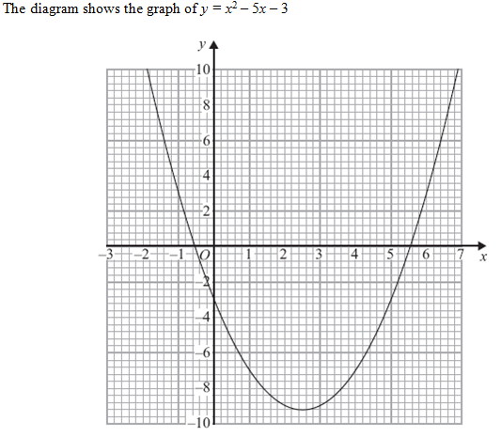
#4 Solving Quadratics by using a Graph - Preview
Edexcel Nov 2011 NonCalc
Use the graph to find estimates for the solutions of
$x^{2}−5x−3=0$ Accept $−0.6$ to $−0.5$, $5.5$ to $5.6$.
$x^{2}−5x−3=6$ $x=−1.4, 6.4$
Recall that we can find the solutions to two simultaneous equations by drawing the two lines, and finding the points of intersection.
?
?
b) Use the graph to find estimates for the solutions of the simultaneous equations:
$$y=x^{2}−5x−3 \\ y=x−4$$ $$x=0.2, y=−3.8 \\ x=5.8, y=1.6$$
Since $y=x^{2}−5x−3$ and we want $0=x^{2}−5x−3$, we’re looking where $y=0$.
?
Tip: Remember that the easiest way to sketch lines like $y=x−4$ is to just pick two sensible values of $x$ (e.g. 0 and 4), and see what $y$ is for each. Then join up the two points with a line.

Slide 42
#4 Solving Quadratics by using a Graph - Preview
We’ll come back to this topic in ‘Sketching Graphs’.

