Slide 1
Algebra: Expanding Brackets
Skipton Girls’ High School
Objectives: Be able to expand an expression when it involves two brackets multiplied together.

Slide 2

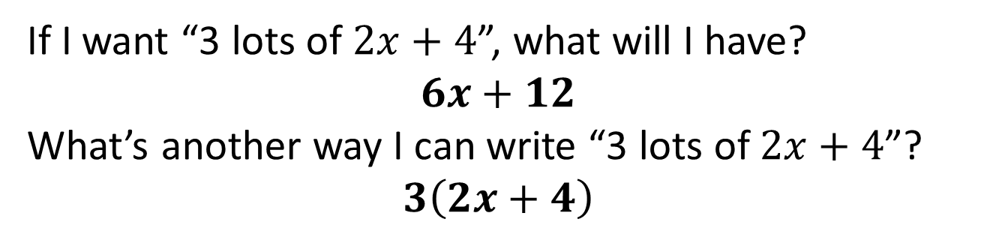
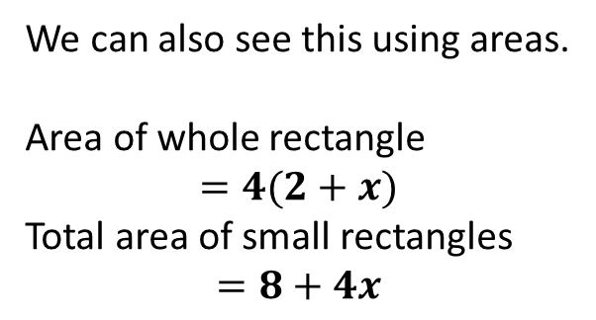


Brackets
If I want “3 lots of $2x+4$”, what will I have?
$$6x+12$$
What’s another way I can write “3 lots of $2x+4$”?
$$3\left(2x+4\right)$$
?
?
So we can multiply each thing inside the bracket by the thing outside it.
$$2$$
$$x$$
We can also see this using areas.
Area of whole rectangle
$$=4(2+x)$$
Total area of small rectangles
$$=8+4x$$
$$4$$
?
?

Slide 3
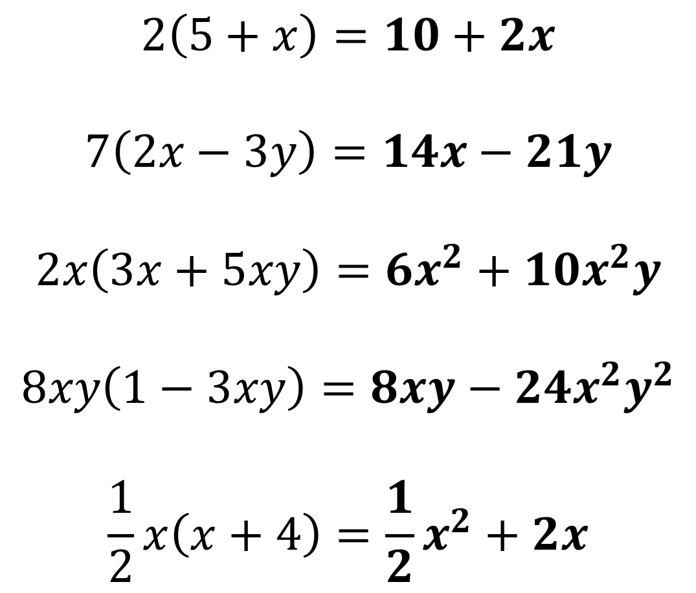
Examples
?
$$2\left(5+x\right)=10+2x$$
$$7\left(2x−3y\right)=14x−21y$$
$$2x\left(3x+5xy\right)=6x^{2}+10x^{2}y$$
$$8xy\left(1−3xy\right)=8xy−24x^{2}y^{2}$$
$$\frac{1}{2}x\left(x+4\right)=\frac{1}{2}x^{2}+2x$$
?
?
?
?

Slide 4

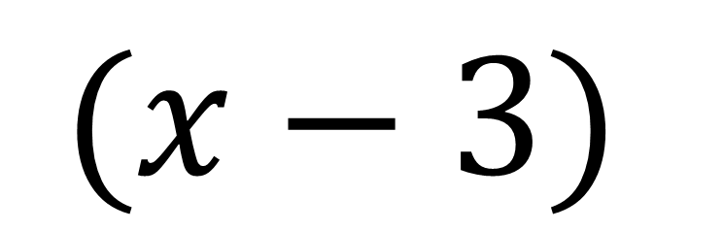
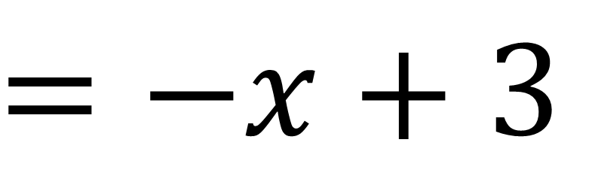


Dealing with negative sign
Click to give hint >
$$−$$
$$(x−3)$$
$$1$$
$$=−1x+3$$
?
$$=−x+3$$
?

Slide 5
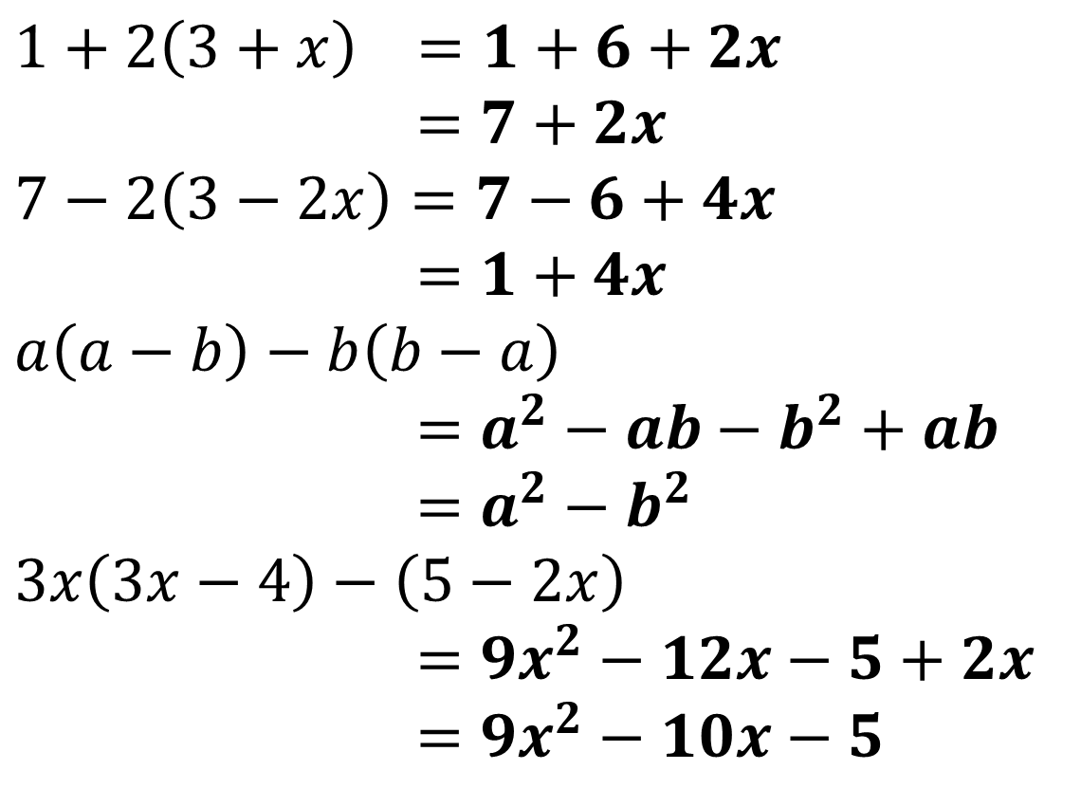
Expanding and Simplifying
If we have multiple brackets we can usually collect like terms after.
$$1+2\left(3+x\right) =1+6+2x \\ =7+2x$$
$$7−2\left(3−2x\right)=7−6+4x \\ =1+4x \\ a\left(a−b\right)−b\left(b−a\right) \\ =a^{2}−ab−b^{2}+ab \\ =a^{2}−b^{2} \\ 3x\left(3x−4\right)−\left(5−2x\right) \\ =9x^{2}−12x−5+2x \\ =9x^{2}−10x−5$$
?
?
?
?

Slide 6

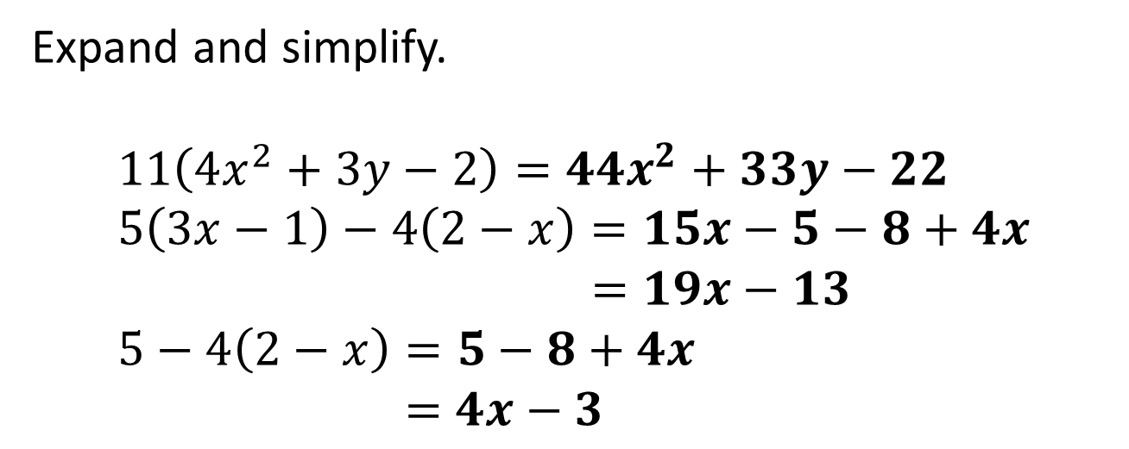
Test Your Understanding
Expand and simplify.
$$11\left(4x^{2}+3y−2\right)=44x^{2}+33y−22 \\ 5\left(3x−1\right)−4\left(2−x\right)=15x−5−8+4x \\ =19x−13 \\ 5−4\left(2−x\right)=5−8+4x \\ =4x−3$$
?
?
?
Key Note: $−3+4x$ is also acceptable, but $4x−3$ is preferable. Can you think why?

Slide 7



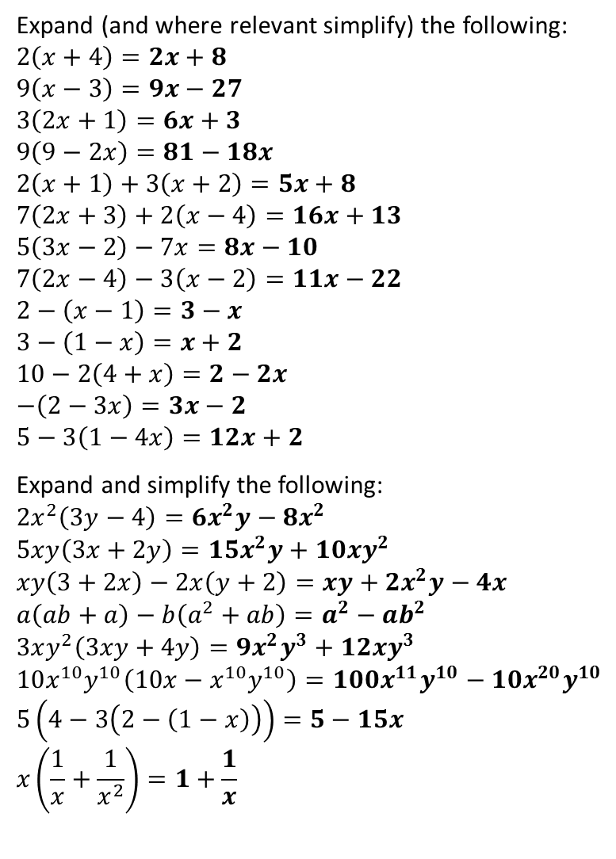

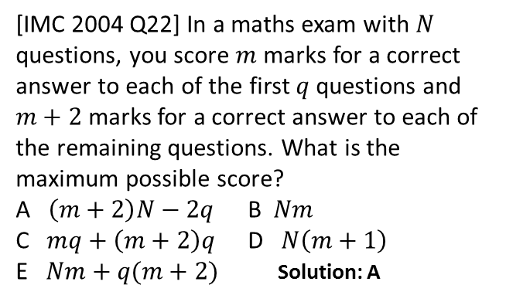




Exercises
1
Expand (and where relevant simplify) the following:
$$2\left(x+4\right)=2x+8 \\ 9\left(x−3\right)=9x−27 \\ 3\left(2x+1\right)=6x+3 \\ 9\left(9−2x\right)=81−18x \\ 2\left(x+1\right)+3\left(x+2\right)=5x+8 \\ 7\left(2x+3\right)+2\left(x−4\right)=16x+13 \\ 5\left(3x−2\right)−7x=8x−10 \\ 7\left(2x−4\right)−3\left(x−2\right)=11x−22 \\ 2−\left(x−1\right)=3−x \\ 3−\left(1−x\right)=x+2 \\ 10−2\left(4+x\right)=2−2x \\ −\left(2−3x\right)=3x−2 \\ 5−3\left(1−4x\right)=12x+2$$
Expand and simplify the following:
$$2x^{2}\left(3y−4\right)=6x^{2}y−8x^{2}$$
$$5xy\left(3x+2y\right)=15x^{2}y+10xy^{2} \\ xy\left(3+2x\right)−2x\left(y+2\right)=xy+2x^{2}y−4x$$
$$a\left(ab+a\right)−b\left(a^{2}+ab\right)=a^{2}−ab^{2} \\ 3xy^{2}\left(3xy+4y\right)=9x^{2}y^{3}+12xy^{3} \\ 10x^{10}y^{10}\left(10x−x^{10}y^{10}\right)=100x^{11}y^{10}−10x^{20}y^{10} \\ 5\left(4−3\left(2−\left(1−x\right)\right)\right)=5−15x \\ x\left(\frac{1}{x}+\frac{1}{x^{2}}\right)=1+\frac{1}{x}$$
Find the area and perimeter of the following (expand and simplify your answer)
3
a
?
b
?
$$2a$$
?
$$x+3$$
c
d
?
$$1$$
e
?
?
$$5$$
$$5$$
f
g
?
h
?
i
?
?
$$A=5x+15 \\ P=2x+16$$
j
?
?
$$2$$
k
?
$$A=10a−4\left(2a−2\right) \\ =2a+8 \\ P=2a+10$$
?
l
?
m
?
?
2
a
?
4
[IMC 2004 Q22] In a maths exam with $N$ questions, you score $m$ marks for a correct answer to each of the first $q$ questions and $m+2$ marks for a correct answer to each of the remaining questions. What is the maximum possible score?
A $\left(m+2\right)N−2q$ B $Nm$
C $mq+\left(m+2\right)q$ D $N\left(m+1\right)$
E $Nm+q(m+2)$ Solution: A
b
?
c
?
d
?
e
?
f
?
g
?
h
?
?

Slide 8



RECAP: Expanding single bracket
You already know how to expand a bracket when you have a single term in front of it…
?
$$x\left(2 + y\right)= 2x+xy$$
But more generally, what would happen if we multiplied two brackets together?
$$\left(x+2\right)\left(x+3\right)= ?$$
$$\left(x+y+1\right)\left(x−1\right)= ?$$

Slide 9


Starter
Work out the area of rectangle in two ways…
x
y
1) By using the sides of the big rectangle.
a
?
$$Area=(x+y)(a+b)$$
2) By combining the area of the four smaller rectangles.
b
?
$$Area=xa+xb+ya+yb$$

Slide 10
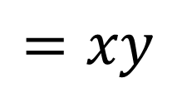

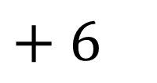
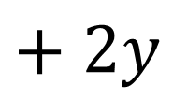
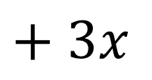
Expanding Brackets in General
!
To expand out two brackets, multiply each of the things in the first bracket by each of the things in the second bracket.
Click for Choice 1
Click for Choice 2
$$(x+2)(y+3)$$
Click for Choice 3
$$=xy$$
$$+ 3x$$
$$+ 2y$$
$$+ 6$$
Click for Choice 4

Slide 11

The Wall of Expansion Destiny
Test your understanding!
?
$$\left(x+2\right)\left(x+3\right) =x^{2}+3x+2x+6 =x^{2}+5x+6$$
?
?
?
$$\left(x−1\right)\left(x+1\right) =x^{2}+x−x−1 =x^{2}−1$$
?
?
$$\left(2x−1\right)\left(x+2\right) =2x^{2}+4x−x−2 =2x^{2}+3x−2$$
$$\left(2x−2\right)\left(y+6\right) =2xy+12x−2y−12$$
?
?
?
$${\left(x+3\right)}^{2} =\left(x+3\right)\left(x+3\right) =x^{2}+6x+9$$
$${\left(x−2\right)}^{2} =\left(x−2\right)\left(x−2\right) =x^{2}−4x+4$$
?
?
“To learn secret way of algebra ninja, expand you must.”

Slide 12


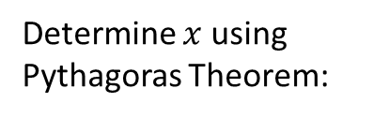


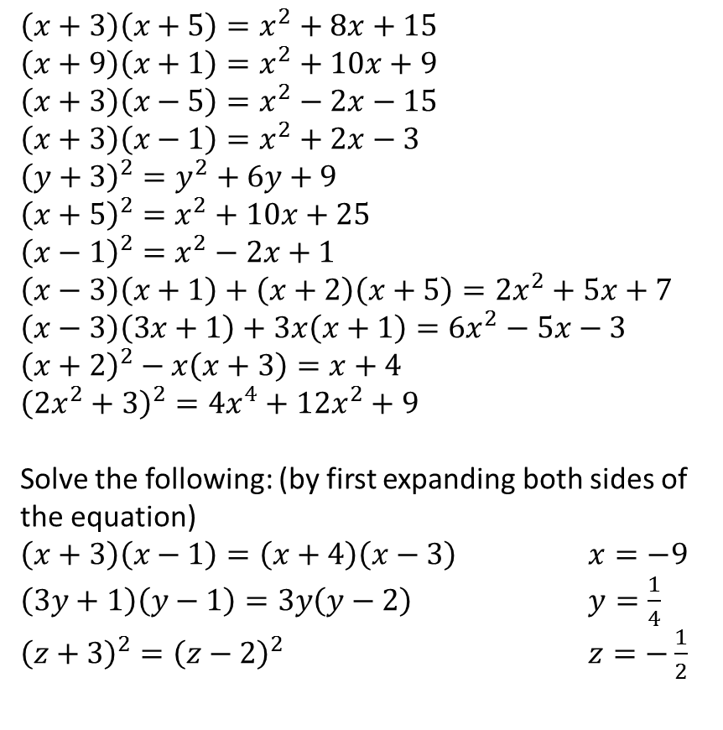




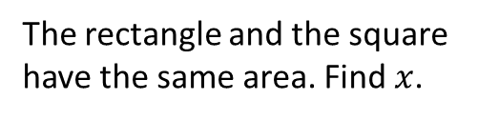

Exercise 1
?
1
$$\left(x+3\right)\left(x+5\right)=x^{2}+8x+15$$
$$\left(x+9\right)\left(x+1\right)=x^{2}+10x+9$$
$$\left(x+3\right)\left(x−5\right)=x^{2}−2x−15$$
$$\left(x+3\right)\left(x−1\right)=x^{2}+2x−3$$
$${\left(y+3\right)}^{2}=y^{2}+6y+9$$
$${\left(x+5\right)}^{2}=x^{2}+10x+25$$
$${\left(x−1\right)}^{2}=x^{2}−2x+1$$
$$\left(x−3\right)\left(x+1\right)+\left(x+2\right)\left(x+5\right)=2x^{2}+5x+7$$
$$\left(x−3\right)\left(3x+1\right)+3x\left(x+1\right)=6x^{2}−5x−3$$
$${\left(x+2\right)}^{2}−x\left(x+3\right)=x+4$$
$${\left(2x^{2}+3\right)}^{2}=4x^{4}+12x^{2}+9$$
Solve the following: (by first expanding both sides of the equation)
$\left(x+3\right)\left(x−1\right)=\left(x+4\right)\left(x−3\right)$ $x=−9$
$\left(3y+1\right)\left(y−1\right)=3y\left(y−2\right)$ $y=\frac{1}{4}$
${\left(z+3\right)}^{2}={\left(z−2\right)}^{2}$ $z=−\frac{1}{2}$
15
The rectangle and the square have the same area. Find $x$.
2
?
3
?
$$x+3$$
$$x$$
4
?
5
$$x−1$$
$$x$$
?
6
?
$$x=\frac{3}{2}$$
7
?
?
8
?
9
?
10
?
11
?
N
Determine $x$ using Pythagoras Theorem:
$$x+4$$
12
?
$$x−4$$
13
?
14
?
$$12$$
?
$$x=9$$

Slide 13









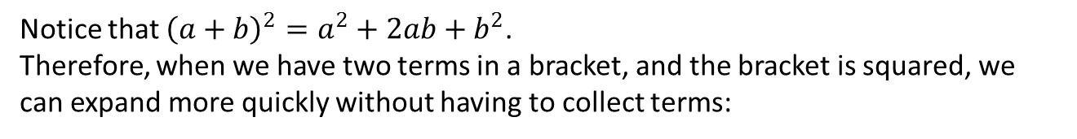












Superpower Skill #1:
Expanding square brackets quickly
?
Notice that ${\left(a+b\right)}^{2}=a^{2}+2ab+b^{2}$.
Therefore, when we have two terms in a bracket, and the bracket is squared, we can expand more quickly without having to collect terms:
Expression
1st Term Squared
2 x 1st Term x 2nd Term
2nd Term Squared
1
$${\left(x+3\right)}^{2}=$$
$$x^{2}$$
$$+6x$$
$$+9$$
2
$${\left(x−5\right)}^{2}=$$
?
?
?
$$x^{2}$$
$$−10x$$
$$+25$$
3
$${\left(x−8\right)}^{2}=$$
?
?
?
$$x^{2}$$
$$−16x$$
$$+64$$
4
?
?
?
$${\left(2x+1\right)}^{2}=$$
$${4x}^{2}$$
$$+4x$$
$$+1$$
?
?
?
5
$${\left(3x−2\right)}^{2}=$$
$${9x}^{2}$$
$$−12x$$
$$+4$$

Slide 14
Superpower Skill #2:
Being careful with negatives
You need to be really careful when subtracting an expression you are about to expand.
Expand 1 – (x + 3)(x – 4)
?
= 1 – (x² – x – 12)
= 1 – x² + x + 12
= 13 – x² + x
?
Bro Tip: Put the expanded expression in a bracket before you subtract it. This helps you avoid sign errors.
Had we not used brackets in the line above, we might have (wrongly) thought this term was negative.

Slide 15
Test Your Understanding
Expand the following.
1
x – (x + 4)(x – 1)
= x – (x² + 3x – 4)
= x – x² – 3x + 4
= 4 – x² – 2x
x² – (2x – 1)²
= x² – (4x² – 4x + 1)
= x² – 4x² + 4x – 1
= -3x² + 4x – 1
?
2
?

Slide 16
Superpower Skill #3:
Expanding brackets with more than 2 items
When there’s more than two items in each bracket, we still use the same rule to expand: Times each thing in the first bracket by each thing in the second bracket...
(x + 3)(x² + x – 2)
= x³ + x² – 2x + 3x² + 3x – 6
= x³ + 4x² + x – 6
?

Slide 17
Test Your Understanding
Expand the following.
1
(x + y)(x + y + 1)
= x² + xy + x + xy + y² + y
= x² + 2xy + y² + x + y
(x² + 3)(x² + x + 1)
= x⁴ + x³ + x² + 3x² + 3x + 3
= x⁴ + x3 + 4x² + 3x + 3
?
2
?

Slide 18
Exercise 2
1
Expand the following WITHOUT working.
(x + 1)² = x² + 2x + 1
(x – 3)² = x² – 6x + 9
(x + 4)² = x² + 8x + 16
(x – 5)² = x² – 10x + 25
(3x + 1)² = 9x² + 6x + 1
(4x – 3)² = 16x² – 24x + 9
(10x + 3)² = 100x² + 60x + 9
(x – y)² = x² – 2xy + y²
3
Expand the following
(x + 2)(x² + 2x + 1) = x³ + 4x² + 5x + 2
(2x + 1)(3x² – 4x + 2) = 6x² – 5x² + 2
(y² – y + 1)(1 – 2y) = -2y³ + 3y² – 3y + 1
(a - 1)(a² + a + 1) = a³ – 1
(x² + x + 1)² = x⁴ + 2x³ + 3x² + 2x + 1
Expand the following:
(Hint: it might help to deal with two brackets at a time)
(x + 1)⁰ = 1
(x + 1)¹ = x + 1
(x + 1)² = x² + 2x + 1
(x + 1)³ = x³ + 3x² + 3x + 1
(x + 1)⁴ = x⁴ + 4x³ + 6x² + 4x + 1
(x + 1)⁵ = x⁵ + 5x⁴ + 10x³ + 10x² + 5x + 1
Do you notice a pattern in the numbers? Try playing with the “nCr” button on your calculator to see if you can work out the first four terms in the expansion of (x + 1)¹⁰⁰.
Coefficients form Pascal’s triangle.
(x + 1)¹⁰⁰ = x¹⁰⁰ + 100x⁹⁹ + 4950x⁹⁸ + 161600x⁹⁷ + ...
a
?
a
?
b
?
b
?
c
?
c
?
d
?
d
?
e
?
e
?
f
?
N
g
?
h
?
?
?
2
Expand the following.
1 – x(x – 1) = 1 – x² + x
2 – (x + 1)(x + 2) = -x² – 3x
x – (x – 2)(x – 3) = -x² + 6x – 6
2x – (x – 3)² = -x² + 8x - 9
(2x + 1)² – (2x – 1)² = 8x
(3x + 3)(x – 1) – (2x – 3)(x + 2) = x² – x + 3
?
?
a
?
?
b
?
?
c
?
d
?
e
?
f
?
?

