Slide 1
Geometry Similarity and Congruency
Skipton Girls’ High School

Slide 2
Similarity vs Congruence
!
Two shapes are congruent if:
?
They are the same shape and size
(flipping is allowed)
!
Two shapes are similar if:
?
They are the same shape
(flipping is again allowed)
b
b
b
a
a
a

Slide 3
Similarity
These two triangles are similar. What is the missing length, and why?
5
?
7.5
8
12
There’s two ways we could solve this:
The ratio of the left side and bottom side is the same in both cases, i.e.:
$$\frac{5}{8}=\frac{x}{12}$$
Find scale factor: $\frac{12}{8}$
Then multiply or divide other sides by scale factor as appropriate.
$$x=5×\frac{12}{8}$$

Slide 4
Quickfire Examples
Given that the shapes are similar, find the missing side (the first 3 can be done in your head).
1
2
10
12
?
32
24
?
15
18
15
20
3
4
17
24
11
20
40
25
25.88
?
30
?

Slide 5
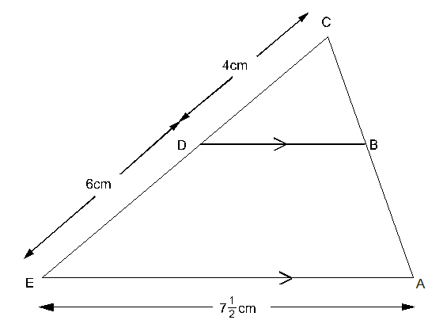
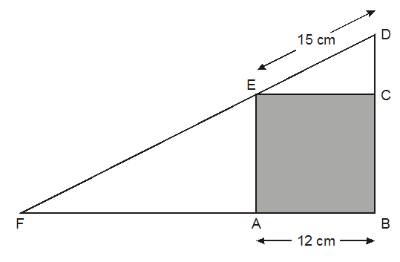
Harder Problems
Work out with your neighbour.
1
In the diagram BCD is similar to triangle ACE. Work out the length of BD.
2
The diagram shows a square inside a triangle. DEF is a straight line.
What is length EF?
(Hint: you’ll need to use Pythag at some point)
Since EC = 12cm, by Pythagoras, DC = 9cm. Using similar triangles AEF and CDE:
$$\frac{15}{9}=\frac{EF}{12}$$
Thus $EF=20$
?
$$\frac{BD}{4}=\frac{7.5}{10} → BD=3$$
?

Slide 6
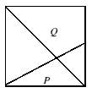
Exercise 1
$$7$$
$$A$$
$$2cm$$
A swimming pool is filled with water. Find $x$.
1
$$5cm$$
2
$$5$$
3
4
$$r$$
$$12cm$$
$$3.75$$
$$4$$
$$3cm$$
$$15m$$
$$x$$
$$y$$
$$12cm$$
$$10cm$$
$$9cm$$
$$1.2m$$
$$3.7m$$
?
$$B$$
$$C$$
$$x$$
$$x=5.25$$
$$y=5.6$$
?
$$r=3.75cm$$
$$BC=8cm \\ AC=12.5cm$$
?
$$x=10.8$$
$$1.8m$$
?
?
5
6
$$6$$
$$3$$
[Source: IMC] The diagram shows a square, a diagonal and a line joining a vertex to the midpoint of a side. What is the ratio of area $P$ to area $Q$?
N₁
N₂
$$8$$
$$5$$
$$4$$
$$x$$
$$5$$
$$x$$
$$7$$
$$3$$
?
$$x=4.2$$
$$x=4.5$$
?
$$4$$
N₃
Let $a$ and $b$ be the lengths of the two shorter sides of a right-angled triangle, and let $h$ be the distance from the right angle to the hypotenuse. Prove $\frac{1}{a^{2}}+\frac{1}{b^{2}}=\frac{1}{h^{2}}$
[Source: IMO] A square is inscribed in a 3-4-5 right-angled triangle as shown. What is the side-length of the square?
The two unlabelled triangles are similar, with bases in the ratio 2:1. If we made the sides of the square say 6, then the areas of the four triangles are 12, 15, 6, 3.
$$P:Q=6:15$$
$$A$$
?
Suppose the length of the square is $x$. Then $\frac{3−x}{x}=\frac{x}{4−x}$. Solving: $x=\frac{12}{7}$
By similar triangles $AH=\frac{ah}{b}$
Using Pythag on $ΔAOH:$
$$a^{2}=h^{2}+\frac{a^{2}h^{2}}{b^{2}}$$
Divide by $a^{2}h^{2}$ and we’re done.
?
$$H$$
?
$$a$$
$$h$$
$$O$$
$$b$$
$$B$$

Slide 7
A4/A3/A2 paper
$$x$$
“A” sizes of paper (A4, A3, etc.) have the special property that what two sheets of one size paper are put together, the combined sheet is mathematically similar to each individual sheet.
What therefore is the ratio of length to width?
A5
$$y$$
A4
$$\frac{x}{y}=\frac{2y}{x}$$
$$∴ x=\sqrt{2}y$$
So the length is $\sqrt{2}$ times greater than the width.
?
A5

Slide 8
GCSE: Congruent Triangles
Objective: Understand and use SSS, SAS, ASA and RHS conditions to prove the congruence of triangles using formal arguments.

Slide 9
What is congruence?
These triangles are similar.
These triangles are congruent.
?
?
They are the same shape.
They are the same shape and size.
(Only rotation and flips allowed)

Slide 10
Starter
Suppose two triangles have the side lengths. Do the triangles have to be congruent?
Yes, because the all the angles are determined by the sides.
Would the same be true if two quadrilaterals had the same lengths?
No. Square and rhombus have same side lengths but are different shapes.
?
?
In pairs, determine whether comparing the following pieces of information would be sufficient to show the triangles are congruent.
a
b
c
d
3 sides the same.
Two sides the same and angle between them.
All angles the same.
Two angles the same and a side the same.
Two sides the same and angle not between them.
✓Congruent
?
?
?
?
✓Congruent
× Not necessarily Congruent (but Similar)
✓Congruent
× Not necessarily Congruent (we’ll see why)

Slide 11
Proving congruence
GCSE papers will often ask for you to prove that two triangles are congruent.
There’s 4 different ways in which we could show this:
!
a
?
SAS
Two sides and the included angle.
b
?
ASA
Two angles and a side.
c
?
SSS
Three sides.
d
?
RHS
Right-angle, hypotenuse and another side.

Slide 12
Proving congruence
Why is it not sufficient to show two sides are the same and an angle are the same if the side is not included?
Try and draw a triangle with the same side lengths and indicated angle, but that is not congruent to this one.
Click to Reveal
In general, for “ASS”, there are always 2 possible triangles.

Slide 13
What type of proof
For triangle, identify if showing the indicating things are equal (to another triangle) are sufficient to prove congruence, and if so, what type of proof we have.
This angle is known from the other two.
⎦
SSS
SAS
⎦
SSS
SAS
⎦
SSS
SAS
⎦
SSS
SAS
ASA
RHS
ASA
RHS
ASA
RHS
ASA
RHS
⎦
SSS
SAS
⎦
SSS
SAS
⎦
SSS
SAS
⎦
SSS
SAS
ASA
RHS
ASA
RHS
ASA
RHS
ASA
RHS
Notes:
Ask why the features not sufficient for congruence are not sufficient.

Slide 14
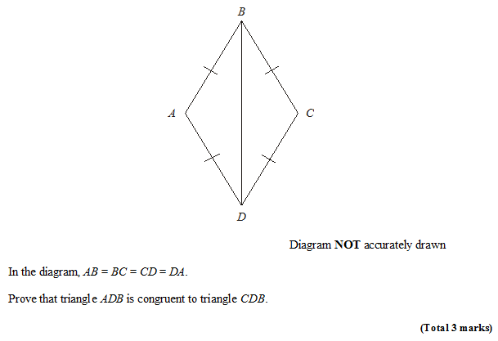
Example Proof
Nov 2008 Non Calc
STEP 1: Choose your appropriate proof (SSS, SAS, etc.)
STEP 2: Justify each of three things.
STEP 3: Conclusion, stating the proof you used.
Solution:
$AD=CD$ as given
$AB=BC$ as given
$BD$ is common.
$∴ΔADB$ is congruent to $ΔCDB$ by SSS.
?
Bro Tip: Always start with 4 bullet points: three for the three letters in your proof, and one for your conclusion.

Slide 15
Check Your Understanding
$$A$$
$$B$$
$ABCD$ is a parallelogram. Prove that triangles $ABC$ and $ACD$ are congruent.
(If you finish quickly, try proving another way)
$$D$$
$$C$$
Using $SSS$:
Using $SAS$:
Using $ASA$:
?
$AD=BC$ as opposite sides of parallelogram are equal in length.
$∠ADC=∠ABC$ as opposite angles of parallelogram are equal.
$AB=DC$ as opposite sides of parallelogram are equal in length.
$∴$ Triangles $ABC$ and $ACD$ are congruent by SAS.
?
$AC$ is common.
$AD=BC$ as opposite sides of parallelogram are equal in length.
$AB=DC$ for same reason.
$∴$ Triangles $ABC$ and $ACD$ are congruent by SSS.
?
$∠ADC=∠ABC$ as opposite angles of parallelogram are equal.
$AB=DC$ as opposite sides of parallelogram are equal in length.
$∠DAC=∠ACB$ as alternate angles are equal.
$∴$ Triangles $ABC$ and $ACD$ are congruent by ASA.

Slide 16
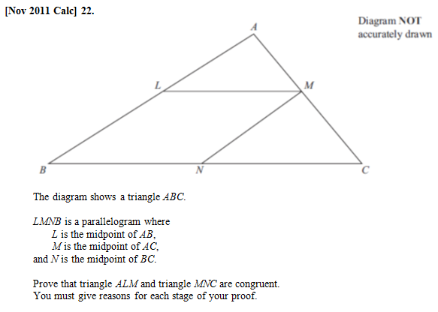
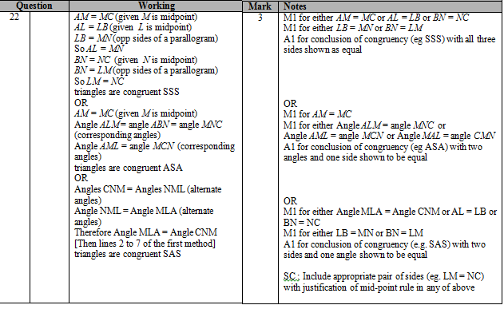
Exercises
(if multiple parts, only do (a) for now)
NOTE
Q1
?

Slide 17
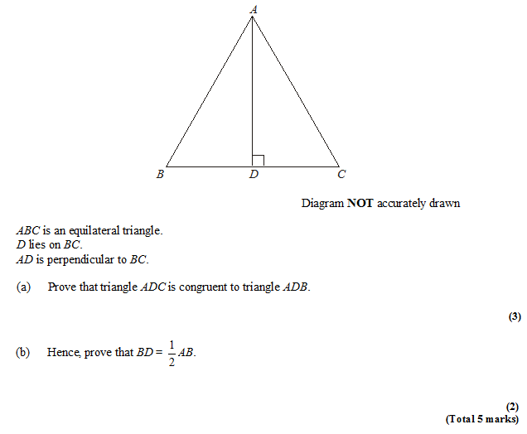
Exercises
Q2
?
AB = AC ($ABC$ is equilateral triangle)
AD is common.
ADC = ADB = 90$°$.
Therefore triangles congruent by RHS.
Since $ADC$ and $ADB$ are congruent triangles, $BD=DC$.
$BC=AB$ as $ABC$ is equilateral.
Therefore $BD=\frac{1}{2}BC=\frac{1}{2}AB$
?

Slide 18
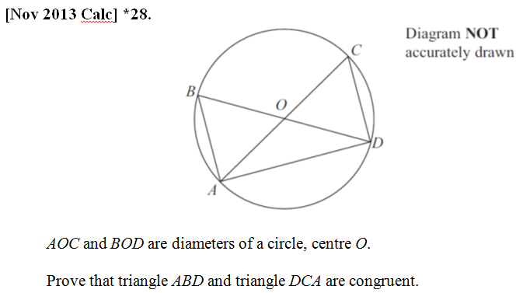
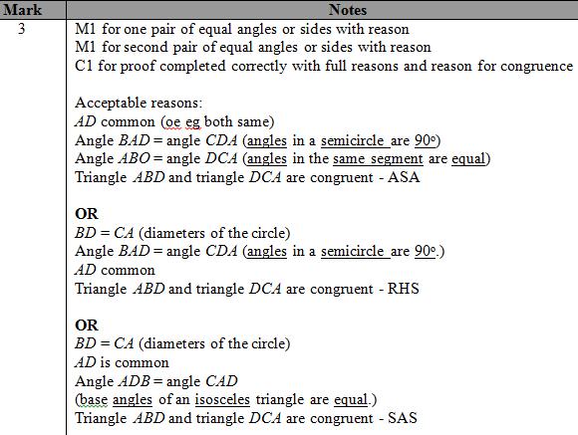
Congruent Triangles
Q3
?

Slide 19
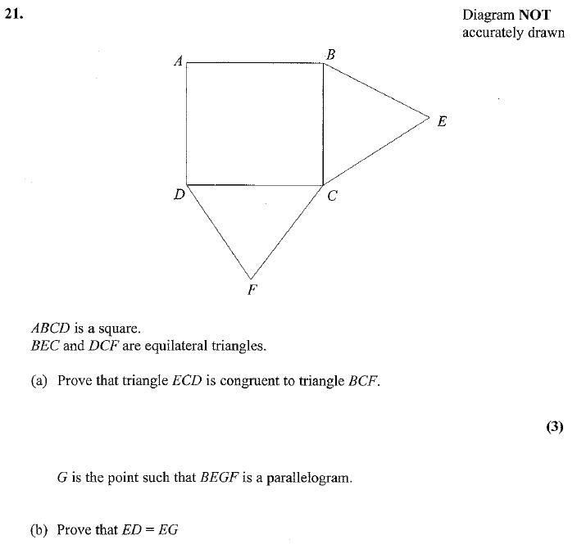
Exercises
Q4
BC = CE equal sides
CF = CD equal sides
BCF = DCE = 150º
BFC is congruent to ECD by SAS.
?
?
So BF=ED (congruent triangles)
BF = EG ( opp sides of parallelogram)
(2)

Slide 20
Check Your Understanding
What are the four types of congruent triangle proofs?
SSS, SAS, ASA (equivalent to AAS) and RHS.
What should be the structure of our proof?
Justification of each of the three letters, followed by conclusion in which we state which proof type we used.
What kinds of justifications can be used for sides and angles?
Circle Theorems, ‘common’ sides, alternate/corresponding angles, properties of parallelograms, sides/angles of regular polygon are equal.
?
?
?

Slide 21
Using completed proof to justify other sides/angles
In this proof, there was no easy way to justify that $AB=CD$.
However, once we’ve completed a congruent triangle proof, this provides a justification for other sides and angles being the same.
We might write as justification:
“As triangles ABD and DCA are congruent, $AB=CD$.”

Slide 22
Exercises
Q2
We earlier showed $ADC$ and $ADB$ are congruent, but couldn’t at that point use $BD=DC$ because we couldn’t justify it.
AB = AC ($ABC$ is equilateral triangle)
AD is common.
ADC = ADB = 90$°$.
Therefore triangles congruent by RHS.
Since $ADC$ and $ADB$ are congruent triangles, $BD=DC$.
$BC=AB$ as $ABC$ is equilateral.
Therefore $BD=\frac{1}{2}BC=\frac{1}{2}AB$
?

Slide 23
Exercises
Q4
BC = CE equal sides
CF = CD equal sides
BCF = DCE = 150º
BFC is congruent to ECD by SAS.
?
So BF=ED (congruent triangles)
BF = EG ( opp sides of parallelogram)
(2)

