Slide 1
GCSE: Fractions
Skipton Girls’ High School
Objectives: Be able to add, subtract, multiply and divide fractions, whether improper fractions or mixed numbers. Find fractions of an amount and solve problems involving successive fractions of an amount.

Slide 2
Teacher Guidance
Possible lesson structure:
Lesson 1: Equivalent fractions, adding/subtracting fractions.
Lesson 2: Mixed numbers, adding/subtracting mixed numbers.
Simple multiplication/cross-cancelling.
Lesson 3: Multiplying mixed numbers. Dividing fractions.
Lesson 4: Fractions of amounts, reverse fractions of amounts.
Problem solving involving fractions of amounts.
Go >
Go >
Go >
Go >

Slide 3
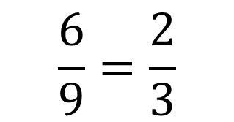
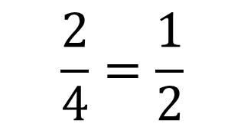
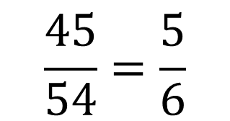
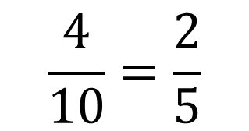
STARTER :: Equivalent Fractions
Give an equivalent fraction which is as simple as possible.
?
?
$$\frac{2}{4}=\frac{1}{2}$$
$$\frac{6}{9}=\frac{2}{3}$$
?
?
$$\frac{4}{10}=\frac{2}{5}$$
$$\frac{45}{54}=\frac{5}{6}$$
Lots of lines here

Slide 4
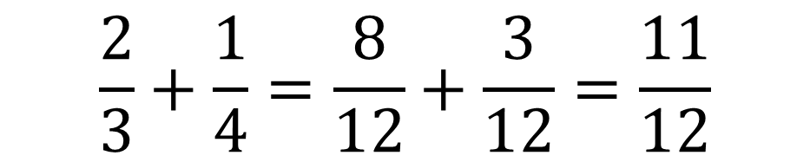
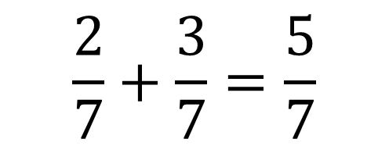
Adding Fractions
Adding fractions is very simple if the denominators are the same.
?
$$\frac{2}{7}+\frac{3}{7}=\frac{5}{7}$$
“I ate 2 sevenths of the pizza followed by 3 sevenths. How much have I eaten?”
Therefore what should be our strategy if the denominators are different?
$$\frac{2}{3}+\frac{1}{4}=\frac{8}{12}+\frac{3}{12}=\frac{11}{12}$$
?
?
?
?
Use equivalent fractions! Find a number both of the denominators go into (preferably the smallest).

Slide 5
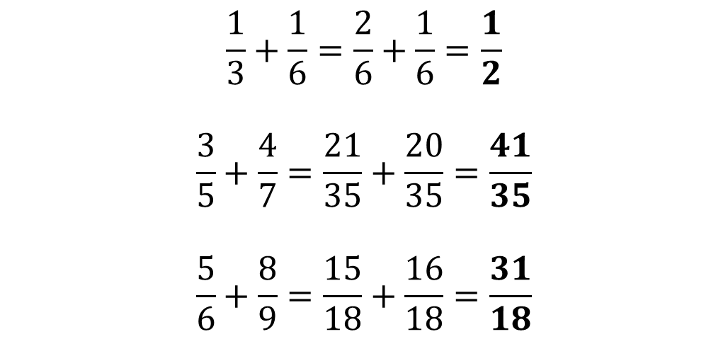
More Examples
?
$$\frac{1}{3}+\frac{1}{6}=\frac{2}{6}+\frac{1}{6}=\frac{1}{2}$$
$$\frac{3}{5}+\frac{4}{7}=\frac{21}{35}+\frac{20}{35}=\frac{41}{35}$$
$$\frac{5}{6}+\frac{8}{9}=\frac{15}{18}+\frac{16}{18}=\frac{31}{18}$$
?
?

Slide 6

Check Your Understanding
?
$$\frac{3}{8}+\frac{1}{4}=\frac{3}{8}+\frac{2}{8}=\frac{5}{8}$$
$$\frac{7}{6}−\frac{6}{7}=\frac{49}{42}−\frac{36}{42}=\frac{13}{42}$$
$$\frac{1}{2}+\frac{1}{3}+\frac{1}{4}+\frac{1}{5}=\frac{30}{60}+\frac{20}{60}+\frac{15}{60}+\frac{12}{60}=\frac{77}{60}$$
$$\frac{1}{2}+\frac{1}{a}=\frac{a}{2a}+\frac{2}{2a}=\frac{a+2}{2a}$$
1
?
2
?
3
?
N

Slide 7
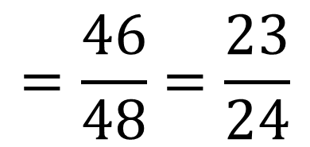

A Quicker (Mental) Method
We can multiply the numerators diagonally.
$$\frac{5}{6}+\frac{1}{8}=$$
40
+ 6
$$=\frac{46}{48}=\frac{23}{24}$$
48
Step 1: Multiply the denominators (note: this guarantees you get a number both 6 and 8 go into, but it may not be the smallest!)
Disadvantages of this method:
Because we’re not finding smallest denominator, further simplification may be required.
Doesn’t extend to more than two fractions.
?
Step 2: Since the 6 got multiplied by 8, so does the 3. i.e. We are multiplying diagonally.
Step 3: And repeat with the other numerator.

Slide 8
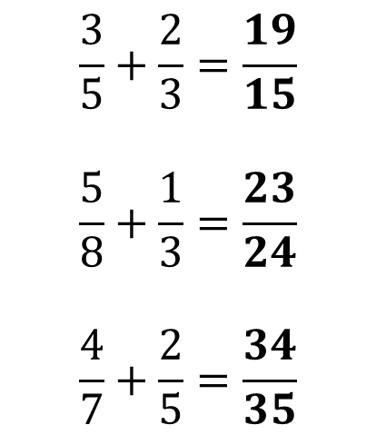
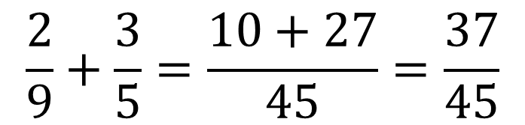
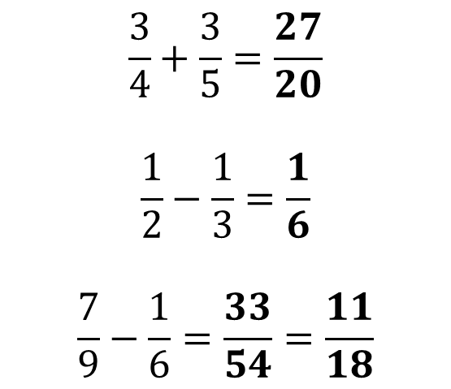
A Quicker (Mental) Method
Another example:
?
$$\frac{2}{9}+\frac{3}{5}=\frac{10+27}{45}=\frac{37}{45}$$
Quickfire Questions (in your head!)
?
?
$$\frac{3}{5}+\frac{2}{3}=\frac{19}{15}$$
$$\frac{5}{8}+\frac{1}{3}=\frac{23}{24}$$
$$\frac{4}{7}+\frac{2}{5}=\frac{34}{35}$$
$$\frac{3}{4}+\frac{3}{5}=\frac{27}{20}$$
$$\frac{1}{2}−\frac{1}{3}=\frac{1}{6}$$
$$\frac{7}{9}−\frac{1}{6}=\frac{33}{54}=\frac{11}{18}$$
?
?
?
?

Slide 9
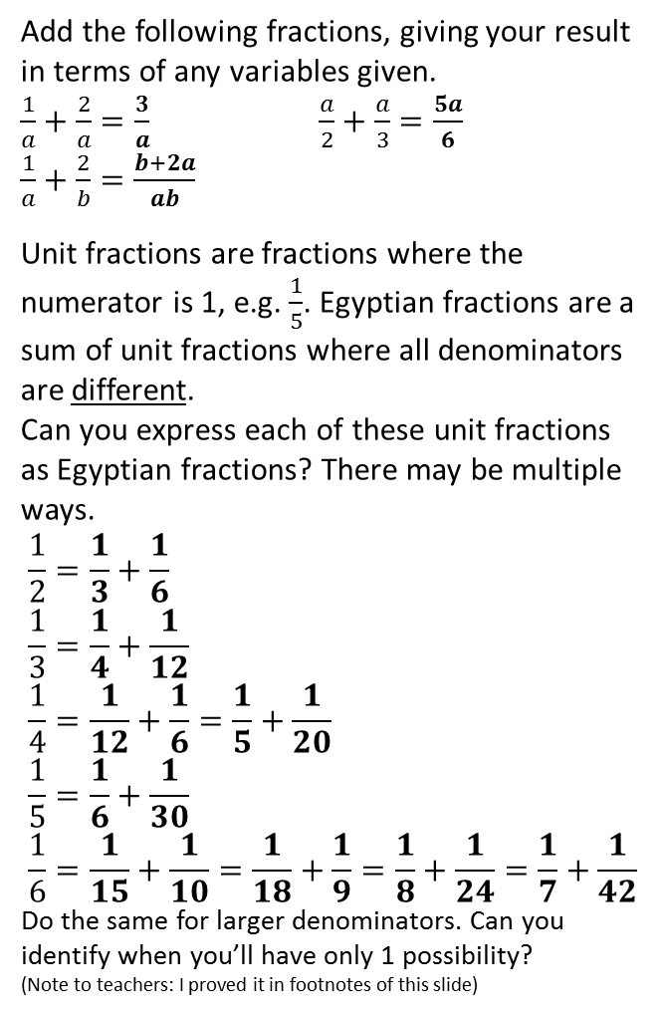


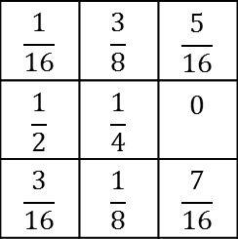
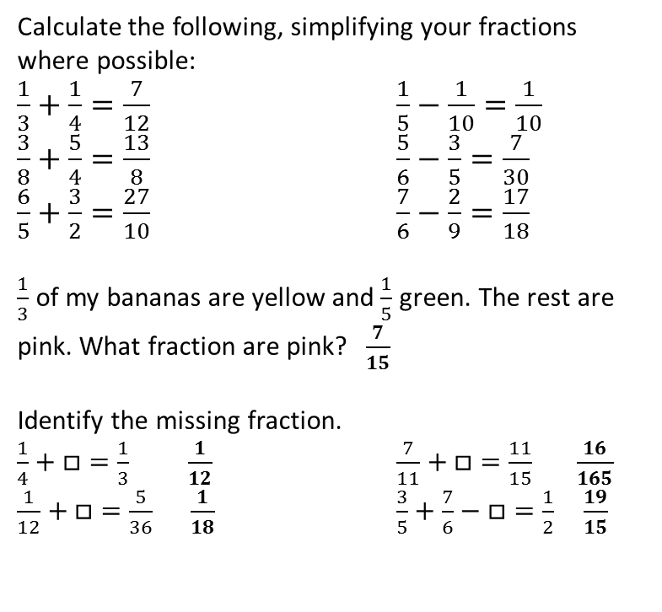
Exercise 1
No calculators!
1
Calculate the following, simplifying your fractions where possible:
$\frac{1}{3}+\frac{1}{4}=\frac{7}{12}$ $\frac{1}{5}−\frac{1}{10}=\frac{1}{10}$
$\frac{3}{8}+\frac{5}{4}=\frac{13}{8}$ $\frac{5}{6}−\frac{3}{5}=\frac{7}{30}$
$\frac{6}{5}+\frac{3}{2}=\frac{27}{10}$ $\frac{7}{6}−\frac{2}{9}=\frac{17}{18}$
$\frac{1}{3}$ of my bananas are yellow and $\frac{1}{5}$ green. The rest are pink. What fraction are pink? $\frac{7}{15}$
Identify the missing fraction.
$\frac{1}{4}+□=\frac{1}{3}$ $\frac{1}{12}$ $\frac{7}{11}+□=\frac{11}{15}$ $\frac{16}{165}$
$\frac{1}{12}+□=\frac{5}{36}$ $\frac{1}{18}$ $\frac{3}{5}+\frac{7}{6}−□=\frac{1}{2} \frac{19}{15}$
6
Add the following fractions, giving your result in terms of any variables given.
$\frac{1}{a}+\frac{2}{a}=\frac{3}{a}$ $\frac{a}{2}+\frac{a}{3}=\frac{5a}{6}$
$\frac{1}{a}+\frac{2}{b}=\frac{b+2a}{ab}$
Unit fractions are fractions where the numerator is 1, e.g. $\frac{1}{5}$. Egyptian fractions are a sum of unit fractions where all denominators are different.
Can you express each of these unit fractions as Egyptian fractions? There may be multiple ways.
$$\frac{1}{2}=\frac{1}{3}+\frac{1}{6} \\ \frac{1}{3}=\frac{1}{4}+\frac{1}{12} \\ \frac{1}{4}=\frac{1}{12}+\frac{1}{6}=\frac{1}{5}+\frac{1}{20} \\ \frac{1}{5}=\frac{1}{6}+\frac{1}{30} \\ \frac{1}{6}=\frac{1}{15}+\frac{1}{10}=\frac{1}{18}+\frac{1}{9}=\frac{1}{8}+\frac{1}{24}=\frac{1}{7}+\frac{1}{42}$$
Do the same for larger denominators. Can you identify when you’ll have only 1 possibility?
(Note to teachers: I proved it in footnotes of this slide)
a
?
b
?
a
?
b
?
c
?
d
?
c
?
e
?
f
?
N
2
?
3
a
?
b
?
1 possibility
c
?
d
?
?
?
Calculate:
$\frac{2}{3}−\left(\frac{1}{4}+\frac{1}{5}\right)=\frac{13}{60}$
$\frac{8}{37}−\frac{3}{49}=\frac{281}{1813}$
$\left(\frac{4}{9}−\frac{2}{7}\right)−\left(\frac{8}{7}−\frac{2}{9}\right)=−\frac{16}{21}$
1 possibility
4
$$\frac{1}{16}$$ | $$\frac{3}{8}$$ | $$\frac{5}{16}$$
$$\frac{1}{2}$$ | $$\frac{1}{4}$$ | $$0$$
$$\frac{3}{16}$$ | $$\frac{1}{8}$$ | $$\frac{7}{16}$$
5
a
?
2 possibilities
?
?
b
?
1 possibility
?
c
?
4 possibilities
Complete the magic square (where the total of each row, column and long diagonal is the same).
$\frac{1}{3}+\frac{1}{8}+\frac{1}{27}=\frac{107}{216}$
d
?
Notes:
Proof for unit fractions that will be completely beyond most Year 7s: Suppose we want to express 1/c as 1/a + 1/b. Therefore 1/c = (a+b)/ab and so cross-multiplying and expanding we get ab – ac – bc = 0. Factorising gives (a – c)(b – c) – c^2 = 0 thus (a – c)(b – c) = c^2. If we find two numbers that multiply to give c^2, then we can add c to each to give a and b. For example, if we had 1/7, then numbers which multiply to give 49 are 1 x 49, so adding 7 to each gives 8 and 56, i.e. 1/7 = 1/8 + 1/56. If c is prime, then there is only one pair of distinct numbers which multiplies to give c^2, and thus there is only one possibility.

Slide 10
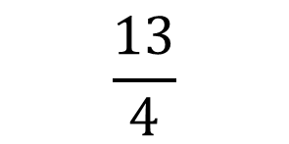

Mixed Numbers $⇔$ Improper Fractions
Improper fractions are where the numerator is greater than the denominator.
Mixed numbers have an integer and fractional part.
?
$$\frac{13}{4}$$
$$3\frac{1}{4}$$
?
We could make up 3 wholes using quarters (because 4 goes into 13 three times).
The remainder was 1, so we have 1 quarter left over.

Slide 11
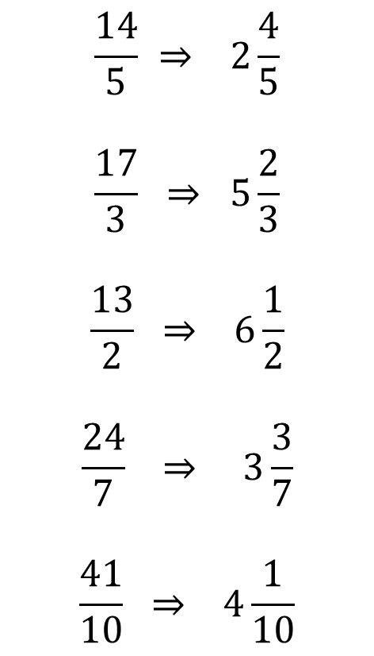

Mixed Numbers $⇔$ Improper Fractions
How many thirds does the 4 wholes give you?
?
$$\frac{14}{5} ⇒ 2\frac{4}{5}$$
$$\frac{17}{3} ⇒ 5\frac{2}{3}$$
$$\frac{13}{2} ⇒ 6\frac{1}{2}$$
$$\frac{24}{7} ⇒ 3\frac{3}{7}$$
$$\frac{41}{10} ⇒ 4\frac{1}{10}$$
?
$$4\frac{1}{3} ⇒ \frac{13}{3}$$
$$2\frac{3}{5} ⇒ \frac{13}{5}$$
$$7\frac{1}{2} ⇒ \frac{15}{2}$$
$$8\frac{2}{3} ⇒ \frac{26}{3}$$
$$11\frac{6}{7} ⇒ \frac{83}{7}$$
?
?
?
?
?
?
?
?

Slide 12

Adding Mixed Numbers
To add mixed numbers:
$$3\frac{1}{2}+5\frac{1}{3} =3\frac{3}{6}+5\frac{2}{6} \\ =5\frac{5}{6}$$
$$2\frac{5}{6}+5\frac{1}{3}=2\frac{5}{6}+5\frac{2}{6} \\ =7\frac{7}{6} \\ =8\frac{1}{6}$$
?
Make fractional parts the same.
?
Add whole parts and fractional parts separately.
?
?
If we’ve ‘overflown’ into the next whole, we need to carry.
?

Slide 13



Subtracting Mixed Numbers
To subtract mixed numbers…
$$9\frac{1}{3}−4\frac{1}{2}=9\frac{2}{6}−4\frac{3}{6} \\ =8\frac{8}{6}−4\frac{3}{6} \\ =4\frac{5}{6}$$
(Alternatively you can just convert both to improper fractions and subtract as normal)
?
We’d end up with a negative number for the fractions. Can we borrow a whole? (In the same way we borrow in column subtraction)
?
?
$$56\frac{2}{5}−40\frac{3}{7} \\ =56\frac{14}{35}−40\frac{15}{35} \\ =55\frac{49}{35}−40\frac{15}{35} \\ =15\frac{34}{35}$$
$$7\frac{1}{4}−3\frac{2}{3}=7\frac{3}{12}−3\frac{8}{12} \\ =6\frac{15}{12}−3\frac{8}{12} \\ =3\frac{7}{12}$$
?
?
?
?
?
?

Slide 14
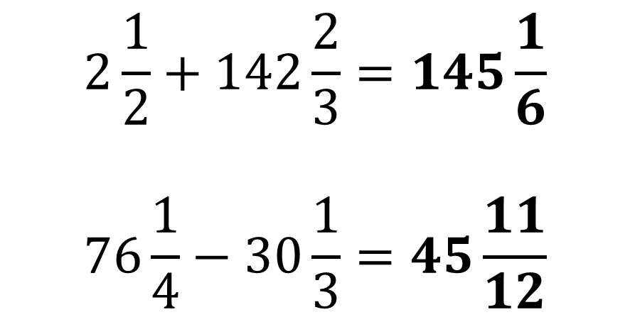
Check Your Understanding
?
$$2\frac{1}{2}+142\frac{2}{3}=145\frac{1}{6} \\ 76\frac{1}{4}−30\frac{1}{3}=45\frac{11}{12}$$
?

Slide 15

Multiplying Fractions
Skills to do with multiplying fractions:
Multiply simple fractions.
Multiply a mixture of whole numbers, proper fractions and mixed numbers.
Understand ‘cross cancelling’ with fractions, including with several fractions where there may be a pattern of cancelling.
Find a fraction of an amount (including a fraction of a fraction).
Understand how to deal with fractions nested inside fractions.
Solve puzzles involving fractions, particularly involving successive fractions of an amount and what’s left.
Multiplying fractions is fairly easy. Simply multiply numerators and denominators.
?
$$\frac{3}{4}×\frac{5}{7}=\frac{15}{28}$$

Slide 16


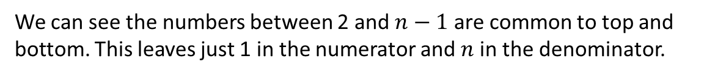
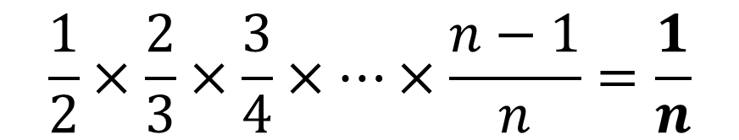
Cross-Cancelling
Recall that we can simplify fractions by dividing top and bottom by a common factor.
Since numerators are being combined and denominators likewise, there’s nothing preventing us cancelling any numerator with any denominator.
1
5
?
$$\frac{6}{11}×\frac{55}{18}=\frac{5}{3}$$
1
3
?
$$\frac{10}{21}×\frac{14}{15}=\frac{4}{9}$$
?
$$\frac{1}{2}×\frac{2}{3}×\frac{3}{4}×…×\frac{n−1}{n}=\frac{1}{n}$$
We can see the numbers between 2 and $n−1$ are common to top and bottom. This leaves just 1 in the numerator and $n$ in the denominator.

Slide 17
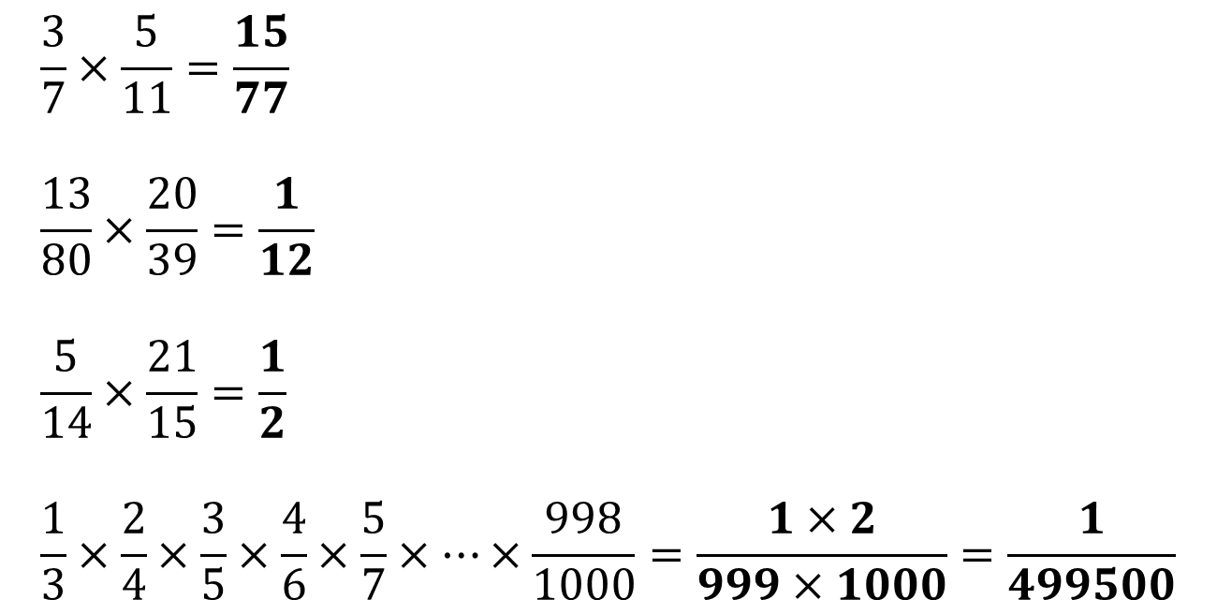
Test Your Understanding
Ensure you simplify your fraction.
?
$$\frac{3}{7}×\frac{5}{11}=\frac{15}{77} \\ \frac{13}{80}×\frac{20}{39}=\frac{1}{12} \\ \frac{5}{14}×\frac{21}{15}=\frac{1}{2} \\ \frac{1}{3}×\frac{2}{4}×\frac{3}{5}×\frac{4}{6}×\frac{5}{7}×…×\frac{998}{1000}=\frac{1×2}{999×1000}=\frac{1}{499500}$$
A
B
?
?
C
?
N
All numbers between 3 and 998 will cancel top and bottom. This leaves just 1 and 2 in the numerator and 999 and 1000 in the denominator.

Slide 18
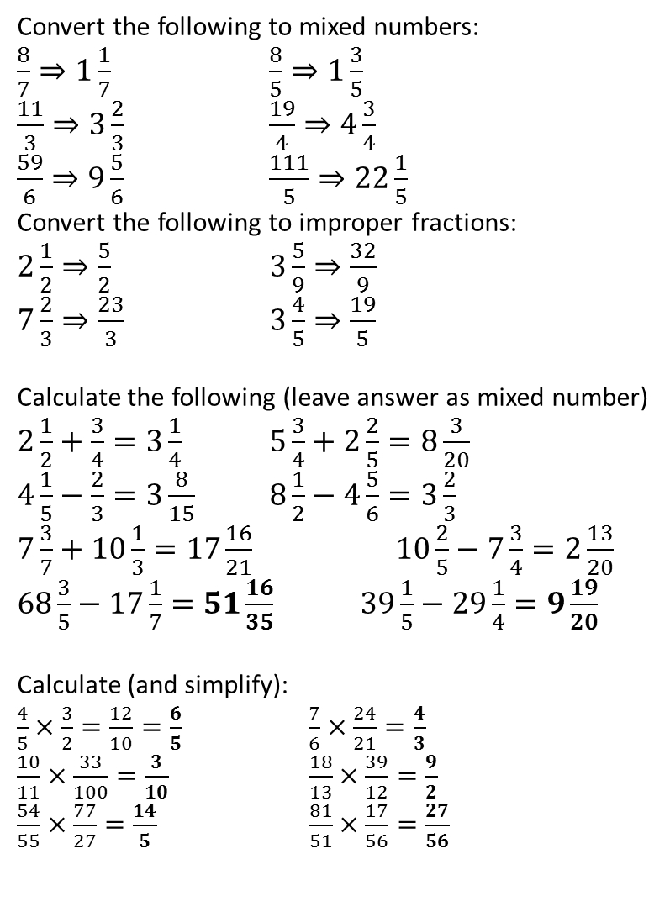
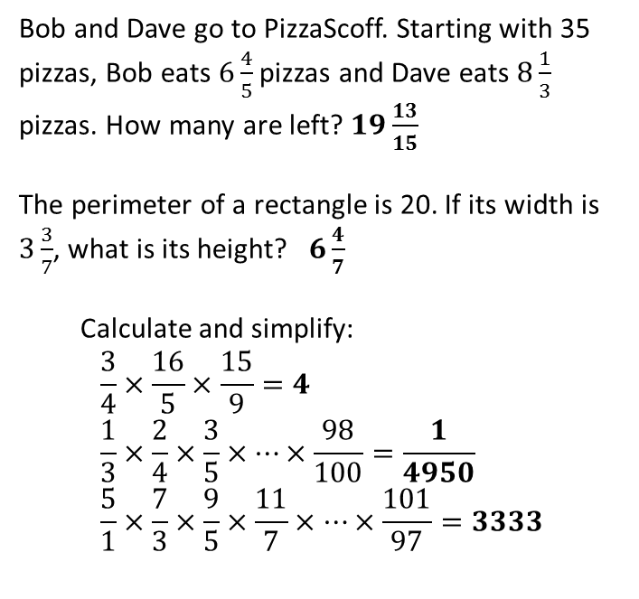

Exercise 2
1
Convert the following to mixed numbers:
$\frac{8}{7}⇒1\frac{1}{7}$ $\frac{8}{5}⇒1\frac{3}{5}$
$\frac{11}{3}⇒3\frac{2}{3}$ $\frac{19}{4}⇒4\frac{3}{4}$
$\frac{59}{6}⇒9\frac{5}{6}$ $\frac{111}{5}⇒22\frac{1}{5}$
Convert the following to improper fractions:
$2\frac{1}{2}⇒\frac{5}{2}$ $3\frac{5}{9}⇒\frac{32}{9}$
$7\frac{2}{3}⇒\frac{23}{3}$ $3\frac{4}{5}⇒\frac{19}{5}$
Calculate the following (leave answer as mixed number)
$2\frac{1}{2}+\frac{3}{4}=3\frac{1}{4}$ $5\frac{3}{4}+2\frac{2}{5}=8\frac{3}{20}$
$4\frac{1}{5}−\frac{2}{3}=3\frac{8}{15}$ $8\frac{1}{2}−4\frac{5}{6}=3\frac{2}{3}$
$7\frac{3}{7}+10\frac{1}{3}=17\frac{16}{21}$ $10\frac{2}{5}−7\frac{3}{4}=2\frac{13}{20}$
$68\frac{3}{5}−17\frac{1}{7}=51\frac{16}{35}$ $39\frac{1}{5}−29\frac{1}{4}=9\frac{19}{20}$
Calculate (and simplify):
$\frac{4}{5}×\frac{3}{2}=\frac{12}{10}=\frac{6}{5}$ $\frac{7}{6}×\frac{24}{21}=\frac{4}{3}$
$\frac{10}{11}×\frac{33}{100}=\frac{3}{10}$ $\frac{18}{13}×\frac{39}{12}=\frac{9}{2}$
$\frac{54}{55}×\frac{77}{27}=\frac{14}{5}$ $\frac{81}{51}×\frac{17}{56}=\frac{27}{56}$
Bob and Dave go to PizzaScoff. Starting with 35 pizzas, Bob eats $6\frac{4}{5}$ pizzas and Dave eats $8\frac{1}{3}$ pizzas. How many are left? $19\frac{13}{15}$
The perimeter of a rectangle is 20. If its width is $3\frac{3}{7}$, what is its height? $6\frac{4}{7}$
Calculate and simplify:
$$\frac{3}{4}×\frac{16}{5}×\frac{15}{9}=4 \\ \frac{1}{3}×\frac{2}{4}×\frac{3}{5}×…×\frac{98}{100}=\frac{1}{4950} \\ \frac{5}{1}×\frac{7}{3}×\frac{9}{5}×\frac{11}{7}×…×\frac{101}{97}=3333$$
5
a
?
b
?
c
?
d
?
?
e
?
f
?
6
2
?
a
?
b
?
c
?
d
?
7
a
?
3
?
a
?
b
?
b
c
?
d
?
N
?
e
?
f
?
g
?
h
?
N
Simplify:
$$\frac{3}{4}×\frac{5}{4}×\frac{4}{5}×\frac{6}{5}×\frac{5}{6}×\frac{7}{6}…×\frac{n−1}{n}×\frac{n+1}{n}$$
After the first fraction, each pair of fractions cancel. This leaves just the first and last fraction, giving $\frac{3\left(n+1\right)}{4n}$
4
a
?
b
?
?
?
c
?
d
e
?
f
?

Slide 19
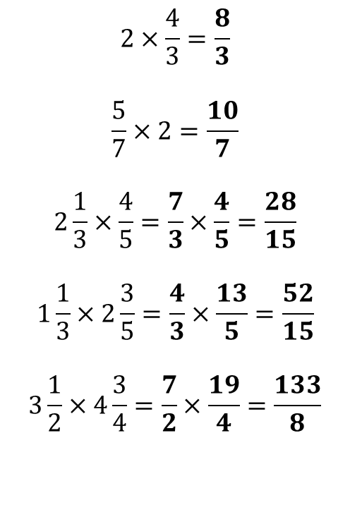


Multiplying Mixed Numbers
If the numbers are not improper fractions, convert them into improper fractions.
Examples:
Quickfire Questions:
Schoolboy Error: thinking the answer is $\frac{8}{6}.$
?
?
$$3\frac{1}{2}×2\frac{1}{4}=\frac{7}{2}×\frac{9}{4}=\frac{63}{8}$$
$$4×3\frac{2}{5}=\frac{4}{1}×\frac{17}{5}=\frac{68}{5}$$
$$7\frac{2}{3}×2=\frac{23}{3}×\frac{2}{1}=\frac{46}{3}$$
$$2×\frac{4}{3}=\frac{8}{3}$$
$$\frac{5}{7}×2=\frac{10}{7}$$
$$2\frac{1}{3}×\frac{4}{5}=\frac{7}{3}×\frac{4}{5}=\frac{28}{15}$$
$$1\frac{1}{3}×2\frac{3}{5}=\frac{4}{3}×\frac{13}{5}=\frac{52}{15}$$
$$3\frac{1}{2}×4\frac{3}{4}=\frac{7}{2}×\frac{19}{4}=\frac{133}{8}$$
?
?
?
?
?
?

Slide 20
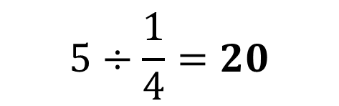
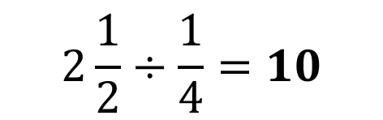

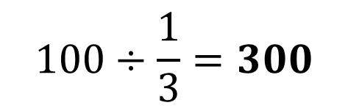
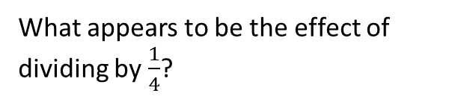
Dividing Fractions
Mental division
$$2\frac{1}{2}÷\frac{1}{4}=10$$
What if this was phrased as “how many quarter pizzas go into two and a half pizzas”?
?
$$5÷\frac{1}{4}=20$$
?
What appears to be the effect of dividing by $\frac{1}{4}$?
$$100÷\frac{1}{3}=300$$
?
Or by $\frac{1}{3}$?

Slide 21
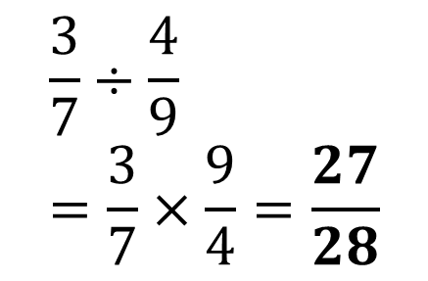
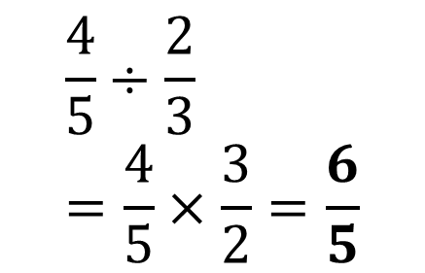



Dividing Fractions
More generally…
Reciprocate (i.e. ‘flip’) the second fraction, and use multiplication instead.
$$\frac{4}{5}÷\frac{2}{3} \\ =\frac{4}{5}×\frac{3}{2}=\frac{6}{5}$$
$$\frac{3}{7}÷\frac{4}{9} \\ =\frac{3}{7}×\frac{9}{4}=\frac{27}{28}$$
?
?
$$2\frac{1}{2}÷1\frac{1}{3} \\ =\frac{5}{2}÷\frac{4}{3} \\ =\frac{5}{2}×\frac{3}{4}=\frac{15}{8}$$
$$2÷3\frac{1}{2} \\ =\frac{2}{1}÷\frac{7}{2} \\ =\frac{2}{1}×\frac{2}{7}=\frac{4}{7}$$
$$8÷1\frac{4}{5} \\ =\frac{8}{1}÷\frac{9}{5} \\ =\frac{8}{1}×\frac{5}{9}=\frac{40}{9}$$
?
?
?

Slide 22


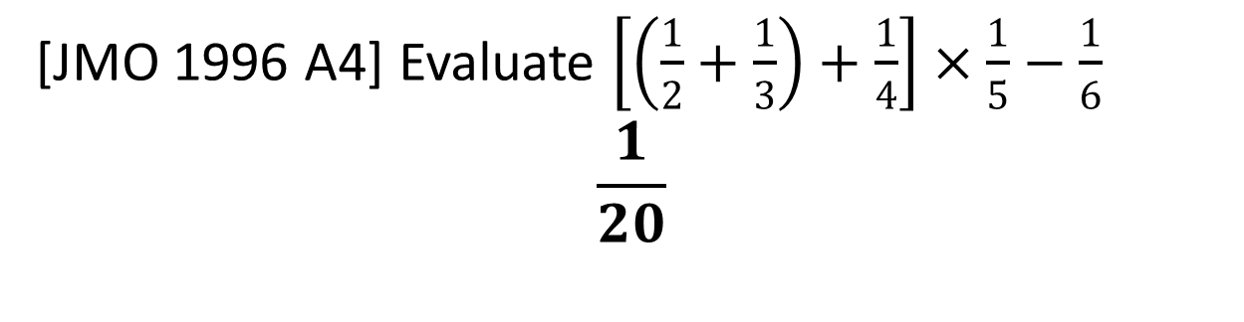

Test Your Understanding
$$3\frac{2}{5}×4 \\ =\frac{17}{5}×\frac{4}{1} \\ =\frac{68}{5}$$
$$8÷\frac{1}{5} \\ =40$$
$$6÷1\frac{3}{4} \\ =\frac{6}{1}÷\frac{7}{4} \\ =\frac{6}{1}×\frac{4}{7}$$
A
B
C
?
?
?
D
[JMO 1996 A4] Evaluate $\left[\left(\frac{1}{2}+\frac{1}{3}\right)+\frac{1}{4}\right]×\frac{1}{5}−\frac{1}{6}$
$$\frac{1}{20}$$
?

Slide 23
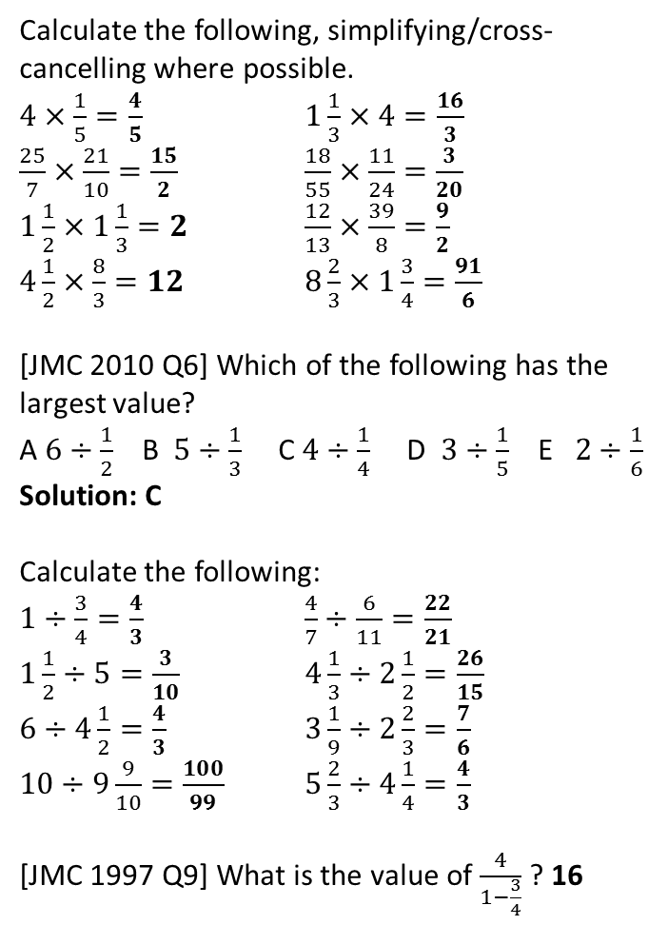
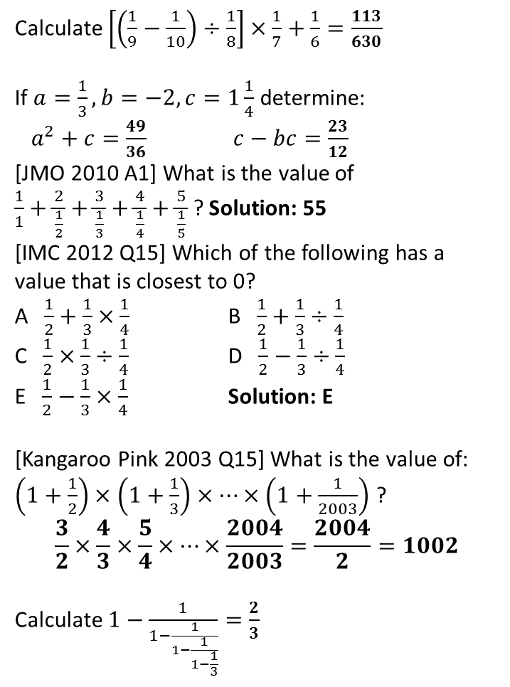
Exercise 3
Calculate the following, simplifying/cross-cancelling where possible.
$4×\frac{1}{5}=\frac{4}{5}$ $1\frac{1}{3}×4=\frac{16}{3}$
$\frac{25}{7}×\frac{21}{10}=\frac{15}{2}$ $\frac{18}{55}×\frac{11}{24}=\frac{3}{20}$
$1\frac{1}{2}×1\frac{1}{3}=2$ $\frac{12}{13}×\frac{39}{8}=\frac{9}{2}$
$4\frac{1}{2}×\frac{8}{3}=12$ $8\frac{2}{3}×1\frac{3}{4}=\frac{91}{6}$
[JMC 2010 Q6] Which of the following has the largest value?
A $6÷\frac{1}{2}$ B $5÷\frac{1}{3}$ C $4÷\frac{1}{4}$ D $3÷\frac{1}{5}$ E $2÷\frac{1}{6}$
Solution: C
Calculate the following:
$1÷\frac{3}{4}=\frac{4}{3}$ $\frac{4}{7}÷\frac{6}{11}=\frac{22}{21}$
$1\frac{1}{2}÷5=\frac{3}{10}$ $4\frac{1}{3}÷2\frac{1}{2}=\frac{26}{15}$
$6÷4\frac{1}{2}=\frac{4}{3}$ $3\frac{1}{9}÷2\frac{2}{3}=\frac{7}{6}$
$10÷9\frac{9}{10}=\frac{100}{99}$ $5\frac{2}{3}÷4\frac{1}{4}=\frac{4}{3}$
[JMC 1997 Q9] What is the value of $\frac{4}{1−\frac{3}{4}}$ ? 16
Calculate $\left[\left(\frac{1}{9}−\frac{1}{10}\right)÷\frac{1}{8}\right]×\frac{1}{7}+\frac{1}{6}=\frac{113}{630}$
If $a=\frac{1}{3}, b=−2, c=1\frac{1}{4}$ determine:
$a^{2}+c=\frac{49}{36}$ $c−bc=\frac{23}{12}$
[JMO 2010 A1] What is the value of
$\frac{1}{1}+\frac{2}{\frac{1}{2}}+\frac{3}{\frac{1}{3}}+\frac{4}{\frac{1}{4}}+\frac{5}{\frac{1}{5}}$ ? Solution: 55
[IMC 2012 Q15] Which of the following has a value that is closest to 0?
A $\frac{1}{2}+\frac{1}{3}×\frac{1}{4}$ B $\frac{1}{2}+\frac{1}{3}÷\frac{1}{4}$
C $\frac{1}{2}×\frac{1}{3}÷\frac{1}{4}$ D $\frac{1}{2}−\frac{1}{3}÷\frac{1}{4}$
E $\frac{1}{2}−\frac{1}{3}×\frac{1}{4}$ Solution: E
[Kangaroo Pink 2003 Q15] What is the value of: $\left(1+\frac{1}{2}\right)×\left(1+\frac{1}{3}\right)×…×\left(1+\frac{1}{2003}\right)$ ?
$$\frac{3}{2}×\frac{4}{3}×\frac{5}{4}×…×\frac{2004}{2003}=\frac{2004}{2}=1002$$
Calculate $1−\frac{1}{1−\frac{1}{1−\frac{1}{1−\frac{1}{3}}}}=\frac{2}{3}$
1
5
?
a
?
b
?
?
?
6
c
d
?
?
e
?
f
?
7
g
?
h
?
?
8
2
?
?
3
a
?
b
?
N₁
c
?
d
?
e
?
f
?
?
g
?
h
?
N₂
?
4
?

Slide 24



Embedded Fractions
[JMO 2004 A1] Write $\frac{1}{1+\frac{1}{3}}$ as a decimal.
There’s two ways you could deal with this:
Multiply top and bottom of outer fraction by denominator of inner one.
?
$$\frac{1}{1+\frac{1}{3}}=\frac{3}{3+1}=\frac{3}{4}$$
$$\frac{1}{1+\frac{1}{3}}=\frac{1}{\left(\frac{4}{3}\right)}=1÷\frac{4}{3} \\ =\frac{1}{1}×\frac{3}{4}=\frac{3}{4}=0.75$$
Simplify denominator then treat outer fraction as a division.
?

Slide 25

Check Your Understanding
A
What is $\frac{3}{\frac{1}{4}+\frac{1}{3}}$?
$$3÷\left(\frac{1}{4}+\frac{1}{3}\right)=3÷\frac{7}{12}=\frac{3}{1}×\frac{12}{7}=\frac{36}{7}$$
What is $\frac{1}{1−\frac{1}{1−\frac{1}{3}}}$?
$$=\frac{1}{1−\frac{1}{\left(\frac{2}{3}\right)}}=\frac{1}{1−\frac{3}{2}}=\frac{1}{−\frac{1}{2}}=−2$$
?
N
?

Slide 26


Fractions of Amounts
?
Find $\frac{3}{4}$ of 80 $→$ $\frac{3}{4}×80=60$
Find $\frac{2}{3}$ of $\frac{4}{5}$ $→$ $\frac{2}{3}×\frac{4}{5}=\frac{8}{15}$
Find $\frac{1}{2}$ of $\frac{2}{3}$ of $\frac{3}{4}$ of $\frac{4}{5}$ $→$ $\frac{1}{2}×\frac{2}{3}×\frac{3}{4}×\frac{4}{5}=\frac{1}{5}$
[JMC 2004 Q15] Granny spends one third of her weekly pension on Thursday night, and one quarter of what remains on Friday. What fraction of the original amount is left for her big night out on Saturday?
She retains $\frac{3}{4}$ of the $\frac{2}{3}$ remaining. $→\frac{3}{4}×\frac{2}{3}=\frac{1}{2}$
[JMO 2014 A10] My four pet monkeys and I harvested a large pile of peanuts. Monkey A woke in the night and ate half of them; then Monkey B woke and ate one third of what remained; then Monkey C woke and ate one quarter of the rest; finally Monkey D ate one fifth of the much diminished remaining pile. What fraction of the original harvest was left in the morning? $→ \frac{4}{5}×\frac{3}{4}×\frac{2}{3}×\frac{1}{2}=\frac{1}{5}$
You can think of the word ‘of’ as $×$
?
?
?
?

Slide 27

Reverse Fractions of Amounts
$\frac{3}{7}$ of a number is 18. What was the original number?
$\frac{1}{7}$ is 6. Thus number is 42.
[Kangaroo Grey 2014 Q4] A bucket was half full. A cleaner added two litres of water to the bucket. The bucket was then three-quarters full. How many litres can the bucket hold?
$\frac{1}{4}$ is 2 litres. Thus whole bucket is 8 litres.
Bob has just been on a diet and managed to lose $\frac{2}{5}$ of his body weight. He is now 15 stone. How heavy was he pre-diet?
$\frac{3}{5}$ of his original weight is 15kg. $\frac{1}{5}$ is 5kg. Thus his original weight was 25kg.
?
?
?

Slide 28


Exercise 4
If $\frac{4}{7}$ of a number is 20, what is the number? 35
If $\frac{5}{6}$ of a number is 30, what is $\frac{2}{3}$ of it? 24
[IMC 2015 Q3] What is a half of a third, plus a third of a quarter, plus a quarter of a fifth? Solution: $\frac{3}{10}$
[JMC 2013 Q13] When painting the lounge, I used half of a 3 litre can to complete the first coat of paint. I then used two thirds of what was left to complete the second coat. How much paint was left after both coats were complete? Solution: 500ml
[IMC 2007 Q4] Between them, Ginger and Victoria eat two thirds of a cake. If Ginger eats one quarter of the cake, what fraction of the cake does Victoria eat? Solution: $\frac{5}{12}$
[IMC 1997 Q15] On the first day after the flood, half of Noah’s animals escaped. On the second day one third of the remainder wandered off. On the third day one quarter of the rest hopped it. What fraction of Noah’s original menagerie was then left? $\frac{1}{4}$
[JMO 1997 A6] One half of the class got As. One third of the rest got Bs. One quarter of the remainder got Cs. One fifth of the others got Ds. What fraction of the class got Es or worse? Solution: $\frac{1}{10}$
1
a
?
7
[JMO 2007 A4] The hobbits Frodo, Sam, Pippin and Merry have breakfast at different times. Each one takes a quarter of the porridge in the pan, thinking that the other three have not yet eaten. What fraction of the porridge is left after all four hobbits had their breakfast? Solution: $\frac{81}{256}$
[TMC Regional 2013 Q10] Dean spent one fifth of the amount of money in his wallet and then one fifth of what remained. He spent a total of £72. Find the amount of money in his wallet to start with. £200
[TMC Regional 2009 Q10] Three squirrels, Steve, Keith and Benjamin, have spent all day collecting nuts. At the end of the day they are very tired and go to bed. During the night, Steve wakes up and eats a nut. He then decides to take half of the remaining pile and hides it before going back to sleep. Keith then wakes up. He too is hungry, so eats a nut. He also takes half of the remaining pile and hides it before going back to sleep. Finally, Benjamin wakes up, eats a nut and hides half of the remaining pile. In the morning, all of the squirrels share the remaining nuts equally between them and each goes off with four more nuts. Each squirrel then eats all the nuts he now has. How many nuts has Steve eaten in total? Solution: 56
b
?
2
?
?
3
8
?
?
4
9
?
5
?
6
?
?

