Slide 1
GCSE: Indices
Skipton Girls’ High School
Objectives: Understand and use the laws of indices. Change the base, and apply knowledge to more complex equations.

Slide 2
Terminology Recap
!
?
“Power” or “index” (plural: “indices”) or “exponent”
“Base”
?
3⁴
! We say this as “3 to the power of 4” or “3 raised to the power of 4” or “3 to the 4”.
The whole expression is sometimes (confusingly) referred to as a ‘power’ or ‘power expression’.

Slide 3
Multiplying Power Expressions with the Same Base
3⁵ × 3⁴
How would I write this multiplication out in full?
Therefore, how could I write the result of this multiplication in the form 3^{k}?
3⁹
?

Slide 4
1st Law of Indices
!
a^{b} × a^{c} = a^{b+c}
?

Slide 5
Dividing power expressions with the same base
4⁷
4²
How would I write this multiplication out in full?
Therefore, how could I write the result of this multiplication in the form 4^{k}?
4⁵
?

Slide 6
2nd Law of Indices
!
a^{b}
a^{c}
= a^{b-c}
?

Slide 7
Raising a power to a power
!
(4²)³
How would I write this multiplication out in full?
Therefore, how could I write the result of this multiplication in the form 4^{k}?
4⁶
?

Slide 8
3rd Law of Indices
!
(a^{b})^{c} = a^{bc}
?

Slide 9
Zero and negative indices
Is there a pattern we can see that will help us out?
3⁰
3⁻¹
3³ = 27
3² = 9
3¹ = 3
3⁰ = 1
3⁻¹ =
3⁻² =
At this point, it doesn’t make sense to say “Multiply 3 by itself negative 1 times”. We’ll have to use a different approach!
?
1
3
?
1
9
?

Slide 10
Final Laws of Indices
!
a¹ = a
a⁰ = 1
1
a^{b}
a^{-b} =

Slide 11
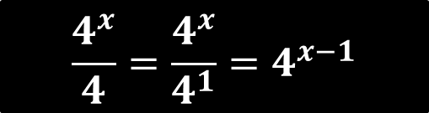
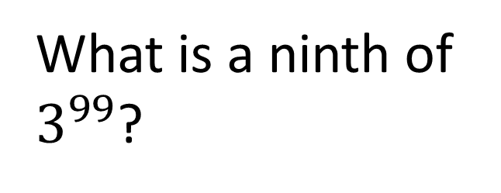
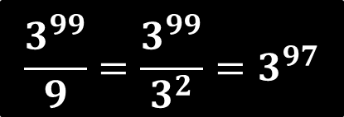
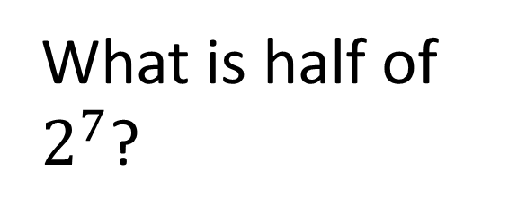

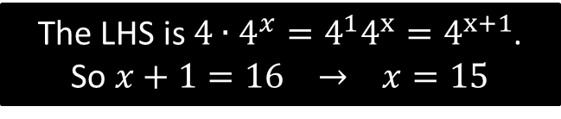
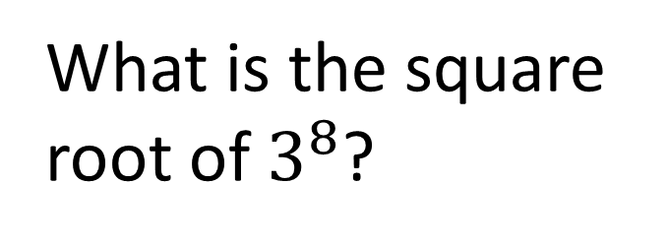
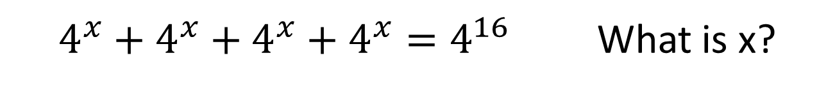
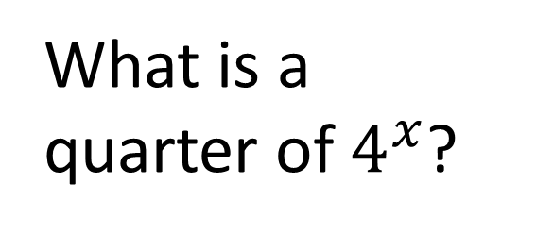
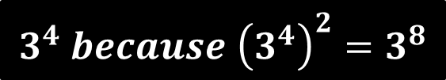
Challenges
What is half of $2^{7}$?
What is a ninth of $3^{99}$?
1
2
?
$$\frac{3^{99}}{9}=\frac{3^{99}}{3^{2}}=3^{97}$$
$$\frac{2^{7}}{2}=\frac{2^{7}}{2^{1}}=2^{6}$$
?
What is a quarter of $4^{x}$?
What is the square root of $3^{8}$?
3
4
?
$$\frac{4^{x}}{4}=\frac{4^{x}}{4^{1}}=4^{x−1}$$
?
$$3^{4} because {\left(3^{4}\right)}^{2}=3^{8}$$
$4^{x}+4^{x}+4^{x}+4^{x}=4^{16}$ What is x?
5
?
The LHS is $4∙4^{x}=4^{1}4^{x}=4^{x+1}$.
So $x+1=16$ $→ x=15$

Slide 12
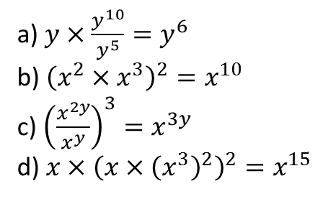
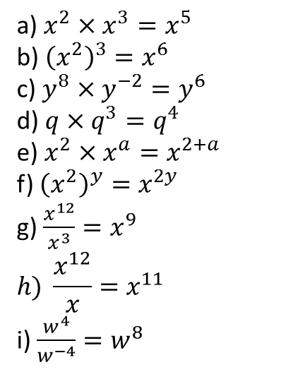
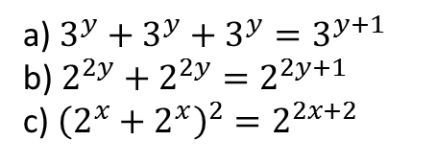

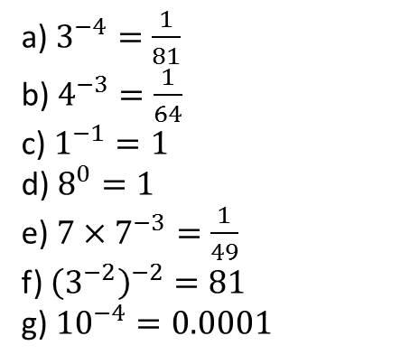
Exercise 1
Please ensure you write out the question.
1
Simplify the following.
3
Evaluate the following (i.e. give as a fraction or integer with no power)
N₁
Solve $\frac{{\left(2^{x}\right)}^{5}}{2^{3}}=\frac{2}{{\left(2^{4}\right)}^{x}}$
$$x=\frac{4}{9}$$
Given that $x^{\frac{1}{2}}=\sqrt{x}$, express $4^{x}+4^{x}$ as a single power of 4.
$$4^{x}+4^{x}=2×4^{x} \\ =\sqrt{4}×4^{x} \\ =4^{\frac{1}{2}}×4^{x} \\ =4^{x+\frac{1}{2}}$$
a) $x^{2}×x^{3}=x^{5}$
b) ${\left(x^{2}\right)}^{3}=x^{6}$
c) $y^{8}×y^{−2}=y^{6}$
d) $q×q^{3}=q^{4}$
e) $x^{2}×x^{a}=x^{2+a}$
f) ${\left(x^{2}\right)}^{y}=x^{2y}$
g) $\frac{x^{12}}{x^{3}}=x^{9}$
$$h) \frac{x^{12}}{x}=x^{11}$$
i) $\frac{w^{4}}{w^{−4}}=w^{8}$
?
?
a) $3^{−4}=\frac{1}{81}$
b) $4^{−3}=\frac{1}{64}$
c) $1^{−1}=1$
d) $8^{0}=1$
e) $7×7^{−3}=\frac{1}{49}$
f) ${\left(3^{−2}\right)}^{−2}=81$
g) ${10}^{−4}=0.0001$
?
?
?
?
?
?
?
N₂
?
?
?
?
?
?
?
?
?
4
Simplify the following.
2
Simplify the following.
a) $3^{y}+3^{y}+3^{y}=3^{y+1}$
b) $2^{2y}+2^{2y}=2^{2y+1}$
c) ${\left(2^{x}+2^{x}\right)}^{2}=2^{2x+2}$
?
a) $y×\frac{y^{10}}{y^{5}}=y^{6}$
b) ${\left(x^{2}×x^{3}\right)}^{2}=x^{10}$
c) ${\left(\frac{x^{2y}}{x^{y}}\right)}^{3}=x^{3y}$
d) $x×{\left(x×{\left(x^{3}\right)}^{2}\right)}^{2}=x^{15}$
?
?
?
?
?
?

Slide 13

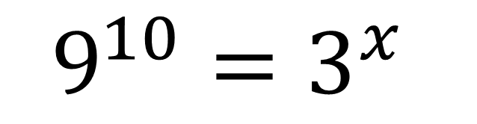

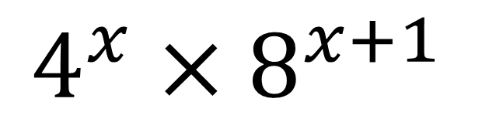
Changes of Base
Solve the following equation.
Express as a single power.
$$9^{10}=3^{x}$$
$$4^{x}×8^{x+1}$$
(Hint: can we express 9 as a power of 3 perhaps?)
?
?
$${\left(3^{2}\right)}^{10}=3^{x} \\ 3^{20}=3^{x} \\ x=20$$
$${\left(2^{2}\right)}^{x}×{\left(2^{3}\right)}^{x+1} \\ =2^{2x}×2^{3x+3} \\ =2^{5x+3}$$
The strategy therefore is to find what both bases are a power of (e.g. 4 and 8 are both powers of 2), and replace them as such.

Slide 14

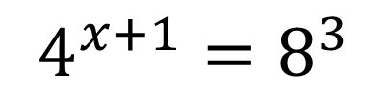
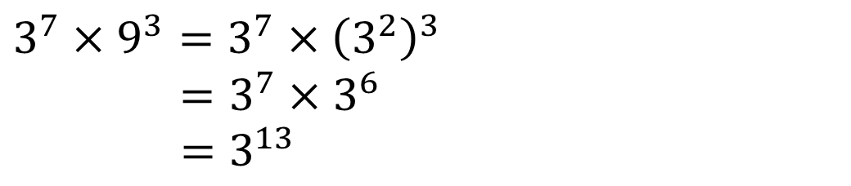

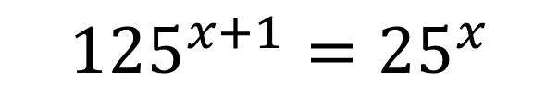
A few more examples…
Solve
Solve
$$4^{x+1}=8^{3}$$
$${125}^{x+1}={25}^{x}$$
$${\left(2^{2}\right)}^{x+1}={\left(2^{3}\right)}^{3} \\ 2^{2x+2}=2^{9} \\ 2x+2=9 \\ x=\frac{7}{2}$$
?
?
$${\left(5^{3}\right)}^{x+1}={\left(5^{2}\right)}^{x} \\ 5^{3x+3}=5^{2x} \\ 3x+3=2x \\ x=−3$$
Express as a single power of 3:
$$3^{7}×9^{3}=3^{7}×{\left(3^{2}\right)}^{3}$$
$=3^{7}×3^{6}$
$$=3^{13}$$
?

Slide 15


Test Your Understanding
2⁸ = 4^{x}
27⁴ = 9^{x}
x = 4
x = 6
?
?
8^{x} = 4¹²
3^{x} = 27¹⁰⁰
x = 8
x = 300
?
?
Express as a single power:
Express as a single power:
?
?
$$3^{x}×{27}^{x−1}=3^{4x−3}$$
$$4^{10}×8^{x}=2^{20+3x}$$

Slide 16
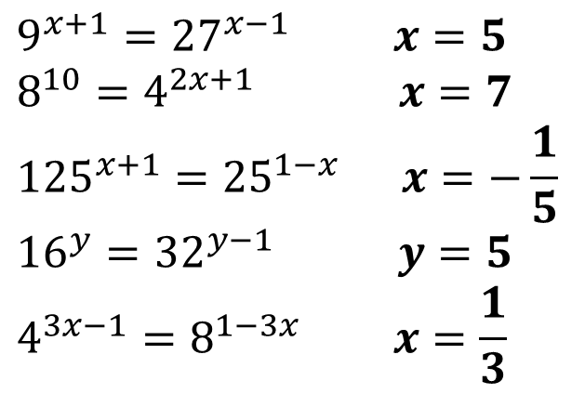
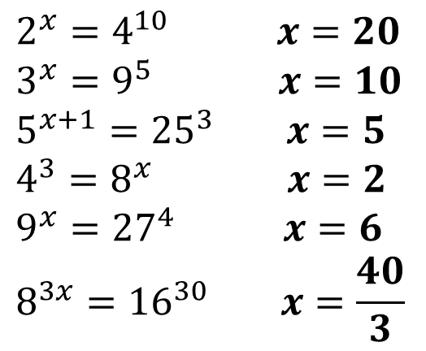
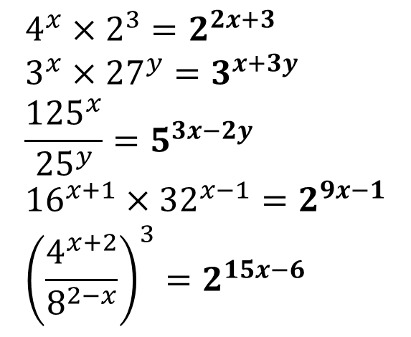
Exercise 2
Please ensure you write out the question.
Solve the following.
Express as a single power.
1
$$2^{x}=4^{10} x=20 \\ 3^{x}=9^{5} x=10 \\ 5^{x+1}={25}^{3} x=5 \\ 4^{3}=8^{x} x=2 \\ 9^{x}={27}^{4} x=6 \\ 8^{3x}={16}^{30} x=\frac{40}{3}$$
$$4^{x}×2^{3}=2^{2x+3} \\ 3^{x}×{27}^{y}=3^{x+3y} \\ \frac{{125}^{x}}{{25}^{y}}=5^{3x−2y} \\ {16}^{x+1}×{32}^{x−1}=2^{9x−1} \\ {\left(\frac{4^{x+2}}{8^{2−x}}\right)}^{3}=2^{15x−6}$$
?
12
?
2
?
13
?
3
?
14
?
4
?
5
?
15
?
6
?
N
?
Solve the following.
7
$$9^{x+1}={27}^{x−1} x=5 \\ 8^{10}=4^{2x+1} x=7 \\ {125}^{x+1}={25}^{1−x} x=−\frac{1}{5} \\ {16}^{y}={32}^{y−1} y=5 \\ 4^{3x−1}=8^{1−3x} x=\frac{1}{3}$$
?
8
?
?
9
10
?
?
11

Slide 17
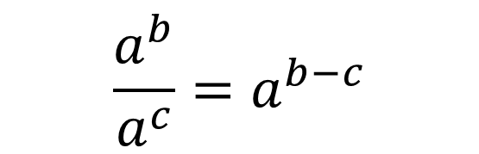



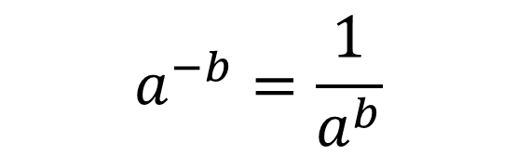

Reminder of the Laws of Indices
?
?
$$a^{b}×a^{c}=a^{b+c}$$
$$a^{0}=1$$
$$\frac{a^{b}}{a^{c}}=a^{b−c}$$
?
?
$$a^{1}=a$$
?
$${\left(a^{b}\right)}^{c}=a^{bc}$$
$$a^{−b}=\frac{1}{a^{b}}$$
?

Slide 18
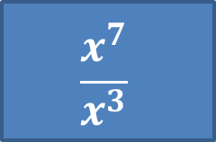
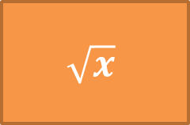
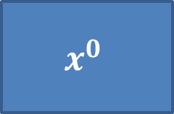
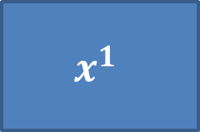
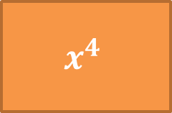
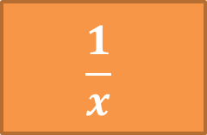
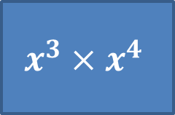
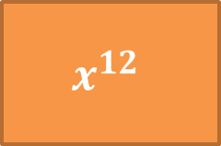
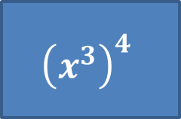
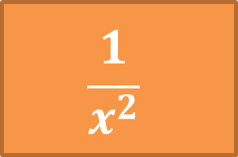
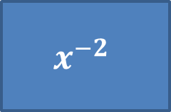
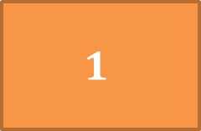
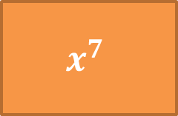
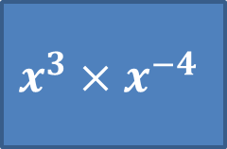
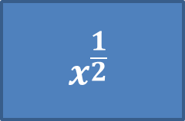
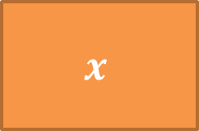
Matching Activity
$$x^{3}×x^{4}$$
$$x^{−2}$$
$$\frac{x^{7}}{x^{3}}$$
$$x^{\frac{1}{2}}$$
$$x^{1}$$
$$x^{0}$$
$${\left(x^{3}\right)}^{4}$$
$$x^{3}×x^{−4}$$
$$1$$
$$x^{7}$$
$$x^{4}$$
$$\frac{1}{x}$$
$$x$$
$$\frac{1}{x^{2}}$$
$$\sqrt{x}$$
$$x^{12}$$

Slide 19

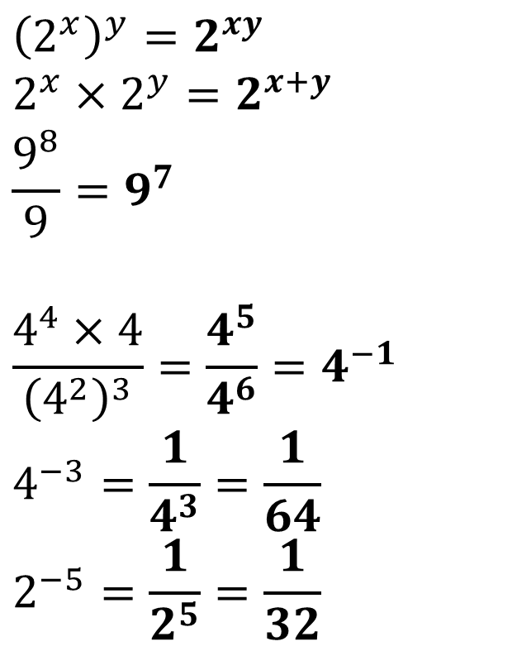
Examples
?
?
Recall “reciprocating” a fraction (i.e. 1 over) flips the fraction. Can you think why?
$${\left(2^{x}\right)}^{y}=2^{xy} \\ 2^{x}×2^{y}=2^{x+y}$$
$$\frac{9^{8}}{9}=9^{7}$$
$$\frac{4^{4}×4}{{\left(4^{2}\right)}^{3}}=\frac{4^{5}}{4^{6}}=4^{−1} \\ 4^{−3}=\frac{1}{4^{3}}=\frac{1}{64} \\ 2^{−5}=\frac{1}{2^{5}}=\frac{1}{32}$$
$${\left(\frac{1}{3}\right)}^{−1}=\frac{3}{1}=3$$
$${\left(\frac{2}{3}\right)}^{−2}={\left(\frac{3}{2}\right)}^{2}=\frac{9}{4}$$
?
?
?
?
?
?

Slide 20
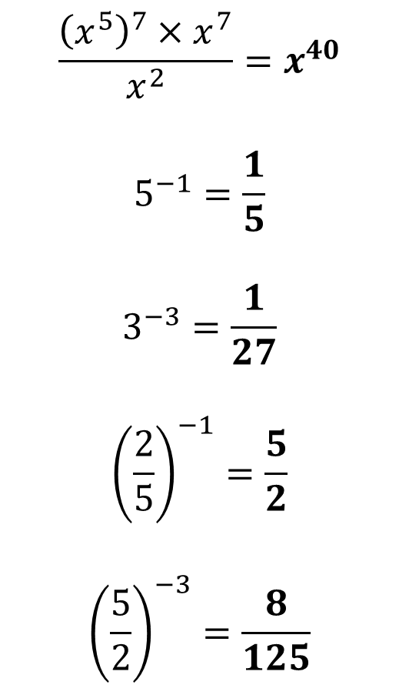
Test Your Understanding
$$\frac{{\left(x^{5}\right)}^{7}×x^{7}}{x^{2}}=x^{40}$$
$$5^{−1}=\frac{1}{5}$$
$$3^{−3}=\frac{1}{27}$$
$${\left(\frac{2}{5}\right)}^{−1}=\frac{5}{2}$$
$${\left(\frac{5}{2}\right)}^{−3}=\frac{8}{125}$$
?
?
?
?
?

Slide 21

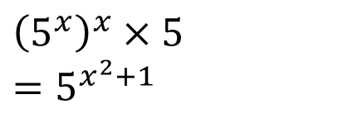
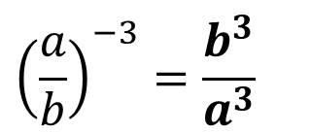














Exercise 1
Simplify the following.
12
$${\left(5^{x}\right)}^{x}×5=5^{x^{2}+1}$$
$$\frac{2^{x}}{2}=2^{x−1}$$
?
$$a^{3}×a^{5}=a^{8}$$
?
1
?
7
$${\left(\frac{3}{5}\right)}^{−1}=\frac{5}{3}$$
13
?
?
2
$${\left(a^{3}\right)}^{5}=a^{15}$$
$$\frac{{\left(x^{2}\right)}^{4}}{x^{2}}=x^{6}$$
8
?
$${\left(\frac{6}{7}\right)}^{−2}=\frac{49}{36}$$
?
14
${\left(m^{2}\right)}^{−5}=m^{−10}$ or $\frac{1}{m^{10}}$
3
?
$$\frac{{\left(y^{9}×y^{−2}\right)}^{2}}{{\left(y^{3}\right)}^{4}}=y^{2}$$
$${\left(\frac{3}{2}\right)}^{−3}=\frac{8}{27}$$
$$\frac{x^{9}}{x^{3}}=x^{6}$$
9
?
15
?
4
?
$$\frac{y^{8}}{y^{−2}}=y^{10}$$
$$5^{−2}=\frac{1}{25}$$
$${\left(\frac{a}{b}\right)}^{−3}=\frac{b^{3}}{a^{3}}$$
5
10
16
?
?
6
?
$$6^{−1}=\frac{1}{6}$$
N
$$4^{x}+4^{x}+4^{x}+4^{x}=4⋅4^{x}=4^{x+1}$$
$$7^{x}×7^{3}=7^{x+3}$$
11
?

Slide 22


Fractional Indices
$$x^{\frac{1}{2}}=\sqrt{x}$$
And how could we prove this?
?
$$\sqrt{x}×\sqrt{x}=x$$
But it’s also the case that:
$$x^{\frac{1}{2}}×x^{\frac{1}{2}}=x^{1}$$
by laws of indices.
So $x^{\frac{1}{2}}=\sqrt{x}$

Slide 23


Fractional Indices
$$x^{\frac{1}{3}}=\sqrt[3]{x}$$
?
$$x^{\frac{1}{n}}=\sqrt[n]{x}$$
?

Slide 24







Examples
$${64}^{\frac{1}{2}}=8$$
?
?
$${16}^{0.25}=2$$
$${64}^{\frac{1}{3}}=4$$
$${\left(\sqrt[3]{7}\right)}^{2}={\left(7^{\frac{1}{3}}\right)}^{2}=7^{\frac{2}{3}}$$
?
?
$${81}^{\frac{1}{2}}=9$$
?
$${\left(−1000\right)}^{\frac{1}{3}}=−10$$
?
$${81}^{\frac{1}{4}}=3$$
?

Slide 25

Test Your Understanding So Far…
$${36}^{\frac{1}{2}}=\sqrt{36}=6 \\ 8^{\frac{1}{3}}=\sqrt[3]{8}=2 \\ {\left(−32\right)}^{\frac{1}{5}}=\sqrt[5]{−32}=−2$$
?
?
?

Slide 26



What if the numerator is not 1?
?
$$9^{\frac{3}{2}}={\left(9^{\frac{1}{2}}\right)}^{3}=3^{3}=27$$
?
$${32}^{\frac{2}{5}}=2^{2}=4$$
…then just deal with what’s left.
Using denominator, do 5th power of 32 first to get 2 (but still have numerator left in the power to deal with)
Best to deal with negative in power first. Recall this does “1 over” the expression without the minus.
?
$${16}^{−\frac{3}{4}}=\frac{1}{{16}^{\frac{3}{4}}}=\frac{1}{2^{3}}=\frac{1}{8}$$

Slide 27

A few more examples
$$4^{−\frac{3}{2}}=\frac{1}{4^{\frac{3}{2}}}=\frac{1}{2^{3}}=\frac{1}{8}$$
$${\left(\frac{27}{8}\right)}^{−\frac{2}{3}}={\left(\frac{8}{27}\right)}^{\frac{2}{3}}={\left(\frac{2}{3}\right)}^{2}=\frac{4}{9}$$
$${\left(\frac{1}{9}\right)}^{−\frac{1}{2}}=9^{\frac{1}{2}}=3$$
?
Recall that “reciprocating” a fraction will cause it to flip.
?
?

Slide 28

Test Your Understanding
?
$${27}^{\frac{2}{3}}=3^{2}=9 \\ 9^{−\frac{3}{2}}=\frac{1}{9^{\frac{3}{2}}}=\frac{1}{3^{3}}=\frac{1}{27} \\ {\left(\frac{125}{64}\right)}^{−\frac{1}{3}}={\left(\frac{64}{125}\right)}^{\frac{1}{3}}=\frac{4}{5} \\ {\left(\frac{4}{9}\right)}^{−\frac{3}{2}}={\left(\frac{9}{4}\right)}^{\frac{3}{2}}={\left(\frac{3}{2}\right)}^{3}=\frac{27}{8}$$
?
?
?

Slide 29















Exercise 2
11
$${\left(\frac{64}{27}\right)}^{−\frac{1}{3}}=\frac{3}{4}$$
$${\left(−64\right)}^{−\frac{1}{3}}=−\frac{1}{4}$$
$${100}^{0.5}=10$$
?
?
1
?
7
$${125}^{\frac{1}{3}}=5$$
$${\left(\frac{9}{16}\right)}^{−\frac{3}{2}}=\frac{64}{27}$$
2
?
12
$${\left(−64\right)}^{−\frac{2}{3}}=\frac{1}{16}$$
?
8
?
$${16}^{−0.5}=\frac{1}{4}$$
?
$${\left(\frac{16}{81}\right)}^{−\frac{3}{4}}=\frac{27}{8}$$
3
?
$${32}^{\frac{2}{5}}=4$$
13
9
?
$${27}^{−\frac{2}{3}}=\frac{1}{9}$$
4
?
$${\left(\frac{8}{27}\right)}^{−\frac{5}{3}}=\frac{81}{16}$$
$${32}^{−\frac{3}{5}}=\frac{1}{8}$$
?
10
?
14
5
$$8^{\frac{4}{3}}=16$$
?
15
Write the following expression without using indices:
$$8^{−\frac{1}{3}}=\frac{1}{2}$$
?
$$x^{−0.5}=\frac{1}{\sqrt{x}}$$
6
?

Slide 30



Applying indices to products and fractions
?
$${\left(ab\right)}^{2}=a^{2}b^{2}$$
?
$${\left(a+b\right)}^{2}=\left(a+b\right)\left(a+b\right) \\ =a^{2}+2ab+b^{2}$$
The moral of the story:
Applying a power to a product applies the power to each term.
Applying a power to a sum does NOT apply power to each term.
i.e. ${\left(a+b\right)}^{n}≠a^{n}+b^{n}$ in general.

Slide 31




Examples
?
$${\left(2x\right)}^{2}=4x^{2}$$
?
$${\left(3x^{2}y\right)}^{3}=27x^{6}y^{3}$$
$${\left(9x^{6}\right)}^{\frac{1}{2}}=3x^{3}$$
?
$${\left(8x^{6}y\right)}^{\frac{1}{3}}=2x^{2}y^{\frac{1}{3}}$$
?

Slide 32




Test Your Understanding
Simplify ${\left(3x^{2}y^{3}\right)}^{2}$
?
$$9x^{4}y^{6}$$
Simplify ${\left(9x^{4}y\right)}^{\frac{1}{2}}$
?
$$3x^{2}y^{\frac{1}{2}}$$

Slide 33
Law of Indices Backwards
(IGCSE Further Maths)
Solve $x^{\frac{3}{4}}=27$
The ‘thinking backwards’ method
The ‘cancelling the power’ method.
(DO THIS!)
If I had some number to the power of $\frac{3}{4}$, what would I do to it?
Find the 4th root then cube it.
So going backwards from 27:
Cube root: 3
Raise to the power of 4: 81
What power should I raise both sides of the equation to ‘cancel’ the $\frac{3}{4}$ power?
$${\left(x^{\frac{3}{4}}\right)}^{\frac{4}{3}}={27}^{\frac{4}{3}} \\ x={27}^{\frac{4}{3}} \\ x=81$$
?
?

Slide 34
Further Examples
Solve $x^{−\frac{2}{3}}=2\frac{7}{9}$
Solve $y^{−3}=3\frac{3}{8}$
?
?
$$x^{−\frac{2}{3}}=\frac{25}{9} \\ x={\left(\frac{25}{9}\right)}^{−\frac{3}{2}}=\frac{27}{125}$$
$$y^{−3}=\frac{27}{8} \\ y={\left(\frac{27}{8}\right)}^{−\frac{1}{3}}=\frac{2}{3}$$

Slide 35
Test Your Understanding
Solve $x^{\frac{2}{3}}=9$
?
$$x=9^{\frac{3}{2}}=27$$
Solve $x^{−\frac{3}{2}}=\frac{8}{27}$
?
$$x={\left(\frac{8}{27}\right)}^{−\frac{2}{3}}=\frac{9}{4}$$

Slide 36


Exercises
?
12
[June 2013 Paper 2] $p^{−2}=q^{6}×r^{4}$
Write $p$ in terms of $q$ and $r$.
Give your answer in its simplest form.
$$p={\left(q^{6}×r^{4}\right)}^{−\frac{1}{2}}=q^{−3}×r^{−2}$$
[Set 3 Paper 1] $x^{\frac{1}{2}}=6$ and $y^{−3}=64$
Work out the value of $\frac{x}{y}$
$$x÷y=36÷\frac{1}{4}=144$$
[Set 1 Paper 2] You are given that $x=5^{m}$ and $y=5^{n}$.
Write $5^{m+2}$ in terms of $x$.
$25x$
Write $5^{m−n}$ in terms of $x$ and $y$.
$\frac{x}{y}$
Write $5^{3n}$ in terms of $y$.
$x^{3}$
Write $5^{\frac{m+n}{2}}$ in terms of $x$ and $y$.
$\sqrt{xy} or \sqrt{x}\sqrt{y}$
1
[June 2012 Paper 1] Simplify ${\left(2cd^{4}\right)}^{3}=8c^{3}d^{12}$
$${\left(ab^{2}\right)}^{3}=a^{3}b^{6}$$
$${\left(9a^{2}\right)}^{\frac{1}{2}}=3a$$
$${\left(16a^{4}b^{3}\right)}^{\frac{1}{2}}=4a^{2}b^{\frac{3}{2}}$$
$${\left(27a^{9}b^{4}\right)}^{\frac{1}{3}}=3a^{3}b^{\frac{4}{3}}$$
$${\left(8a^{6}b^{12}\right)}^{\frac{2}{3}}=4a^{4}b^{8}$$
$${\left(16a^{6}b^{12}\right)}^{\frac{3}{2}}=64a^{9}b^{18}$$
If $x^{\frac{2}{3}}=9$, find $x$. $x=27$
Solve $y^{\frac{4}{3}}=16$ $y=8$
[June 2012 Paper 1] $x^{\frac{3}{2}}=8$ and $y^{−2}=\frac{25}{4}$.
Work out the value of $\frac{x}{y}$ $x÷y=4÷\frac{2}{5}=10$
[June 2013 Paper 1] Solve $x^{−\frac{2}{3}}=7\frac{1}{9}$ writing your answer as a proper fraction. $\frac{27}{512}$
2
?
3
?
?
4
?
?
13
5
6
?
?
7
?
?
14
8
9
?
?
10
?
?
11
?
?
?

Slide 37

Skill 3: Changing bases
What do you notice about all of the numbers:
$$2, 8, 4$$
They’re all powers of 2! We could replace the numbers with $2^{1}$, $2^{3}$ and $2^{2}$ so that we have a consistent base.
?

Slide 38





Skill 3: Changing bases
Solve $4^{x}=2^{10}$
Solve $2^{x}=\frac{8^{3}}{\sqrt{2}}$
1
2
?
$${\left(2^{2}\right)}^{x}=2^{10}$$
$$2^{2x}=2^{10}$$
$$x=5$$
?
$$x=\frac{17}{2}$$
?
?
3
If $2\sqrt{2}=2^{k}$, determine $k$.
$$2\sqrt{2}=2^{1}×2^{\frac{1}{2}}=2^{\frac{3}{2}} \\ k=\frac{3}{2}$$
?

Slide 39

Test Your Understanding
1
If $9\sqrt{3}=3^{k}$, find $k$.
$$9\sqrt{3}=3^{2}×3^{\frac{1}{2}}=3^{\frac{5}{2}} \\ k=\frac{5}{2}$$
Solve $3^{x}=9^{2x−1}$
$$3^{x}={\left(3^{2}\right)}^{2x−1} \\ 3^{x}=3^{4x−2} \\ x=4x−2 \\ 2=3x \\ x=\frac{2}{3}$$
?
2
?

Slide 40
















Exercises
Solve for $x$:
?
1
$$8^{x}=2^{9}$$
$$x=3$$
$$x=\frac{3}{2}$$
$$5^{x}=5\sqrt{5}$$
?
2
$$4^{x}=\frac{8^{6}}{2^{4}}$$
3
$$x=7$$
?
?
$$\text{4}$$
$$2^{x}+2^{x}=2^{19}$$
$$x=18$$
?
5
$${27}^{x}=\sqrt{9^{30}}$$
$$x=10$$
?
6
$$4^{2x+1}=8^{2x−1}$$
$$x=\frac{5}{2}$$
NN
?
$$\sqrt[3]{9}×\sqrt[4]{27}=\sqrt[x]{3}$$
$$x=\frac{12}{17}$$

Slide 41


One Final Difficult GCSE question
$x=2^{p}$, $y=2^{q}$
a) Express in terms of $x$ and/or $y$.
i) $2^{p+q}=2^{p}2^{q}=xy$
ii) $2^{2q}={\left(2^{q}\right)}^{2}=y^{2}$
iii) $2^{p−1}=\frac{2^{p}}{2^{1}}=\frac{x}{2}$
b) Given that:
$$xy=32 \\ 2xy^{2}=32$$
find the value of $p$ and $q.$
$$p=6, q=−1$$
?
?
?
?
?

