Slide 1
GCSE: Percentages
Skipton Girls’ High School

Slide 2
Overview
1
27% of 420
(using a calculator and without using a calculator)
2
The cost of car originally worth £15,000 but after losing 15% of its value.
3
The value of saving account BEFORE it increased by 35% to £16,000
4
The value of an ISA with a principal of £1000, after accruing 5 years of interest at 3% p.a.

Slide 3


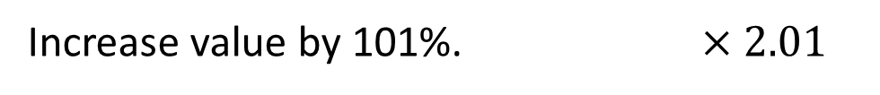
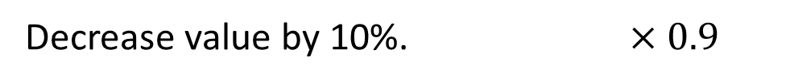
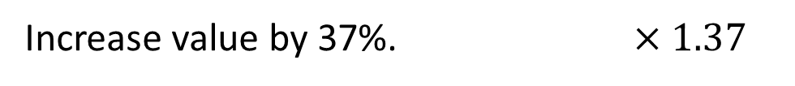
The Key to Percentages
It’s all about identifying a decimal multiplier!
original value $×$ multiplier $=$ new value
What would you multiply by in order to:
?
Find 20% of the value. $×0.2$
?
Increase value by 37%. $×1.37$
?
Decrease value by 10%. $×0.9$
?
Increase value by 101%. $×2.01$
?
Decrease value by 25%, then by 25% again. $×{0.75}^{2}$

Slide 4

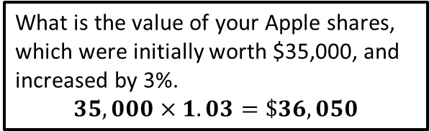

Quickfire Exercises
1
Effect | Multiplier
Increase by 47% | x 1.47
Depreciate by 36% | x 0.64
Find 30% of the value. | x 0.3
Increase by 110% | x 2.1
Decrease by 10%, then increase by 10% | x 0.99
*Increase by 25%, then decrease by 20%. | x 1
?
?
?
?
?
?
2
What is Homer Simpson’s donut count, if it starts at 25,000,000, and he loses 46% due to radiation exposure from the Nuclear Plant.
$$25m×0.54=13.5m$$
N
Usain Bolt increases his speed by 25%. What happens to his time?
Suppose distance $d$, old speed $s$ and time $t$, where $t=\frac{d}{s}$
If speed now $\frac{5}{4}s$, time $=\frac{d}{\frac{5}{4}s}=\frac{4}{5}×\frac{d}{s}=\frac{4}{5}t$, i.e. a decrease of 20%.
Much easier to see if you pick some distance (say 100m) and some time (say 10s).
?
?
3
What is the value of your Apple shares, which were initially worth $35,000, and increased by 3%.
$$35,000×1.03=\$36,050$$
?

Slide 5
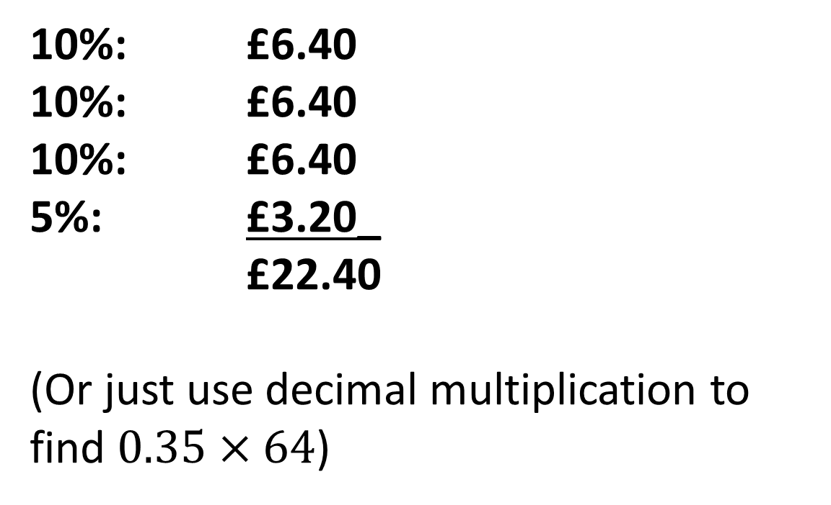
WITHOUT a calculator
35% of £64
10%: £6.40
10%: £6.40
10%: £6.40
5%: £3.20_
£22.40
(Or just use decimal multiplication to find $0.35×64$)

Slide 6
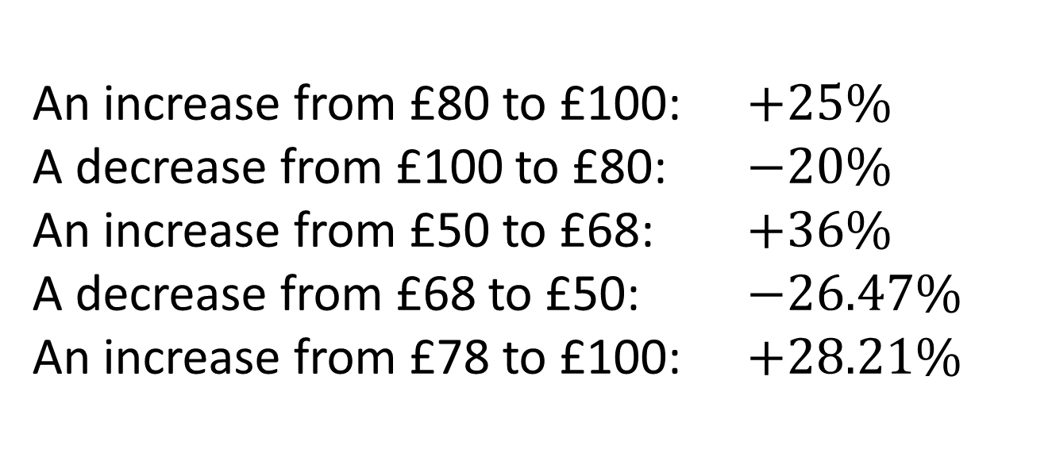
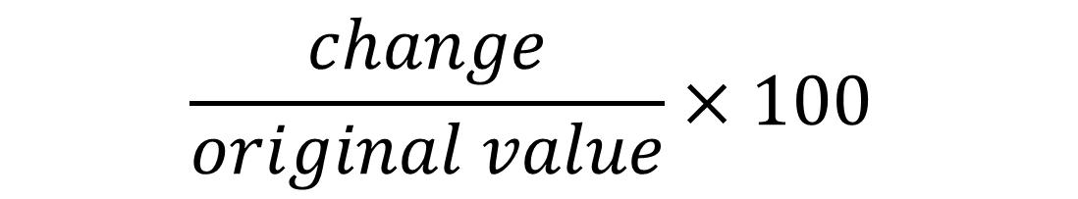
Finding the percentage change
Formula:
$$\frac{change}{original value}×100$$
An increase from £80 to £100: $+25\%$
A decrease from £100 to £80: $−20\%$
An increase from £50 to £68: $+36\%$
A decrease from £68 to £50: $−26.47\%$
An increase from £78 to £100: $+28.21\%$
1
?
2
?
3
?
4
?
5
?

Slide 7
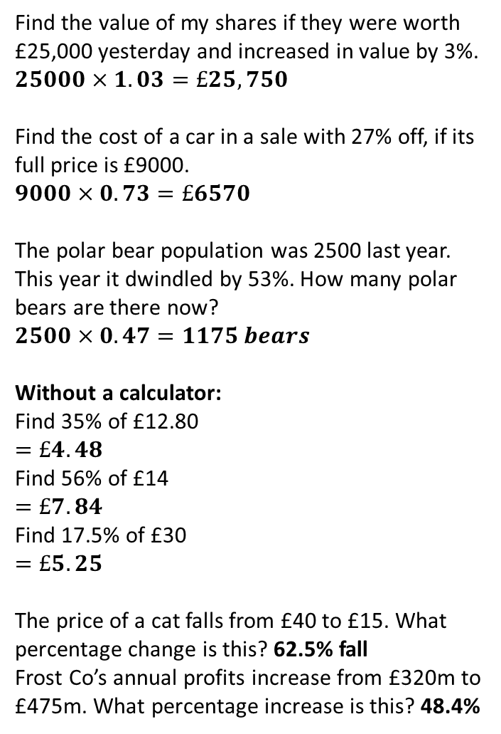
Exercise A
1a
Find the value of my shares if they were worth £25,000 yesterday and increased in value by 3%.
$$25000×1.03=£25,750$$
Find the cost of a car in a sale with 27% off, if its full price is £9000.
$$9000×0.73=£6570$$
The polar bear population was 2500 last year. This year it dwindled by 53%. How many polar bears are there now?
$$2500×0.47=1175 bears$$
Without a calculator:
Find 35% of £12.80
$$=£4.48$$
Find 56% of £14
$$=£7.84$$
Find 17.5% of £30
$$=£5.25$$
The price of a cat falls from £40 to £15. What percentage change is this? 62.5% fall
Frost Co’s annual profits increase from £320m to £475m. What percentage increase is this? 48.4%
4
[IMC] A shop advertised “Everything half price in our sale”, but also now advertises that there is “An additional 15% off sale prices”. Overall, this is equivalent to what reduction on the original prices?
57.5%
[IMC] Inspector Remorse had a difficult year in 2004. A crime wave in Camford meant that he had 20% more cases to solve than in 2003, but his success rate dropped. In 2003, he solved 80% of his cases, but in 2004 he solved only 60% of them. What was the percentage change in the number of cases he solved in 2004 compared with 2003?
Down by 8%
[STMC] In a sale, the price of a computer is reduced by 20%. At this reduced price the shopkeeper still makes a profit of 20%. What would have been his percentage profit if the computer had been sold at full price?
50%
?
b
?
?
5
c
?
2a
?
?
b
?
N
c
?
3a
?
?
b
?

Slide 8
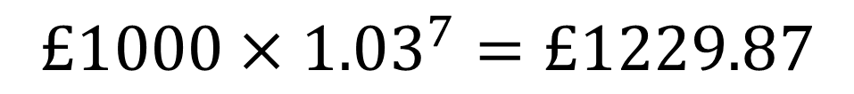
Compound changes
I put £1000 into an account with 3% interest p.a. How much is there in the account after 7 years?
(Hint: again, it’s all about the appropriate multiplier!)
$$£1000×{1.03}^{7}=£1229.87$$
?
My house is worth £250,000. However, due to the economic crisis, the value depreciates by 10% each year. How much is it worth 5 years later
$$£250,000×{0.90}^{5}=£147622.50$$
?

Slide 9
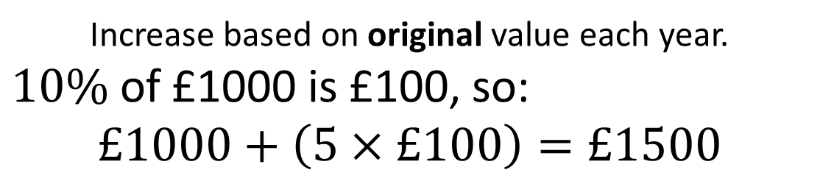
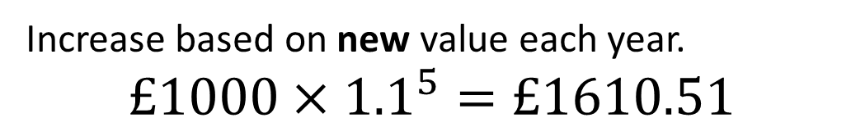
Compound vs ‘Simple’ interest
This rarely comes up in GCSE exams, but you should appreciate the difference between compound and simple interest.
If the principal of a bond is £1000, and the interest rate 10% p.a., find the value after 5 years using:
Compound interest:
?
Increase based on new value each year.
$$£1000×{1.1}^{5}=£1610.51$$
Simple interest:
?
Increase based on original value each year.
$10\%$ of £1000 is £100, so:
$$£1000+\left(5×£100\right)=£1500$$

Slide 10
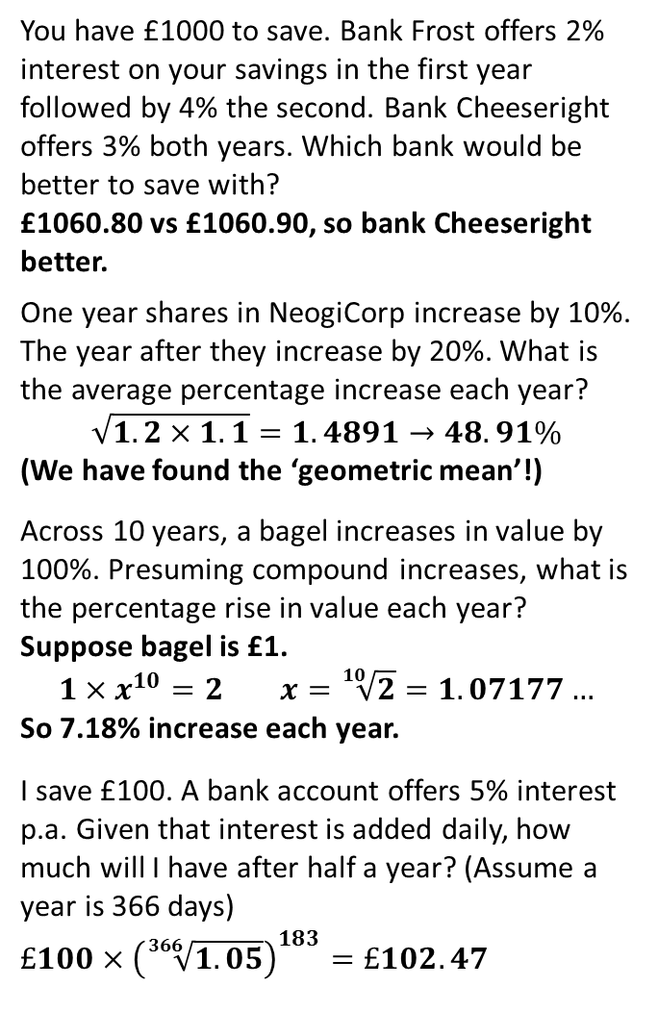
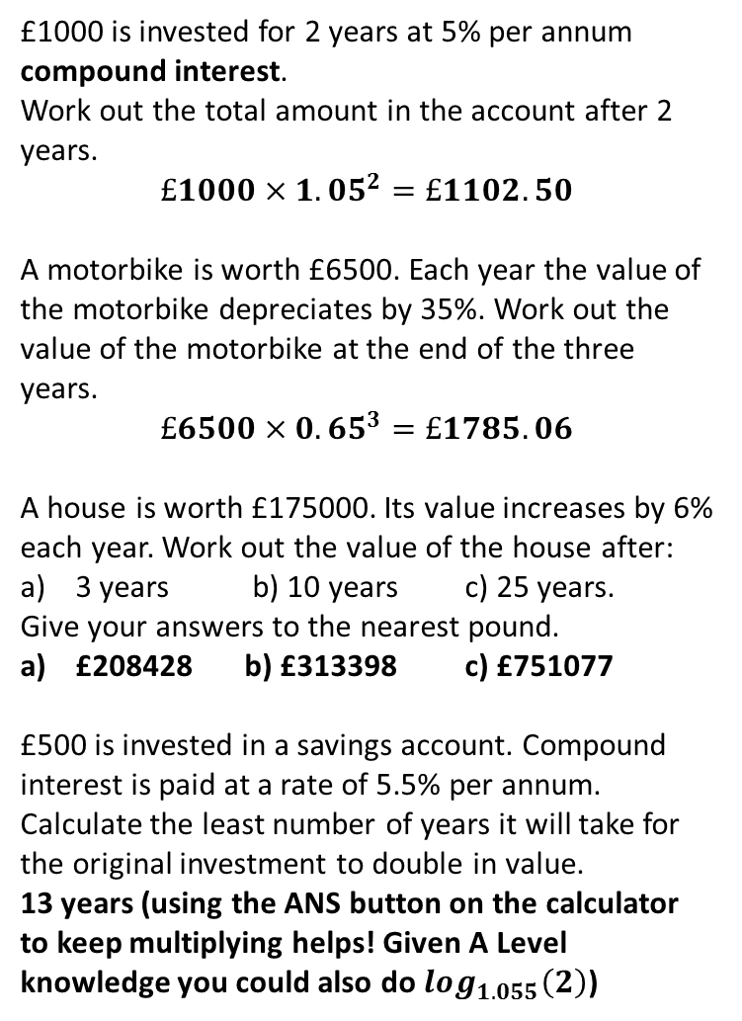
Exercise B
1
£1000 is invested for 2 years at 5% per annum compound interest.
Work out the total amount in the account after 2 years.
$$£1000×{1.05}^{2}=£1102.50$$
A motorbike is worth £6500. Each year the value of the motorbike depreciates by 35%. Work out the value of the motorbike at the end of the three years.
$$£6500×{0.65}^{3}=£1785.06$$
A house is worth £175000. Its value increases by 6% each year. Work out the value of the house after:
3 years b) 10 years c) 25 years.
Give your answers to the nearest pound.
£208428 b) £313398 c) £751077
£500 is invested in a savings account. Compound interest is paid at a rate of 5.5% per annum. Calculate the least number of years it will take for the original investment to double in value.
13 years (using the ANS button on the calculator to keep multiplying helps! Given A Level knowledge you could also do $log_{1.055}\left(2\right)$)
5
You have £1000 to save. Bank Frost offers 2% interest on your savings in the first year followed by 4% the second. Bank Cheeseright offers 3% both years. Which bank would be better to save with?
£1060.80 vs £1060.90, so bank Cheeseright better.
One year shares in NeogiCorp increase by 10%. The year after they increase by 20%. What is the average percentage increase each year?
$$\sqrt{1.2×1.1}=1.4891→48.91\%$$
(We have found the ‘geometric mean’!)
Across 10 years, a bagel increases in value by 100%. Presuming compound increases, what is the percentage rise in value each year?
Suppose bagel is £1.
$$1×x^{10}=2 x=\sqrt[10]{2}=1.07177…$$
So 7.18% increase each year.
I save £100. A bank account offers 5% interest p.a. Given that interest is added daily, how much will I have after half a year? (Assume a year is 366 days)
$£100×{\left(\sqrt[366]{1.05}\right)}^{183}=£102.47$
?
?
2
N₁
?
?
3
N₂
?
?
4
N₃
?
?

Slide 11


Reverse Percentages
original value $×$ multiplier $=$ new value
We’ve so far always multiplied by the multiplier in order to find the new value. But what if we wanted to find the original value before the percentage change?
original value $=\frac{new value}{multiplier}$
?

Slide 12


Example
After a bloody fight with George, Fareed lost 30% of his body’s blood. He now only had 5.6 pints of blood left. How much blood did he originally have?
Method 1: Using multipliers
Method 2: Aiming for 100%
?
?
$$x×0.7=5.6$$
$$x=\frac{5.6}{0.7}=8$$
70% is 5.6 pints
$∴$10% is $0.8$ pints
$∴$100% is $8$ pints

Slide 13


Test Your Understanding
[Edexcel GCSE June 2013] The normal price of a television is reduced by 30% in a sale. The sale price of the television is £350. Work out the normal price of the television.
Method 1:
$$x×0.7=350 \\ x=\frac{350}{0.7}=£500$$
Method 2:
70% is £350
10% is £50
100% is £500
?
[Edexcel GCSE Nov 2013] In a sale normal prices are reduced by 20%. A washing machine has a sale price of £464. By how much money is the normal price of the washing machine reduced?
$$x×0.8=464 \\ x=\frac{464}{0.8}=£580 \\ £580−£464=£116$$
?

Slide 14
To reverse or not to reverse? That is the question.
Shakespeare bought 375 quills this year. This was 25% less than last year. How many did he previously buy?
✗
Don’t Reverse
✓
Reverse
Last year a performance of The Merchant of Venice took in 60 farthings. This year it took in 15% less. How much was made this year?
✗
✓
Reverse
Don’t Reverse
✗
Don’t Reverse
✓
Reverse
A cutlass with 20% VAT costs £162. What was the cost without VAT?
Mecrutio sues Romeo for 150 farthings for mortal injuries inflicted. However, after realising he’s being a bit of a douche, he decides to lower this amount by 36%. How much did he sue Romeo for?
✗
✓
Reverse
Don’t Reverse

Slide 15
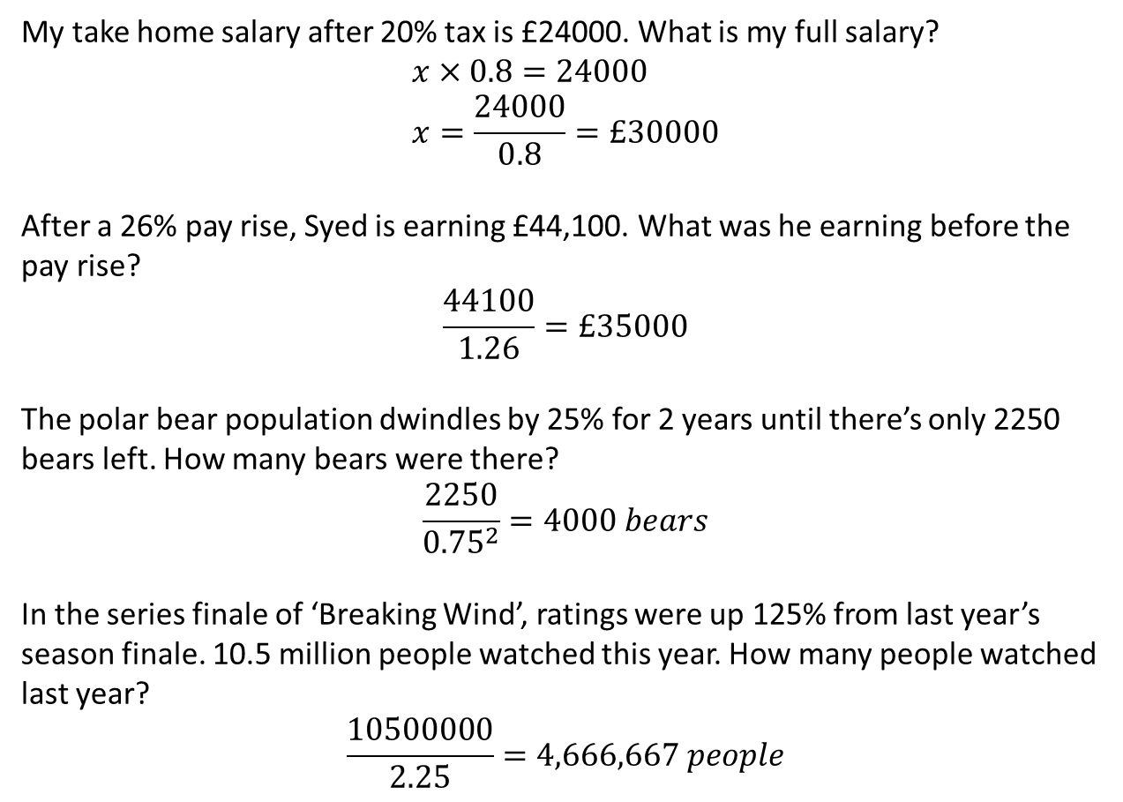
More examples
My take home salary after 20% tax is £24000. What is my full salary?
$$x×0.8=24000 \\ x=\frac{24000}{0.8}=£30000$$
After a 26% pay rise, Syed is earning £44,100. What was he earning before the pay rise?
$$\frac{44100}{1.26}=£35000$$
The polar bear population dwindles by 25% for 2 years until there’s only 2250 bears left. How many bears were there?
$$\frac{2250}{{0.75}^{2}}=4000 bears$$
In the series finale of ‘Breaking Wind’, ratings were up 125% from last year’s season finale. 10.5 million people watched this year. How many people watched last year?
$$\frac{10500000}{2.25}=4,666,667 people$$
?
?
?
?

Slide 16
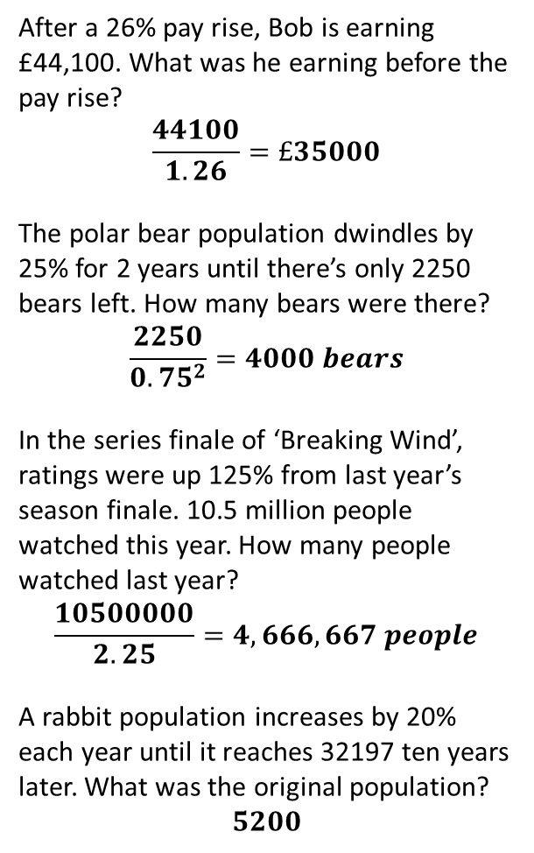
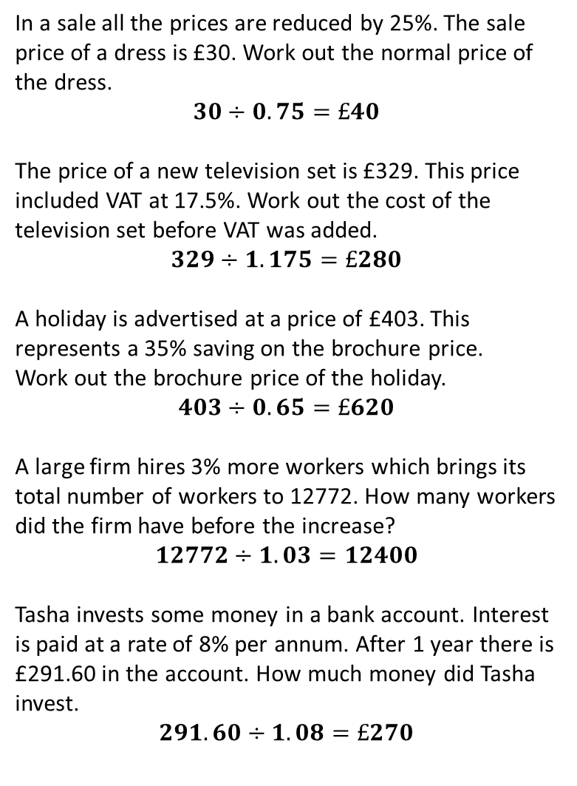
Exercise C
In a sale all the prices are reduced by 25%. The sale price of a dress is £30. Work out the normal price of the dress.
$$30÷0.75=£40$$
The price of a new television set is £329. This price included VAT at 17.5%. Work out the cost of the television set before VAT was added.
$$329÷1.175=£280$$
A holiday is advertised at a price of £403. This represents a 35% saving on the brochure price.
Work out the brochure price of the holiday.
$$403÷0.65=£620$$
A large firm hires 3% more workers which brings its total number of workers to 12772. How many workers did the firm have before the increase?
$$12772÷1.03=12400$$
Tasha invests some money in a bank account. Interest is paid at a rate of 8% per annum. After 1 year there is £291.60 in the account. How much money did Tasha invest.
$$291.60÷1.08=£270$$
6
After a 26% pay rise, Bob is earning £44,100. What was he earning before the pay rise?
$$\frac{44100}{1.26}=£35000$$
The polar bear population dwindles by 25% for 2 years until there’s only 2250 bears left. How many bears were there?
$$\frac{2250}{{0.75}^{2}}=4000 bears$$
In the series finale of ‘Breaking Wind’, ratings were up 125% from last year’s season finale. 10.5 million people watched this year. How many people watched last year?
$$\frac{10500000}{2.25}=4,666,667 people$$
A rabbit population increases by 20% each year until it reaches 32197 ten years later. What was the original population?
$$5200$$
1
?
?
2
7
?
?
3
8
?
4
?
?
5
9
?
?

Slide 17
Recap Quiz
Red Orange or Green?
RED
ORANGE
GREEN

Slide 18
A bank account accrues 3% (compound) interest for 10 years. The principal is £20,000. How much do you have at maturity?
£26,000
£26,878
£26,978

Slide 19
A smurf population falls from 240 to 200. What percentage change is that?
-16.7%
-20%
-24%

Slide 20
After tax of 20%, Kyle earns £5 a year. What was his earnings before tax?
£100,000
£6
£6.25

Slide 21
James Bond’s Aston Martin, originally worth £150,000, depreciates by 15% each year. What is its value after 5 years?
£66,556
£67,556
£68,556

