Slide 1
Number: Rounding & Approximation
Skipton Girls’ High School
Objectives: Round a number to a given number of decimal places or significant figures.
Approximate the value to a multiplication/division by rounding each number to 1 significant figure.

Slide 2

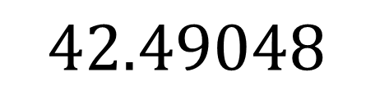
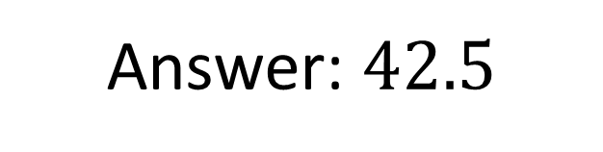
Rounding to decimal places
$≥5$? Yes!
$$42.49048$$
Round this number to 1 decimal place.
Step 1: Imagine underlining up to the required accuracy,
counting from the decimal point.
Do It >
Step 2: Look at the number after the last underlined.
If 5 or more, we increase the last number by 1
(ensure you propagate left any carries)
Do It >
Step 3: Check that you’ve actually given the number to the required accuracy.
(If it’s 1dp, then ensure there’s one digit after the decimal point!)
?
Answer: $42.5$

Slide 3
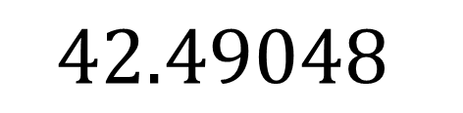
More Examples
$$42.49048$$
Step 1: Imagine underlining up to the required accuracy, counting from the decimal point.
Round this number to:
The nearest whole: 42
1dp: 42.5
2dp: 42.49
3dp: 42.490
4dp: 42.4905
?
Step 2: Look at the number after the last underlined.
If 5 or more, we increase the last number by 1
(ensure you propagate left any carries)
?
?
?
42.490 seems to be the same as 42.49. But why would the latter be wrong?
The 0 at the end gives extra information. It’s telling us that the thousandth’s digit is 0, whereas if we put 42.49, we’re leaving the thousandths digit unspecified.
Step 3: Check that you’ve actually given the number to the required accuracy.
(If it’s 1dp, then ensure there’s one digit after the decimal point!)
?

Slide 4
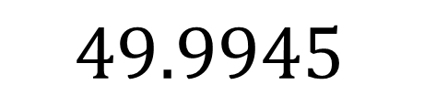
A Harder One…
$$49.9945$$
Step 1: Imagine underlining up to the required accuracy, counting from the decimal point.
Round this number to:
1dp: 50.0
2dp: 49.99
?
Step 2: Look at the number after the last underlined.
If 5 or more, we increase the last number by 1
(ensure you propagate left any carries)
?
Step 3: Check that you’ve actually given the number to the required accuracy.
(If it’s 1dp, then ensure there’s one digit after the decimal point!)

Slide 5
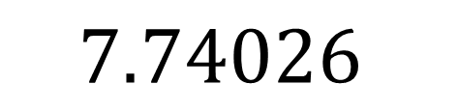
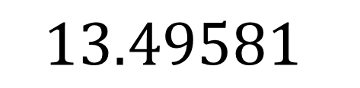
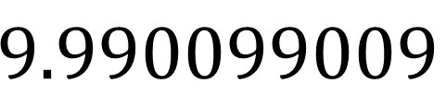
Test Your Understanding
A
$$7.74026$$
B
$$13.49581$$
1dp | 13.5
2dp | 13.50
3dp | 13.496
4dp | 13.4958
1dp | 7.7
2dp | 7.74
3dp | 7.740
4dp | 7.7403
?
?
?
?
?
?
?
?
N
$$9.990099009$$
1dp | 10.0
2dp | 9.99
3dp | 9.990
4dp | 9.9901
?
?
5dp | 9.99010
6dp | 9.990099
7dp | 9.9900990
8dp | 9.99009901
?
?
?
?
?
?

Slide 6
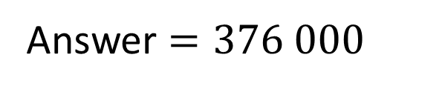
Significant Figures
Suppose it’s your 11th birthday party and 16439 people attend.
If you were casually saying to someone how many people came, what figure might you quote?
We might say 16000 people came.
We seem to have taken ‘2 digits’ of accuracy. However, unlike 2dp, where we’d count 2 digits from the decimal point, we’re counting digits from the start of the number.
We say we’ve rounded to 2 significant figures.
?
Round 375 694 to 3 significant figures.
This is exactly the same as rounding to decimal places, except:
We start counting from the first non-zero digit (not the decimal point).
We have to ‘zero-out’ any digits before the decimal point not used.
(Otherwise we would have changed the place value of the digits we kept)
?
Answer $=376 000$

Slide 7
Examples
Round 17.4864 to:
1 sf: 20
2 sf: 17
3 sf: 17.5
4 sf: 17.49
Round 49 329 to:
1 sf: 50 000
2 sf: 49 000
3 sf: 49 300
4 sf: 49 330
?
?
?
?
?
?
?
?
Round 0.0429028 to:
1 sf: 0.04
2 sf: 0.043
3 sf: 0.0429
4 sf: 0.04290
?
?
?
?

Slide 8
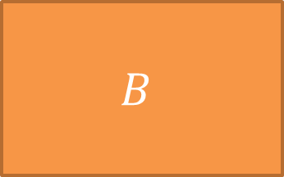



Test Your
Understanding
Vote with the coloured cards in your diaries (use the front for blue)
$$A$$
$$B$$
$$C$$
$$D$$

Slide 9
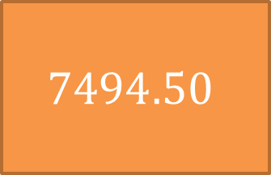
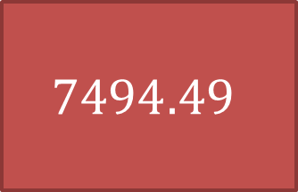
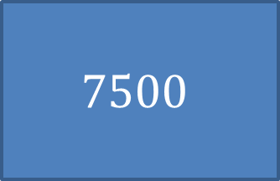
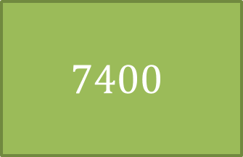
Round 7494.4924 to 2 sf.
$$7494.49$$
$$7494.50$$
$$7400$$
$$7500$$

Slide 10
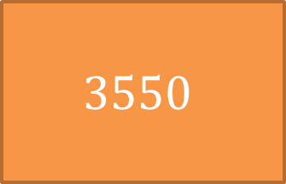
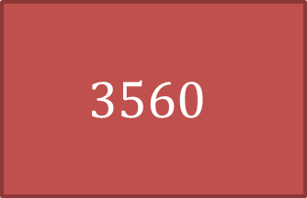
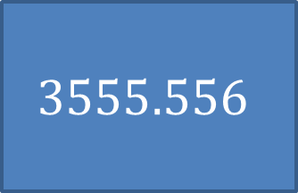
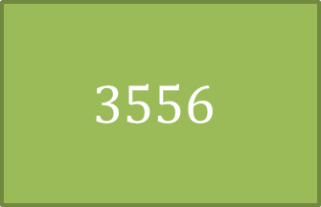
Round 3555.5555 to 3 dp.
$$3560$$
$$3550$$
$$3556$$
$$3555.556$$

Slide 11
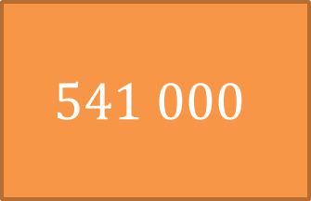
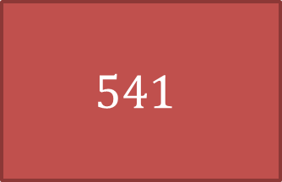
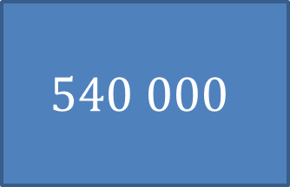
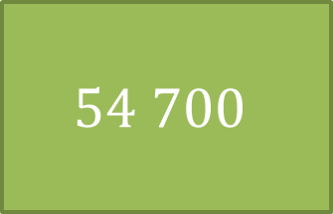
Round 540 693 to 3 sf.
$$541$$
$$541 000$$
$$54 700$$
$$540 000$$

Slide 12
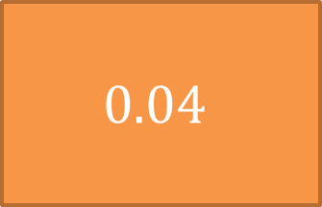
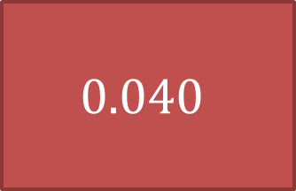

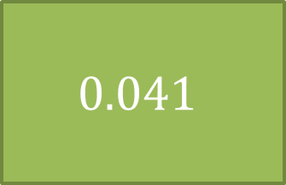
Round 0.04046 to 2 dp.
$$0.040$$
$$0.04$$
$$0.041$$
$$0$$

Slide 13
Round 0.04046 to 2 sf.
$$0.040$$
$$0.04$$
$$0.041$$
$$0$$

Slide 14
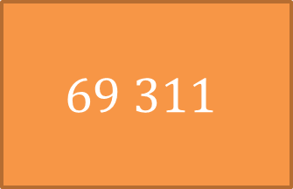
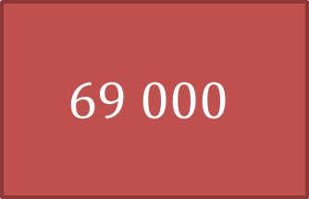
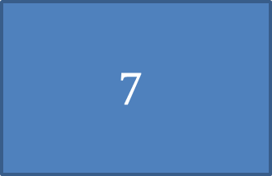
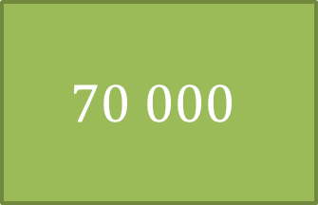
Round 69311 to 1 sf.
$$69 000$$
$$69 311$$
$$70 000$$
$$7$$

Slide 15
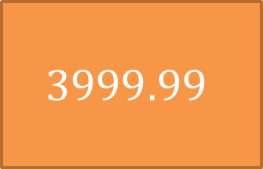
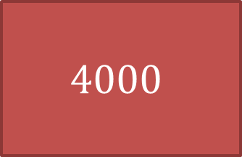
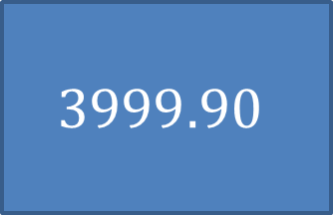
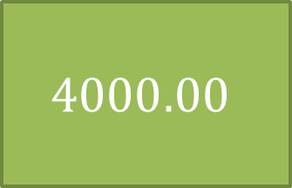
Round 3999.9961 to 2 dp.
$$4000$$
$$3999.99$$
$$4000.00$$
$$3999.90$$

Slide 16
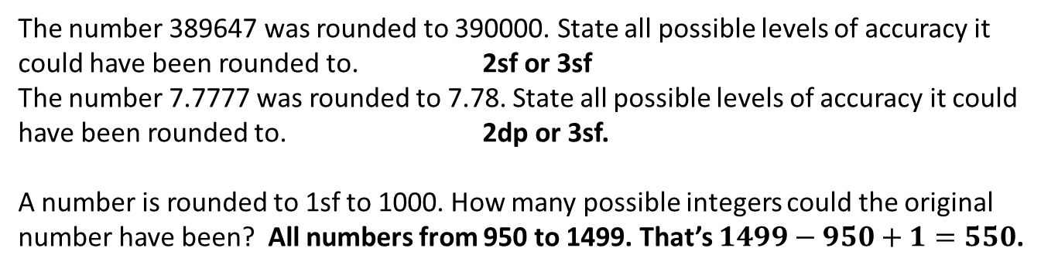
Exercise 1
1
Complete the following table.
 | 1dp | 2dp | 1sf | 2sf | 3sf
123.456 | 123.5 | 123.46 | 100 | 120 | 123
144.402 | 144.4 | 144.40 | 100 | 140 | 144
8888.888 | 8888.9 | 8888.89 | 9000 | 8900 | 8890
437.3946 | 437.4 | 437.39 | 400 | 440 | 437
987.654 | 987.7 | 987.65 | 1000 | 990 | 988
3 809 830.492 | 3809830.5 | 3809830.49 | 4 000 000 | 3 800 000 | 3 810 000
1.98043 | 2.0 | 1.98 | 2 | 2.0 | 1.98
4.80808 | 4.8 | 4.81 | 5 | 4.8 | 4.81
99.009900 | 99.0 | 99.01 | 100 | 99 | 99.0
?
?
?
?
?
?
?
?
?
?
?
?
?
?
?
?
?
?
?
?
?
?
?
?
?
?
?
?
?
?
?
?
?
?
?
?
?
?
?
?
?
?
?
?
?
2
The number 389647 was rounded to 390000. State all possible levels of accuracy it could have been rounded to. 2sf or 3sf
The number 7.7777 was rounded to 7.78. State all possible levels of accuracy it could have been rounded to. 2dp or 3sf.
A number is rounded to 1sf to 1000. How many possible integers could the original number have been? All numbers from 950 to 1499. That’s $1499−950+1=550$.
?
?
N
?

Slide 17
STARTER :: Approximation
[JMC 2010 Q14] The Severn Bridge has carried just over 300 million vehicles since it was opened in 1966. On average, roughly how many vehicles is this per day?
A 600 B 2 000 C 6 000 D 20 000 E 60 000
A
B
C
D
E
[JMC 2003 Q15] It was reported recently that, in an average lifetime of 70 years, each human is likely to swallow about 8 spiders while sleeping. Supposing that the population of the UK is around 60 million, what is the best estimate of the number of unfortunate spiders consumed in this way in the UK each year?
A 50 000 B 600 000 C 7 000 000 D 80 000 000 E 900 000 000
A
B
C
D
E

Slide 18

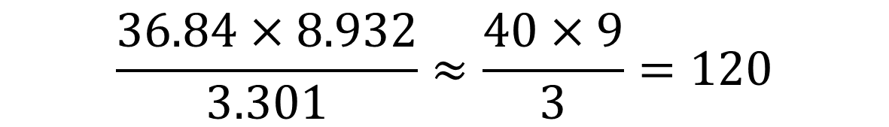
Approximating $× ÷$
! To approximate, round each number to 1 significant figure first.
‘approximately equal to’
$$\frac{312×5.94}{2.03}≈\frac{300×6}{2}=900$$
?
$$\frac{36.84×8.932}{3.301}≈\frac{40×9}{3}=120$$
?

Slide 19
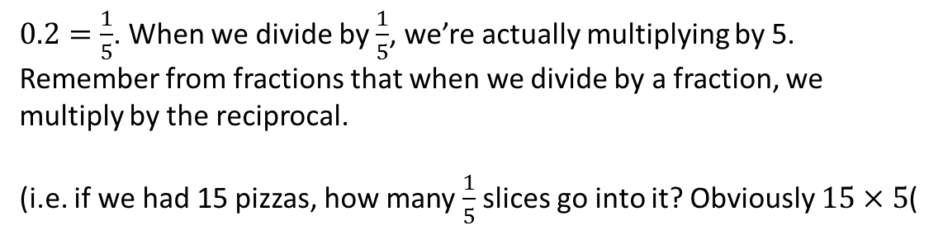

Dividing by numbers less than 1.
?
?
$$\frac{5.203×2.87}{0.19}≈\frac{5×3}{0.2}=75$$
$0.2=\frac{1}{5}$. When we divide by $\frac{1}{5}$, we’re actually multiplying by 5.
Remember from fractions that when we divide by a fraction, we multiply by the reciprocal.
(i.e. if we had 15 pizzas, how many $\frac{1}{5}$ slices go into it? Obviously $15×5$(

Slide 20
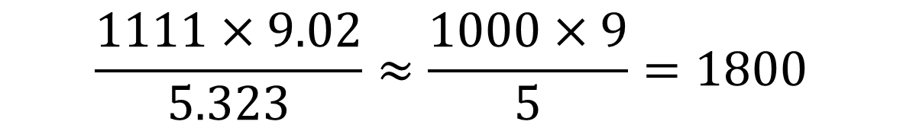
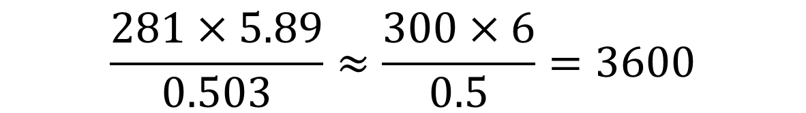
Test Your Understanding
?
?
$$\frac{1111×9.02}{5.323}≈\frac{1000×9}{5}=1800$$
?
?
$$\frac{281×5.89}{0.503}≈\frac{300×6}{0.5}=3600$$

Slide 21
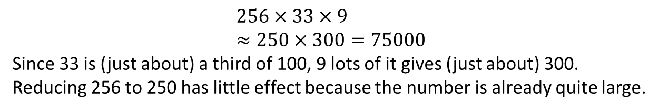
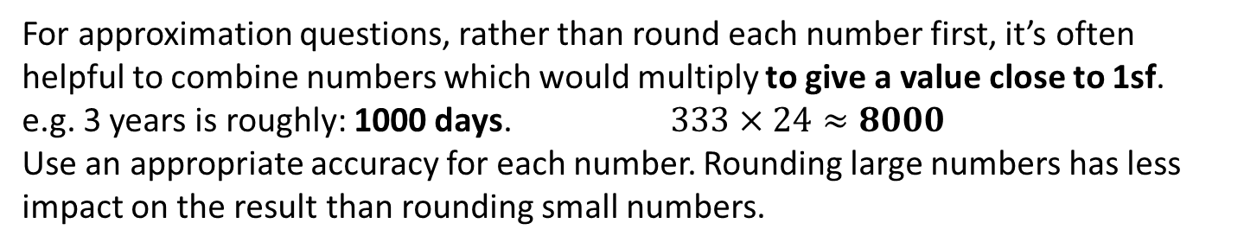
Maths Challenge Strategies
For approximation questions, rather than round each number first, it’s often helpful to combine numbers which would multiply to give a value close to 1sf.
e.g. 3 years is roughly: 1000 days. $333×24≈8000$
Use an appropriate accuracy for each number. Rounding large numbers has less impact on the result than rounding small numbers.
?
?
[JMC 2000 Q16] A book has 256 pages with, on average, 33 lines on each page and 9 words on each line. Which of the following is the best approximation to the number of words in the book?
A 64 000 B 68 000 C 72 000
D 76 000 E 80 000
A
B
C
D
E
$$256×33×9 \\ ≈250×300=75000$$
Since 33 is (just about) a third of 100, 9 lots of it gives (just about) 300. Reducing 256 to 250 has little effect because the number is already quite large.

Slide 22
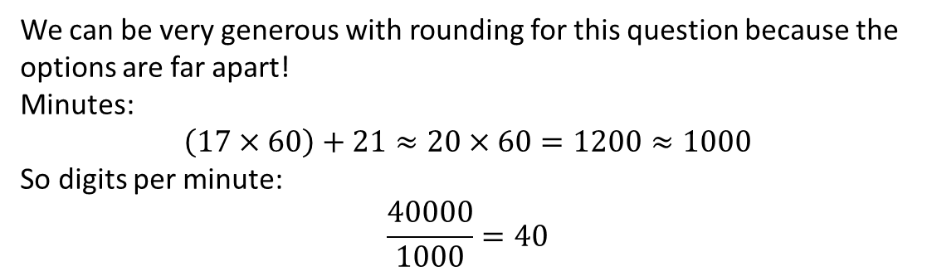
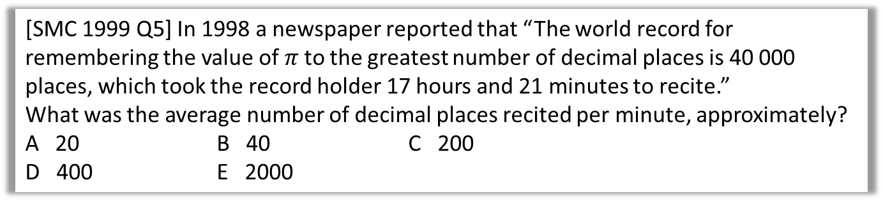
Test Your Understanding
[SMC 1999 Q5] In 1998 a newspaper reported that “The world record for remembering the value of $π$ to the greatest number of decimal places is 40 000 places, which took the record holder 17 hours and 21 minutes to recite.”
What was the average number of decimal places recited per minute, approximately?
A 20 B 40 C 200
D 400 E 2000
A
B
C
D
E
We can be very generous with rounding for this question because the options are far apart!
Minutes:
$$\left(17×60\right)+21≈20×60=1200≈1000$$
So digits per minute:
$$\frac{40000}{1000}=40$$

Slide 23
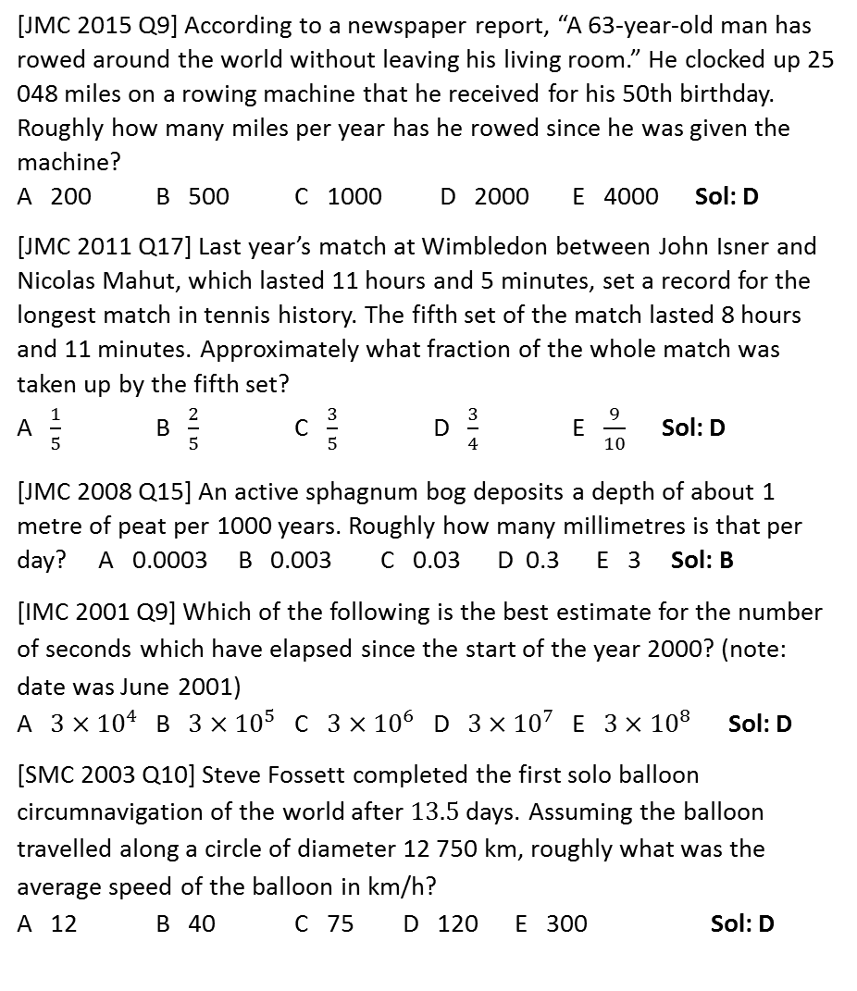
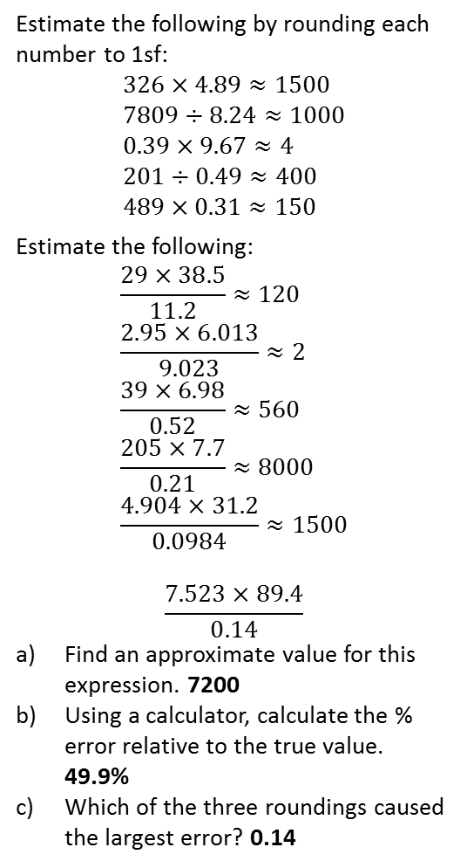
Exercise 2
1
Estimate the following by rounding each number to 1sf:
$$326×4.89≈1500 \\ 7809÷8.24≈1000 \\ 0.39×9.67≈4 \\ 201÷0.49≈400 \\ 489×0.31≈150$$
Estimate the following:
$$\frac{29×38.5}{11.2}≈120 \\ \frac{2.95×6.013}{9.023}≈2 \\ \frac{39×6.98}{0.52}≈560 \\ \frac{205×7.7}{0.21}≈8000 \\ \frac{4.904×31.2}{0.0984}≈1500$$
$$\frac{7.523×89.4}{0.14}$$
Find an approximate value for this expression. 7200
Using a calculator, calculate the % error relative to the true value. 49.9%
Which of the three roundings caused the largest error? 0.14
[JMC 2015 Q9] According to a newspaper report, “A 63-year-old man has rowed around the world without leaving his living room.” He clocked up 25 048 miles on a rowing machine that he received for his 50th birthday. Roughly how many miles per year has he rowed since he was given the machine?
A 200 B 500 C 1000 D 2000 E 4000 Sol: D
[JMC 2011 Q17] Last year’s match at Wimbledon between John Isner and Nicolas Mahut, which lasted 11 hours and 5 minutes, set a record for the longest match in tennis history. The fifth set of the match lasted 8 hours and 11 minutes. Approximately what fraction of the whole match was taken up by the fifth set?
A $\frac{1}{5}$ B $\frac{2}{5}$ C $\frac{3}{5}$ D $\frac{3}{4}$ E $\frac{9}{10}$ Sol: D
[JMC 2008 Q15] An active sphagnum bog deposits a depth of about 1 metre of peat per 1000 years. Roughly how many millimetres is that per day? A 0.0003 B 0.003 C 0.03 D 0.3 E 3 Sol: B
[IMC 2001 Q9] Which of the following is the best estimate for the number of seconds which have elapsed since the start of the year 2000? (note: date was June 2001)
A $3×{10}^{4}$ B $3×{10}^{5}$ C $3×{10}^{6}$ D $3×{10}^{7}$ E $3×{10}^{8}$ Sol: D
[SMC 2003 Q10] Steve Fossett completed the first solo balloon circumnavigation of the world after $13.5$ days. Assuming the balloon travelled along a circle of diameter 12 750 km, roughly what was the average speed of the balloon in km/h?
A 12 B 40 C 75 D 120 E 300 Sol: D
4
a
?
b
?
c
?
?
d
?
e
?
2
5
a
?
b
?
?
?
c
d
?
6
e
?
?
3
7
?
?
8
?
?
?

Slide 24
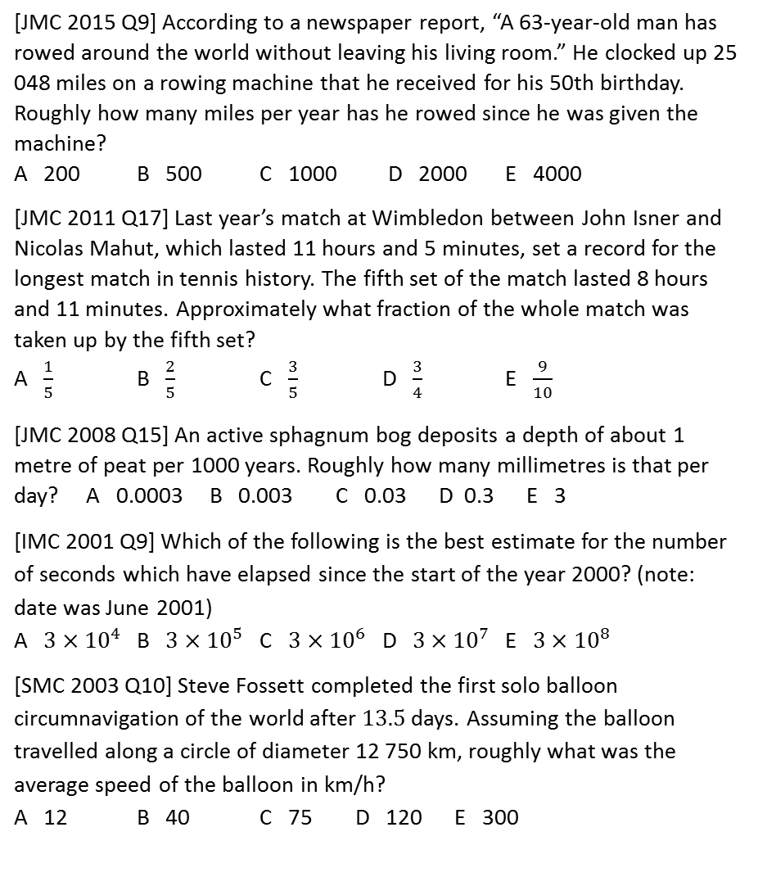
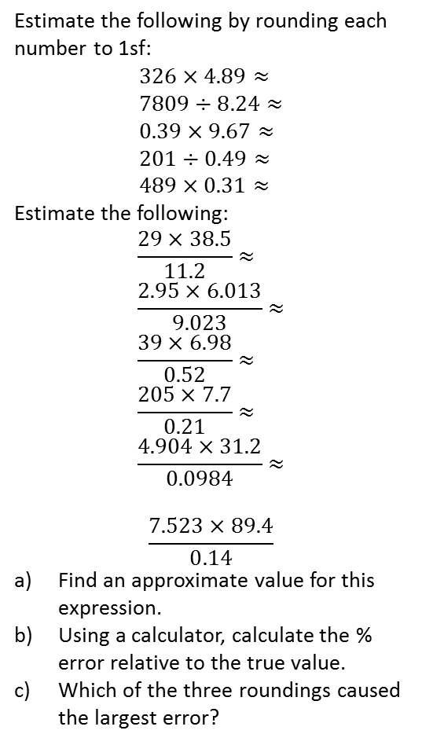
Main Exercise
1
Estimate the following by rounding each number to 1sf:
$$326×4.89≈ \\ 7809÷8.24≈ \\ 0.39×9.67≈ \\ 201÷0.49≈ \\ 489×0.31≈$$
Estimate the following:
$$\frac{29×38.5}{11.2}≈ \\ \frac{2.95×6.013}{9.023}≈ \\ \frac{39×6.98}{0.52}≈ \\ \frac{205×7.7}{0.21}≈ \\ \frac{4.904×31.2}{0.0984}≈$$
$$\frac{7.523×89.4}{0.14}$$
Find an approximate value for this expression.
Using a calculator, calculate the % error relative to the true value.
Which of the three roundings caused the largest error?
[JMC 2015 Q9] According to a newspaper report, “A 63-year-old man has rowed around the world without leaving his living room.” He clocked up 25 048 miles on a rowing machine that he received for his 50th birthday. Roughly how many miles per year has he rowed since he was given the machine?
A 200 B 500 C 1000 D 2000 E 4000
[JMC 2011 Q17] Last year’s match at Wimbledon between John Isner and Nicolas Mahut, which lasted 11 hours and 5 minutes, set a record for the longest match in tennis history. The fifth set of the match lasted 8 hours and 11 minutes. Approximately what fraction of the whole match was taken up by the fifth set?
A $\frac{1}{5}$ B $\frac{2}{5}$ C $\frac{3}{5}$ D $\frac{3}{4}$ E $\frac{9}{10}$
[JMC 2008 Q15] An active sphagnum bog deposits a depth of about 1 metre of peat per 1000 years. Roughly how many millimetres is that per day? A 0.0003 B 0.003 C 0.03 D 0.3 E 3
[IMC 2001 Q9] Which of the following is the best estimate for the number of seconds which have elapsed since the start of the year 2000? (note: date was June 2001)
A $3×{10}^{4}$ B $3×{10}^{5}$ C $3×{10}^{6}$ D $3×{10}^{7}$ E $3×{10}^{8}$
[SMC 2003 Q10] Steve Fossett completed the first solo balloon circumnavigation of the world after $13.5$ days. Assuming the balloon travelled along a circle of diameter 12 750 km, roughly what was the average speed of the balloon in km/h?
A 12 B 40 C 75 D 120 E 300
4
a
b
c
d
e
2
5
a
b
c
d
6
e
3
7
8

Slide 25
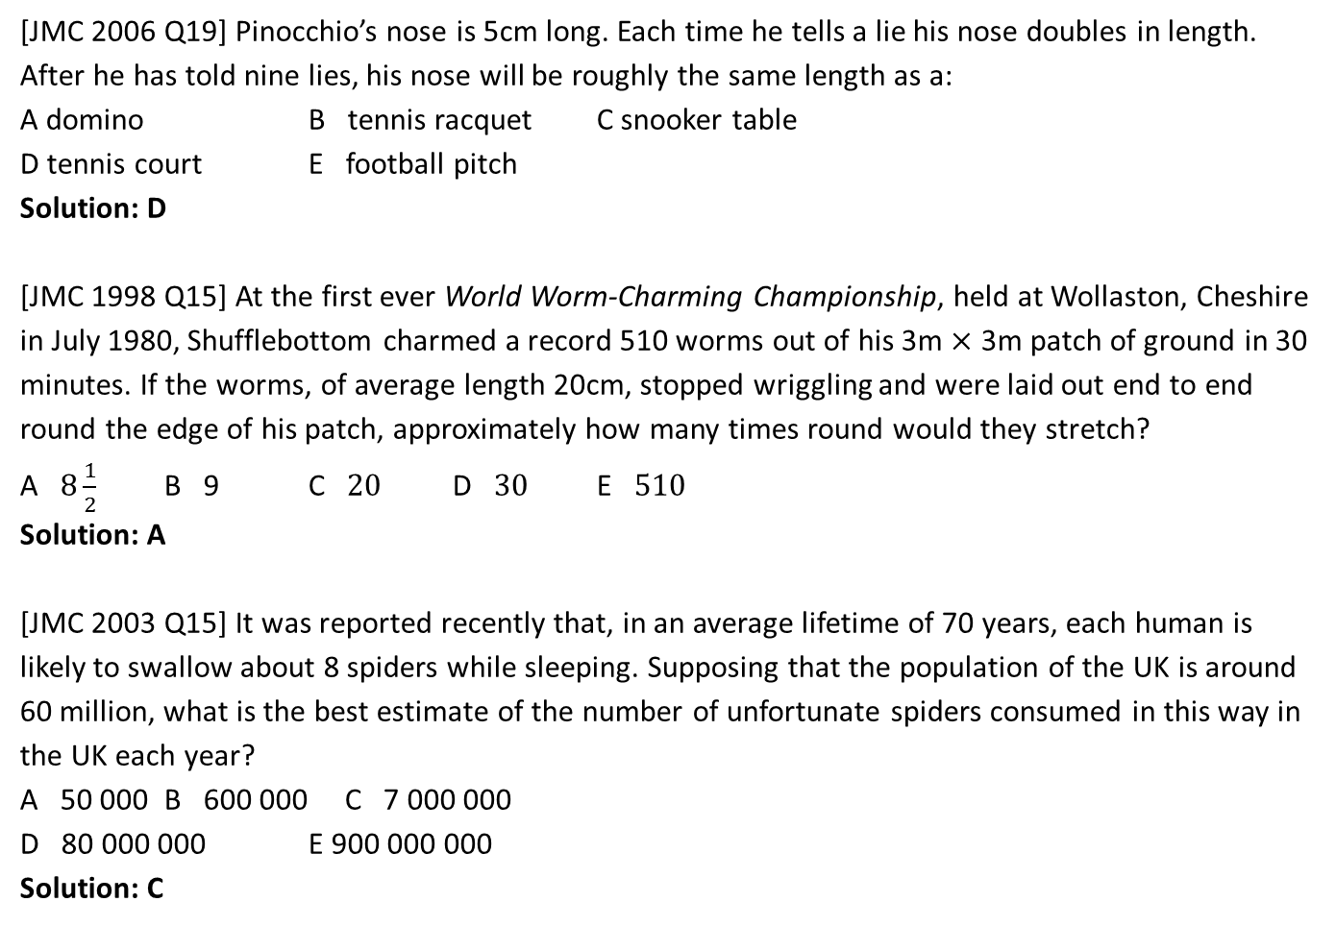
Exercise 2
9
[JMC 2006 Q19] Pinocchio’s nose is 5cm long. Each time he tells a lie his nose doubles in length. After he has told nine lies, his nose will be roughly the same length as a:
A domino B tennis racquet C snooker table
D tennis court E football pitch
Solution: D
[JMC 1998 Q15] At the first ever World Worm-Charming Championship, held at Wollaston, Cheshire in July 1980, Shufflebottom charmed a record 510 worms out of his 3m $×$ 3m patch of ground in 30 minutes. If the worms, of average length 20cm, stopped wriggling and were laid out end to end round the edge of his patch, approximately how many times round would they stretch?
A $8\frac{1}{2}$ B 9 C $20$ D $30$ E $510$
Solution: A
[JMC 2003 Q15] It was reported recently that, in an average lifetime of 70 years, each human is likely to swallow about 8 spiders while sleeping. Supposing that the population of the UK is around 60 million, what is the best estimate of the number of unfortunate spiders consumed in this way in the UK each year?
A 50 000 B 600 000 C 7 000 000
D 80 000 000 E 900 000 000
Solution: C
?
10
?
11
?

